Slide 1
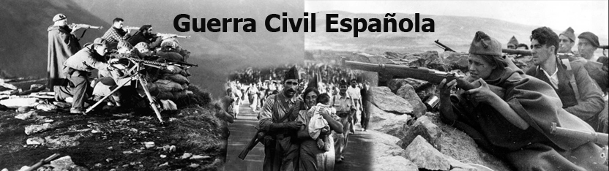
SPANISH CIVIL WAR AND GENOCIDE
Francisco Blasco Torres
Juanjo Piqueras Maciá
Inés Nauhardt Rojo
Bárbara Maciá Carrillo

Slide 2
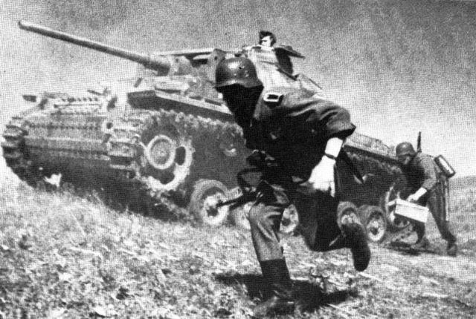
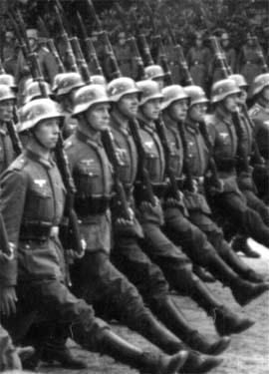
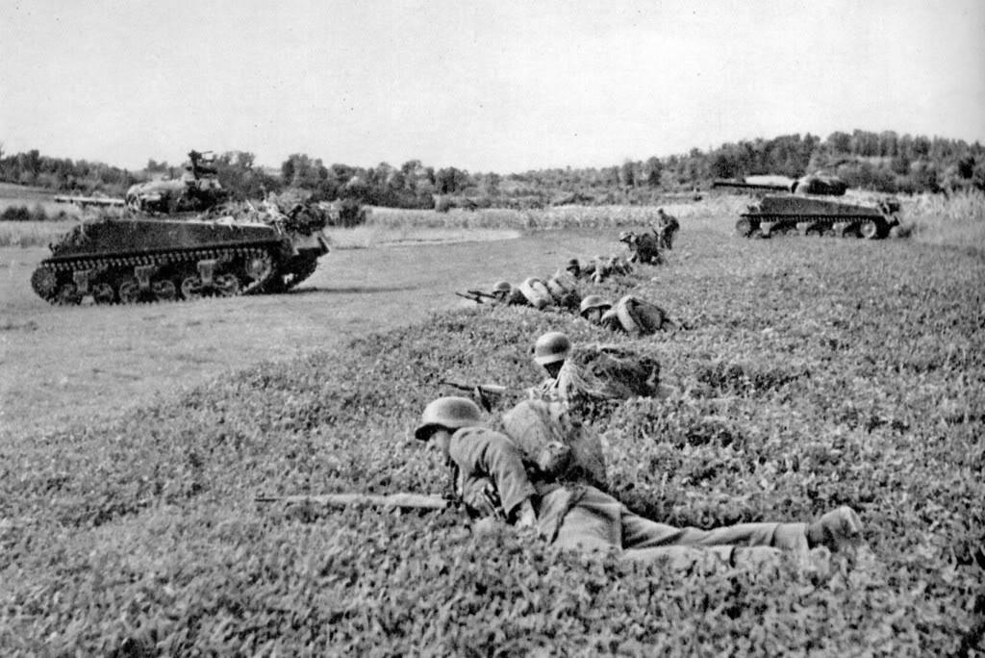
SPAIN AT CIVIL WAR
The Spanish Civil War was fought from 1936 to 1939 between the Republicans, who were loyal to the democratic Spanish Republic, and the Nationalists, a rebel group led by General Francisco Franco.
The Nationalists won, and Franco ruled Spain for the next 36 years, from 1939 until his death in 1975. The war is often called the "dress rehearsal" for World War II.

Slide 3
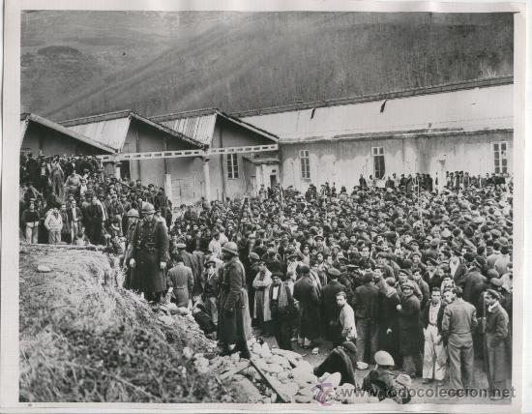
During the Spanish Civil War and the early years of Franco’s dictatorship, more than 180 concentration camps functioned, from which emerged:
- Castuera concentration camp.
- Camp of the Cartuja de Porta Coeli.
- The concentration camp Corchuela.
- Concentration camp of Miranda de Ebro.
- Concentration camp at Los Almendros.
- Concentration camp of Albatera.

Slide 4
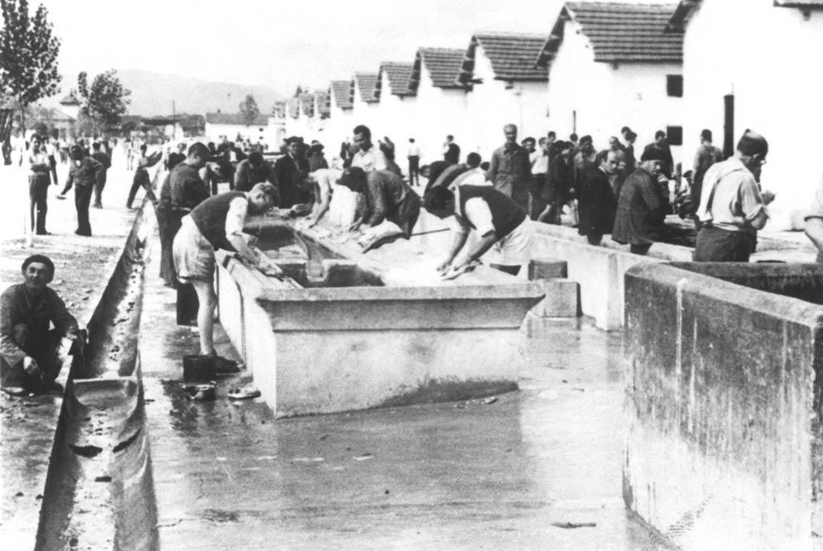
Concentration camps
Until November 1936 the Republicans were imprisoned or murdered.
In November 1936 prison camps were opened.
In March 1937 the prisoners were classified into:
    - Disaffected, sentenced to jail or death.
    - Indifferent, no history or collateral.
    - Doubtful, for lack of data.
  They were condemned to hard labor in working
  battalions.

Slide 5
FRANCO’S VICTORY
Supported by:
The international situation was favourable to fascism, which helped consolidate the violent counterrevolution.
Large sectors of society rejected liberal democracy and revolution. They wanted an authoritarian solution to keep the order and strengthen the state.
Other sectors rejected reformist projects, anticlericalism and expropriated revolution that followed the military coup.
The victory of Franco's army swept violently politics and class fight the parliamentary system, the secular Republic and revolutionary atheism.

Slide 6
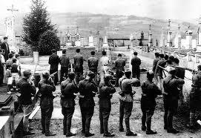
FRANCOIST’S SHOOTING
A way of francoist’s repression was the shooting, mainly in the most important cities.
In Alicante there was a funerary nameplate with the names of the murdered people, specifically of the 724 republicans shot in the Franquism, between 1939 and 1945.

Slide 7
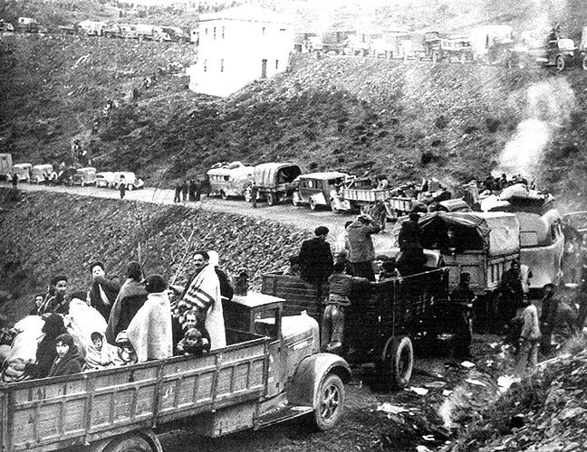
REPRESSION AFTER THE WAR
With the victory, peaceful times didn’t arrive: there were many repressive laws and courts. It was established a legal and moral context of repression:
- thousands exiled.
- 150.000 executed by firearm.
- 30.000 missing.
- 500.000 shut in 118 work camps.
- 90.000 prisioners in 119 squads.
- repression of race, accompanied by a social climate set in chauvinism with robbery of children in female prisions.
- solid culture of silence and terror.

Slide 8
SPANISH FASCISM
There were different disputes:
Military conflict.
Class war between different conceptions of social order.
Religious war.
War between the ideas of “homeland” and “nation”.
War between the ideas of communism and capitalism.
Battlefield of fascism, communism and international democracy.

Slide 9
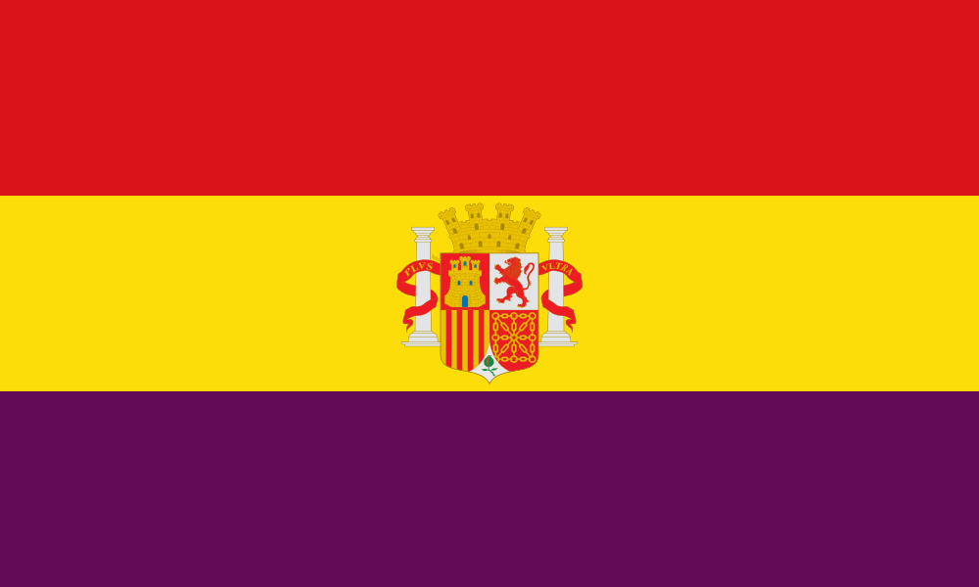
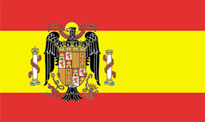
TWO FACED SIDES
The Republican side:
Several political ideologies came together to fight the revolts. Those included constitucional democrats, progressives, peripheral nationalists, socialists, communists and anarchist revolutionaries.
Purposes:
Maintenance of multiparty parliamentary democracy.
Establishment of a socialist state or a libertarian social revolution.
The national side:
Initially instituted at the National Defense Council, it was replaced by the designation of the General Francisco Franco as Head of Government and State. It was integrated by fascists, carlists, alfonsins monarchists and other conservative groups.
Purpose:
A new system of totalitarian nationalism which later became Francoism.

Slide 10
OUR FAMILIES

Slide 11
FRAN’S FAMILY
My grandfather was born in 1937 into a poor family. At that age his family used to eat a lof of rotten food (banana peels,dates or figs). His father died of bronchitis. When he was seven he became a fig collector.
My grandmother was born in 1942. At that age, if you had food, the police usually took it. She used to live near the railway and the people travelling by train threw them some food.
My other grandmother went to Elche to serve in the house of a rich family. Her father went to war in the communist band. When Franco won the war, the police took away his lands.

Slide 12
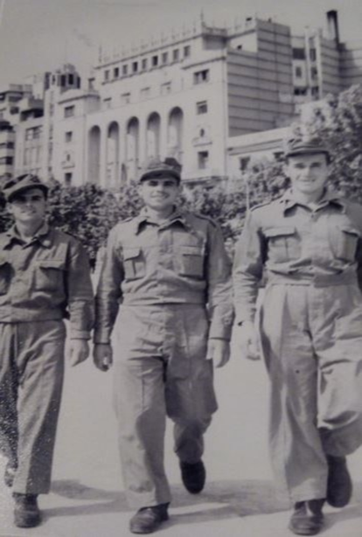
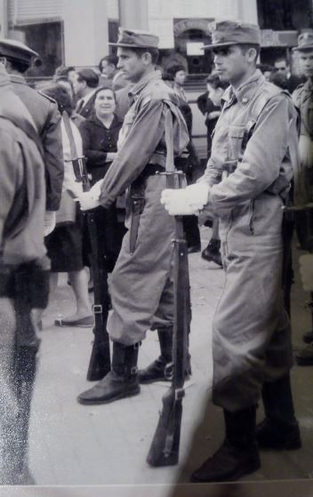
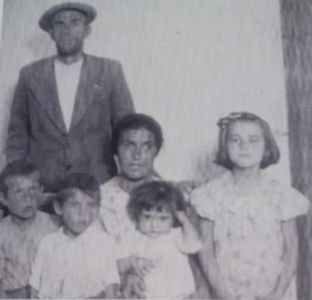
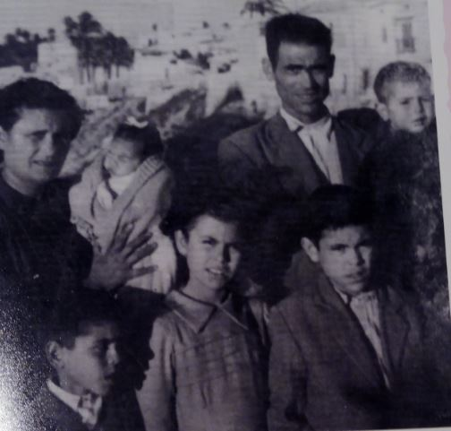

Slide 13
INES' FAMILY
My great-grandfather was part of the police during the war (1936-1939) and after that, during the post-war. He has given a post in Santander after the war, and there, he witnessed the great fire of Santander, which devastated almost the entire city. He was awarded with a medal for his bravery, and he lived many shocking moments because of involvement at war.
In 1939, when the war ended with the victory of the fascist band, he was ordered to execute a group of people at a firing squad. When he saw what he actually had to do, he spoiled his weapon on purpose, refusing to be responsible of any innocent man's death. He showed that, aside from the different ideals between him and those men, he could keep his humanity.

Slide 14
BARBARA'S FAMILY
My great-grandfather, Juan Martínez Adsuar, worked the lands of a lady who lived on the ground floor of a country house. When hte communists came to beg for things, he gave them whatever they wanted to protect his family and the lady owner of the lands.
Antonio Durá was one of those communists. He married María Esclapez Brotons, my great-grandmother’s aunt. He had a bomb factory in a small village called Pinoso and he also raped nuns and burnt churches. One day, he dropped off a bomb in a box and it exploded. They had to collect Antonio’s body parts into a box.

Slide 15
José Ramilo Expósito, my great-grandfather, was recruited by the Frente Nacional in 1936. A year later, he was imprisoned and believed to be dead. He had nothing left when he went back home because his wife was with another man. So he started a new life.
He met my great-gradmother, Manuela Salgado Tejela, but they could never get married because he was still legally married to his previous wife.
He had six children, one with his first wife and five with my great-grandmother. If he were alive today, he would be 102 years old.
When he turned 65, he rejected a payment from the government because he wanted to forget all about the War.

Slide 16
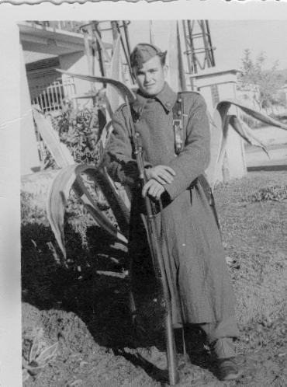
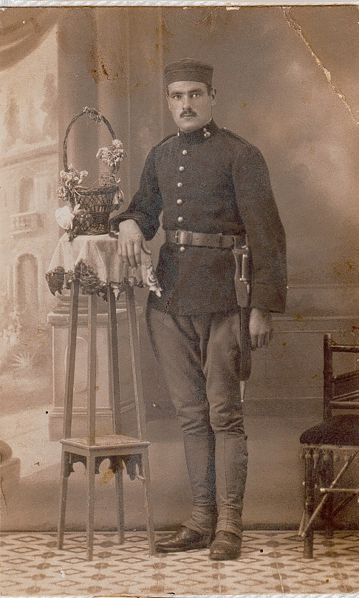
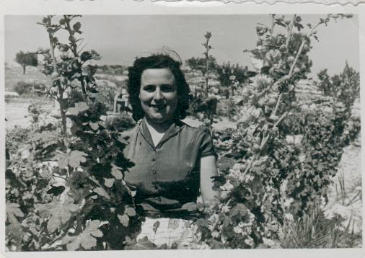
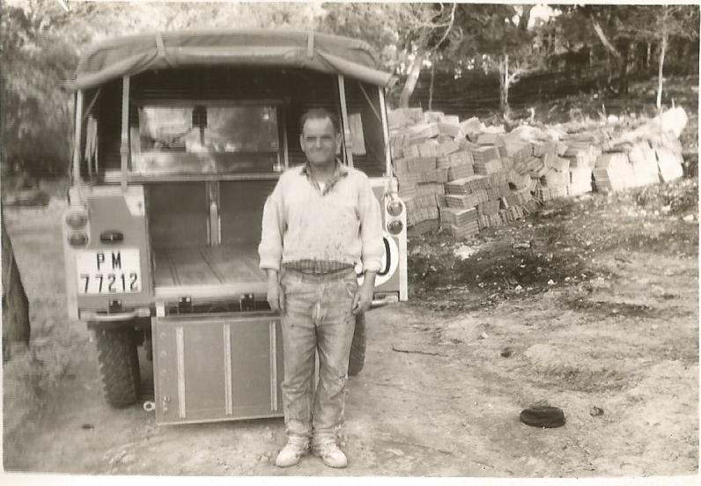

Slide 17
JUANJO'S FAMILY
My great-grandfather, Antonio Piqueras Díaz, was named mayor of "La Higuera" in May 1930.
During the war, some republicans from other towns came by lorries to take the people in town to the suburbs to kill them.
When they came to kill the people who were in the part of Franco my great-grandfather protected them by saying: “You can't take these people to kill them”.
After the war, the police came to the town’s little church and there they started calling for the republicans. My great-grandfather was protected by the same people he had protected before.
My great-grandfather was an admired man in his town before, during and after the war.

Slide 18
Miguel Hernández was born in Orihuela, a town near Elche, in 1910. He grew up in a humble family and he had to work with his father’s cattle. Soon, he started writing poetry and decided to go to Madrid, where he met other important artists. He became one of the most important poets of his time.
When the Civil War started in 1936, he took sides for the Republican Party and he enrolled the army. He became a soldier and a poet, and he devoted his poetry to freedom.
After the war, he was sent to prison, where he died two years later.
In 2010, the Spanish hip hop singer Nach, born in Alicante, created this song out of Miguel Hernández’s lyrics to celebrate the anniversary of the poet’s birth. This is our tribute to both poet and singer.

Slide 19
