Slide 1
Slovakia and
Resistance

Slide 2
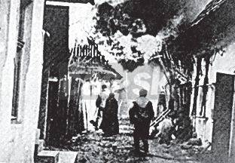
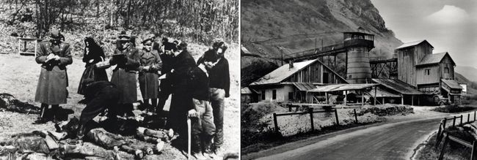
The terror of the SS in Slovakia against the civilian population:
more than 90 villages were burned and there were 211 mass graves.

Slide 3
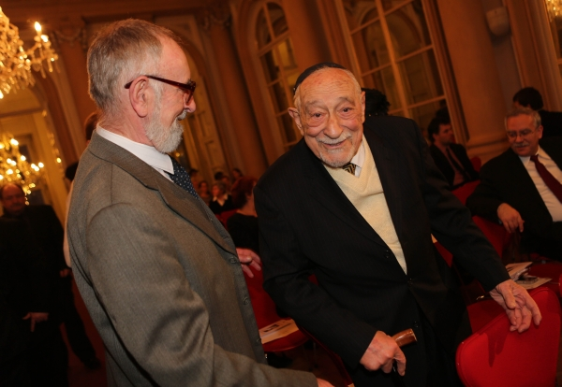
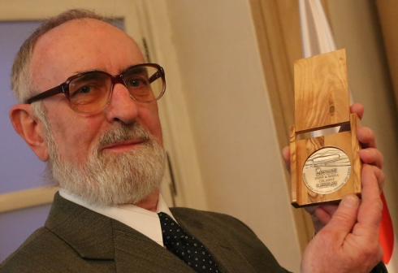
Jewish family of four Bodner in November 1944 knocked on the door of strangers in Old Mountains. The couple Joseph and Mary Chladný to know that hiding the persecuted Jews in occupied Slovakia felony. They hid them until the end of World War I
Savior son Joseph Chladný and one of survivors -Yosef Bodner.

Slide 4
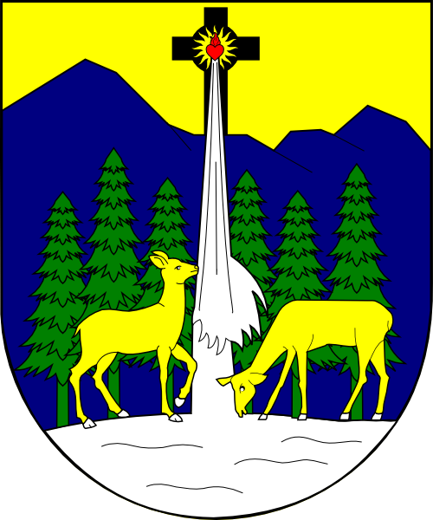
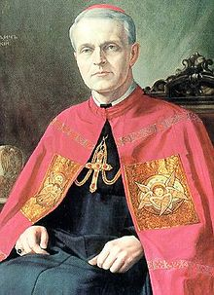
Peter Pavol Gojdič
* In 1926 the Apostolic Administrator of the eparchy of Presov.
* 1927 - titular bishop
*1940 residential Greek-Catholic bishop of Prešov
1950 arrested and interned
*In a staged trial and sentenced for treason for life.
2001- by Pope John Paul II. St. Peter's Square in Rome declared blessed.
2007 - honorary title of Righteous among the Nations.

Slide 5
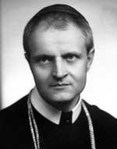
Bishop Gojdic reacted to the idea of spreading Nazi ideology in the Slovak society with a pastoral letter of January 1939, in which he called the Nazi ideology an epidemic.
„The current, prudent nationalists can not make friends with the idea that everyone, whether white or black, Tatar or Turk, the same creature of God, and therefore has the same right to life and to everything that is dear to him, whether it is native speech, rare old habits or little tradition. (...) My love, it does not mean hating alien, it does not give anyone the right to do injustice to another, damage, annoyed, enslave his neighbor...“

Slide 6
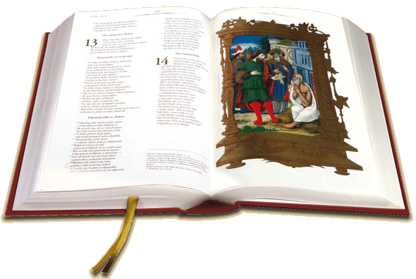
All bishops protested against the code specific memorandum to the President of the Republic and the Prime Minister 7. 11. 1,941th
"... We just want to remind that the materialistic theory of racism is in direct conflict with the teachings of the Catholic Church on the common origin of all people in a single Creator and Father of full equality of men before God .... As we can continue to learn that before God all are equal? How will they be able to vote without contradictions Christ's commandment: "Do not do to others, what you do not want others to do to you!" .....

Slide 7
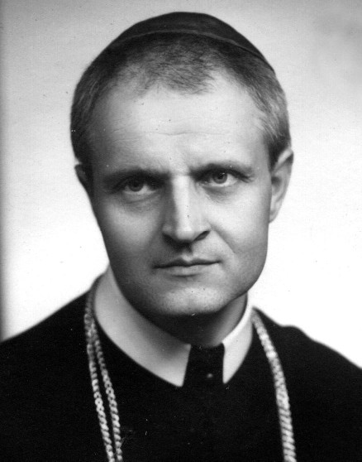
Gojdič wrote a letter to the chargé d'affaires Giusepe Burzio in May 16th1942 describing the horrors of transports and proposing the resignation of President J. Tiso
“We are deeply grieved by the atrocities committed during deportations of Jews in Eastern Slovakia by members of the so-called Hlinka Guard, who is in charge of carrying out the decree on deportation of the poor Jewish people.
Barbarism against those poor people exceed inhumanity and remind us of acts of Communist-Bolshevik Russia, Spain and Mexico.

Slide 8
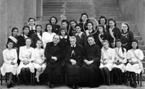
Bishop of Presov Gojdič did not only express protest, but he engaged personally within his possibilities in saving Jews.
He inspired several priests by his personal example and instructions to act in favour of the persecuted.
Redemptorists and nuns of the Order of St. Basil the Great in charge of a girls' dormitory hid Jewish children in the dorm and orphanage.
Mariane Zack – one of survivor.

Slide 9
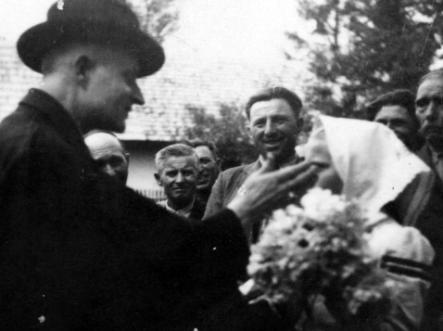
Bishop Gojdič is known to have saved some thirty racially persecuted people We still do not know the names of all rescued .
He was helping Jewish families by issuing authentic and false birth certificates, presidential exceptions.
Bishop Gojdič issued a mandate for some Greek Catholic priests to baptize and issue original and false birth certificates.
Some of the suspected priests were detained and arrested and internment in Ilava. andin Ilava for some time.
One priest Peter Dudinskýaccording to the record s of the investigation gave the baptism of 210 Jews.

Slide 10
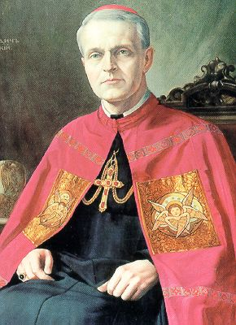
*Marianna Zachová - Spitzerová - 12 years old in 1942. Gojdic took her and her sister Zuzana to the boarding school in the convent of the Sisters of Basil the Great and even enabled them to attend grammar school in Presov
Some of rescued people:
*the Fleischer family from transportation to a concentration camp.. He have given them a baptism certificate that he delivered personally.
*Pavel Lukac - Spitzer was caught in a dramatic situation, when they were with the bishop in town and Hlinka's Guards started catching Jews. Bishop Gojdič hugged him tight and protected him from the guards.

Slide 11
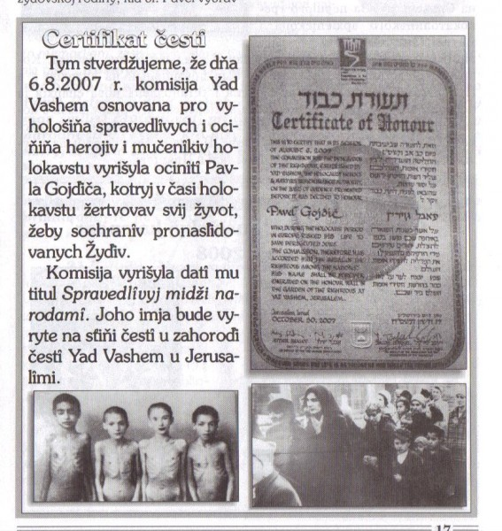
State of Israel gave the bishop Gojdič posthumous title of Righteous Among the Nations for his attitude and active rescue Jews during WW2. The award was handed over to his relatives and then Archbishop of Prešov January 27, 2008 in Bratislava.

Slide 12
Bibliography
Documents
KOVÁČ, Dušan: Kronika Slovenska . Praha: Fortuna Print, 1999, s. 240 – 302. ISBN 80-88980-08-9
POTAŠ, Marián: Dar lásky. Prešov: Vydavateľstvo USPO, 1999, 380 s. ISBN 80-88717-36-1
http://martinsabo.blog.sme.sk/c/86510/Protesty-biskupov-proti-zidovskemu-kodexu-a-deportaciam-zidov.html
http://postoy.sk/comment/8269
http://postoy.sk/gojdic_vatikanu
http://spravy.pravda.sk/domace/clanok/156495-rabin-biskup-gojdic-preukazal-odvahu/
http://www.pulib.sk/elpub2/FF/Pekar2/pdf_doc/borza.pdf
http://www.yadvashem.org/yv/en/righteous/stories/gojdic.asp
Pictures
http://www.milost.sk/logos/clanok/perzekucie-voci-rasovo-prenasledovanym-2
http://www.cas.sk/galeria/211298/rodacka-z-kalista-spomina-na-snp-otca-mi-fasisti-zaziva-rozpilili?foto=1
http://hn.hnonline.sk/pocas-vojny-ukryvali-zidov-dostali-ocenenie-537523
https://sk.wikipedia.org/wiki/Pavol_Peter_Gojdi%C4%8D
http://www.gojdic.wbl.sk/Zivotopis-vladyku--Pavla_OSBM.html
http://www.modlitba.sk/htm/zaujem/svatci/svatci_all/pavol-gojdic.htm
http://www.zlatabiblia.sk/objednavky-mala-biblia.xhtml
http://www.yadvashem.org/yv/en/righteous/stories/gojdic.asp
http://www.greckokat-sabinov.sk/fotogaleria/Do2009/01.Historia_Gojdic/slides/05.php
http://www.gojdic.wbl.sk/Ocenenia.html

