Slide 1
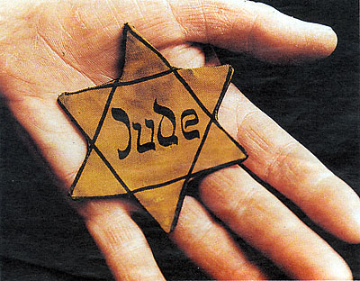
Holocaust in Slovakia

Slide 2
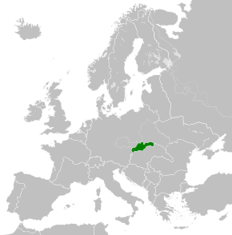
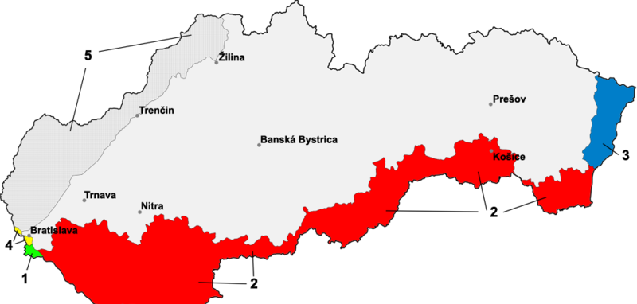
Slovak State 1939- 1945
Slovak State on the map of Europe: Citizens 2 655 053
Area 38 055 sqkm
After the Vienna Award (2nd November 1938) Hungary annexed territories in southern Slovakia.
1, 4 – part of Germany, 2, 3 – part of Hungary. 5- protected area at the border of Protectorate of Bohemia and Moravia

Slide 3
Slovak State 1939 - 1945:
* Founded on 14th March 1939
* Germany determined the policy of Slovakia
* German advisors arrive in Slovakia
* One party government – non-democratic
* 29th August 1944 beginning of the Slovak National Uprising
* 1945 – Slovakia part of Czechoslovakia again

Slide 4
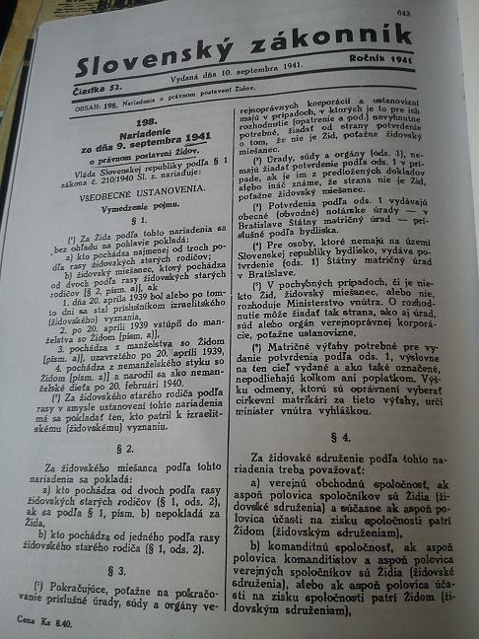
Židovský kódex
The Jewish Code: Regulation of the legal status of Jews no. 198/1941 of 9th September 1941. It contained 290 articles

Slide 5
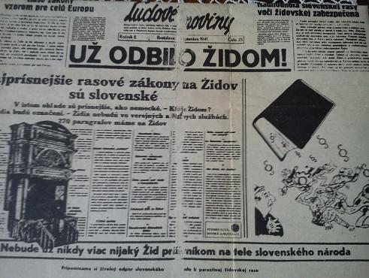
Anti-jewish Legislation
Ľudové noviny informs about the Jewish Code. The Headtitle read „ The End of the Jewish Rule“ and continued „The Strictest Racial Laws.“
„Never again will there be a Jewish leech sucking blood from the Slovak Nation.“

Slide 6
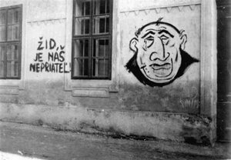
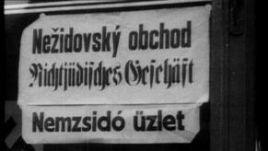
Aryanization
“The Jew is our enemy!“
The term Aryanization refers to forcible transfer of Jewish property into "Aryan hands". Slovak parliament adopted two Aryanization laws. Until March 1942, about 10,000 small Jewish businesses were destroyed and about 2000 of them were aryanised.
„This is not a Jewish shop“

Slide 7
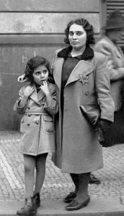
Interventions against Jews in everyday life
Jews were not allowed to possess several things like bicycles, radios, telephones, typewriters, cameras, guns, fishing tackle, sports equipment and leather products. Since 1940, cities draw up a list of streets where Jews were not allowed to live or enter. They had to move out of city centres. Jews were banned from parks, cinemas, theatres, swimming pools, libraries, and other public places.

Slide 8
Jewish camps
The Ministry of Interior has established work centres for Jews from the age of 16 to 60. By the end of September 1941 there were 80 of them.
Big work camps arose at the end of 1941 in the towns of Sereď and Nováky.

Slide 9
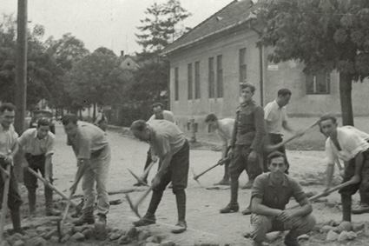
Military service of Jews
Jews, who were in military service were assigned, to specific military work units. Three companies of 900 men were created.

Slide 10
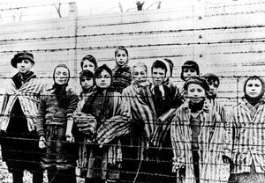
Jewish children
All Jewish children and youths were excluded from universities and secondary schools, according to the Government Order of 1940. They could attend only Jewish primary schools or separate Jewish classes in primary schools. They were often ridiculed, bullied or attacked by peers.
Children were upon arrival to the extermination camps murdered in gas chambers without any registration.
The photo shows 13 children, 7 of them from Slovakia.. The identity of the children was uncovered in 1974, when one of children, Gabi Neumann, recognized himself in the photo.

Slide 11
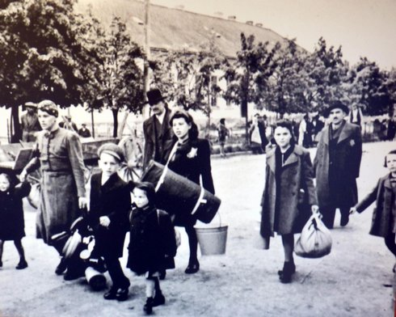
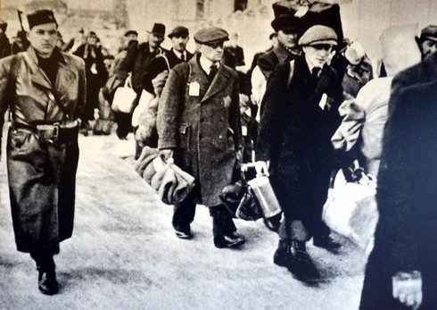
Deportations
The first transport consisted of young women and girls. The first family transport departed from Trnava on 11th April 1942.
In one transport there were about a thousand Jews. The deportations were suspended in October 1942. The Slovak government paid Germany an expatriation fee: 500 Deutschmark for 1 Jew.

Slide 12
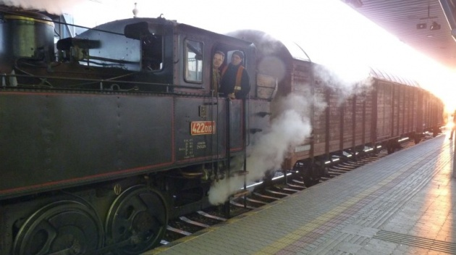
Transports
Trains with Jews of all ages departed from district towns. One boxcar was meant for 40 people. There was straw on the floor, 1 bucket of water to drink and 1 bucket for sanitary purposes.

Slide 13
57,752 Jews were deported in 57 transports from March to October 1942.
19 transports of 18,746 people went to Auschwitz.
38 transports went to the city of Lublin and were deported to extermination camps Treblinka, Belzec, Majdanek, Sobibor. 25,000 Jews from Slovakia died in Sobibor.

Slide 14
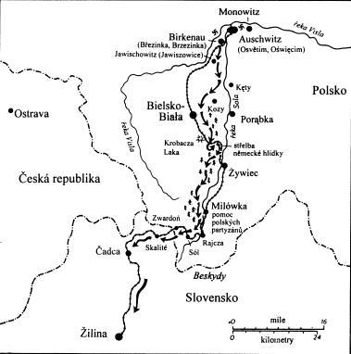
Two Slovak inmates Alfred Wetzler and Walter Rosenberg are the best known. They arrived in Auschwitz in 1942. They escaped on 7th April 1944 and after ten days on the run reached Slovakia. They drew up an official report which gave the most comprehensive information about the camp so far - the Auschwitz Protocols. They joined a guerilla brigade and fought in it until May 1945.

Slide 15
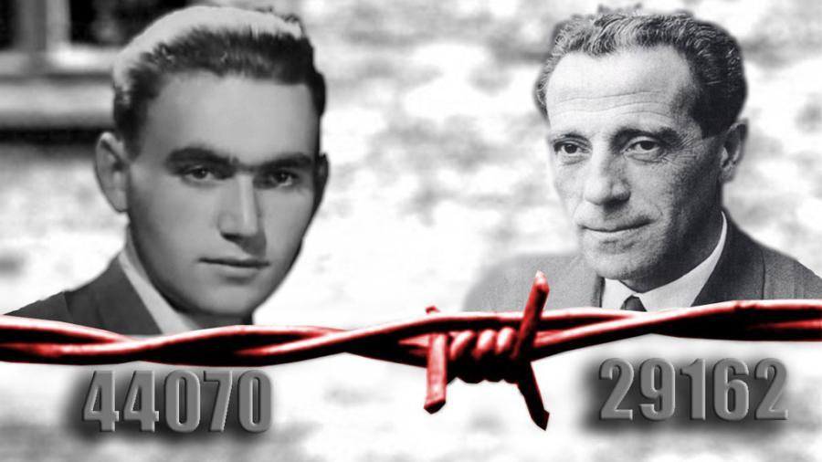
Rudolf Vrba
Alfréd Wetzler
Alfred Wetzler received fake documents in the name of Joseph Lánik. He used it as a stage name, but did not use it in civic life. He worked and lived in Slovakia.
Walter Rosenber got new documents in the name of Rudolf Vrba. He used this name for the rest of his life. He emigrated to Canada and worked in the field of neural biochemy .

Slide 16
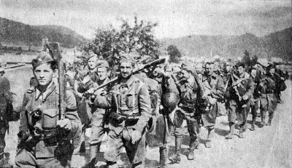
The Slovak National Uprising against the regime and the collaboration with Germany began on 29th August 1944
The German Occupation Troops arrived in Slovakia to suppress the Slovak National Uprising.
There were more than 80,000 victims of the uprising.
The German army resumed the camp in Sereď. From September to April 1945, there were 11,719 Jews detained there and 11 transports left for Auschwitz and other camps. Commander of the camp was Alois Brunner, who organized the deportation in Greece and France.

Slide 17
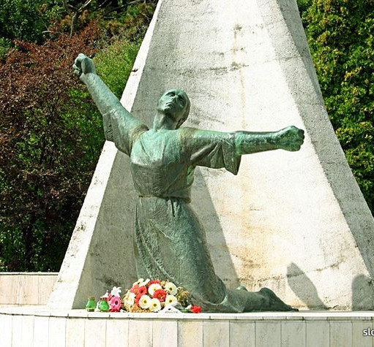
During the occupation, the Nazis burned 90 Slovak towns and villages, killed 5304 people, there were 211 mass graves.
People, who helped the querillia army or hid Jews were threatened by death.

Slide 18
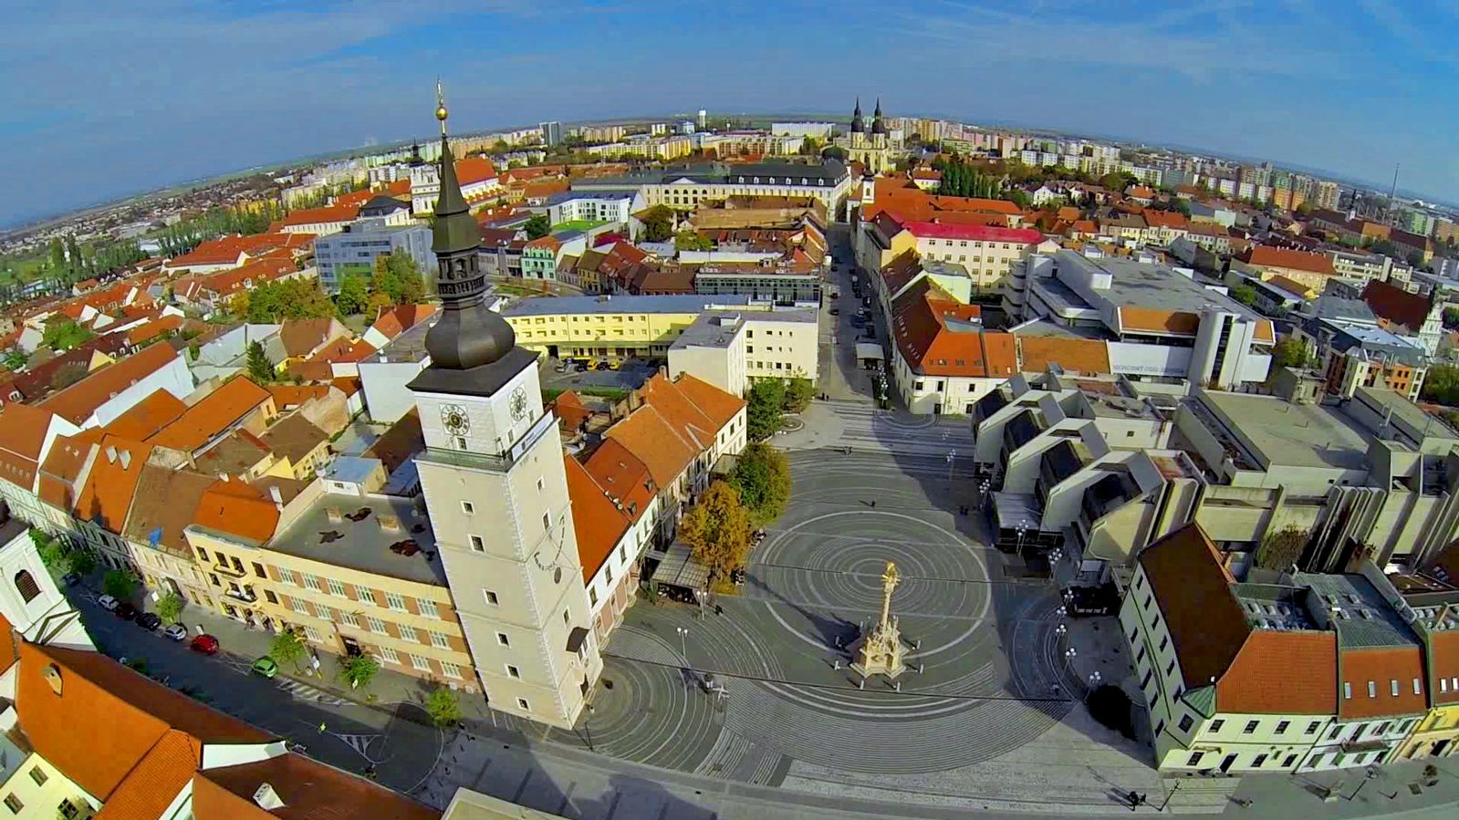
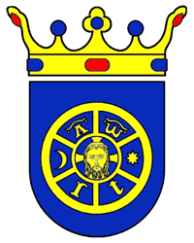
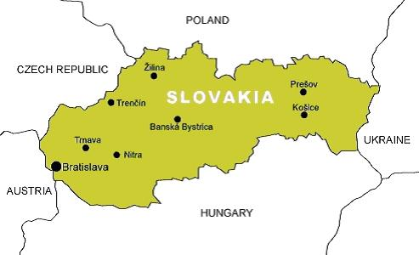
TRNAVA

Slide 19
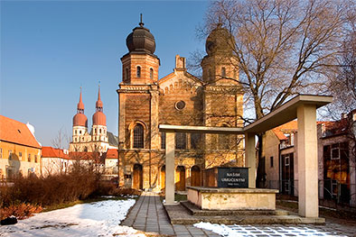
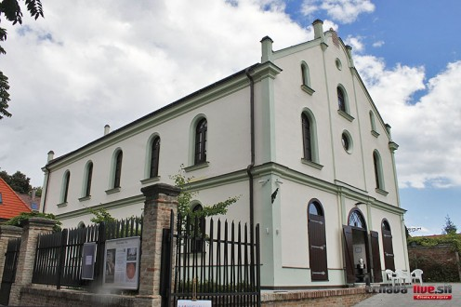
Jews in Trnava
By the year 1942 there were 3226 Jews in Trnava (the total was 25819 citizens).
Most of them were deported to Auschwitz.
Big Synagogue
Small Synagogue

Slide 20
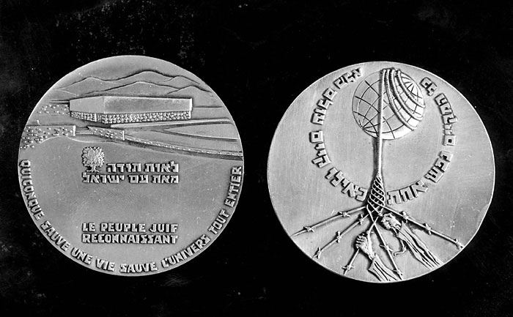
The Righteous Among the Nations = Chasid umot ha–olam.
This honour is awarded to people who saved the life of at least one Jew without
payment and jeopardized the life and safety of themselves and their families. This title
has been granted to more than 24,800 people, including more than 500 Slovaks.
Slovakia is one of the countries with the highest number of awarded People in
proportion to the population.

Slide 21
Bibliography
Documents
KOVÁČ, Dušan: Kronika Slovenska . Praha: Fortuna Print, 1999, s. 240 – 302. ISBN 80-88980-08-9
MEŠŤAN, Pavol a kolektív: Riešenie židovskej otázky na Slovensku v rokoch 1938 – 1945. EDAH o.z. 2013, 63 s. ISBN 978-80-971425-1-3
SALNER, Peter: Prežili holocaust. Bratislava: Veda, 1997, 189 s. ISBN 80-224-0507-8
http://www.upn.gov.sk/data/pdf/vlada_198-1941.pdf
http://www.upn.gov.sk/supis-zidov/zoznam-obci.php?okres=153
http://www.yadvashem.org/
Pictures
http://www.magistra-historia.sk/prve-kroky-riesenia-zidovskej-otazky-v-nacistickom-nemecku/
http://sk.wikipedia.org/wiki/Slovensk%C3%A1_republika_(1939_%E2%80%93_1945)
http://davidkralik.blog.sme.sk/c/303780/Otto-Simko-Cesta-do-plynu-zacala-presadzanim-v-kvinte.html
http://www.ceskatelevize.cz/ct24/svet/135713-likvidaci-slovenskych-zidu-odstartoval-zidovsky-kodex/?mobileRedirect=off
http://www.sme.sk/c/2361054/arizacia-zidovsky-majetok-do-slovenskych-ruk.html
http://www.sme.sk/c/7371273/prezila-koncentracny-tabor-v-seredi-tyfus-i-terezin.html#storm-igal-4126
http://edah.sk/family/bernard-knezo-sch%C3%B6nbrun/25/
http://www.sme.sk/c/5009467/spochybnovaci-holokaustu-neveria-ani-tetovaniu.html
http://poprad.korzar.sme.sk/c/6310740/vypravili-spomienkovy-vlak-k-70-vyrociu-prveho-transportu-zidov.html
http://aktualne.atlas.sk/spomienka-na-prvy-transport-zidov-z-popradu-vypravili-vlak-do-osviencimu/dnes/regiony/
http://www2.holocaust.cz/cz/history/camps
http://www2.holocaust.cz/cz2/resources/ros_chodes/2006/05/vrba_nekrolog
http://www.ceskatelevize.cz/ct24/svet/214149-rekl-pravdu-o-osvetimi-ale-knihu-o-tom-psal-pod-pseudonymem/
http://www.humanisti.sk/view.php?cisloclanku=2012080054
http://slovakia.travel/en/the-memorial-of-the-slovak-national-uprising-snp-nemecka
http://www.trnava.sk/sk/clanok/cestovny-ruch
http://www.trnava-live.sk/2011/11/09/dotyk-meditacie-svetla-v-malej-synagoge/
http://www.slovak-jewish-heritage.org/trnava-status-quo-synagogue.html?&L=1
http://www.yadvashem.org/yv/en/education/languages/slovak/lesson_plans/righteous.asp

