Slide 1
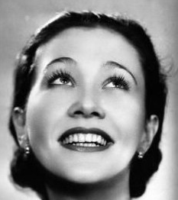
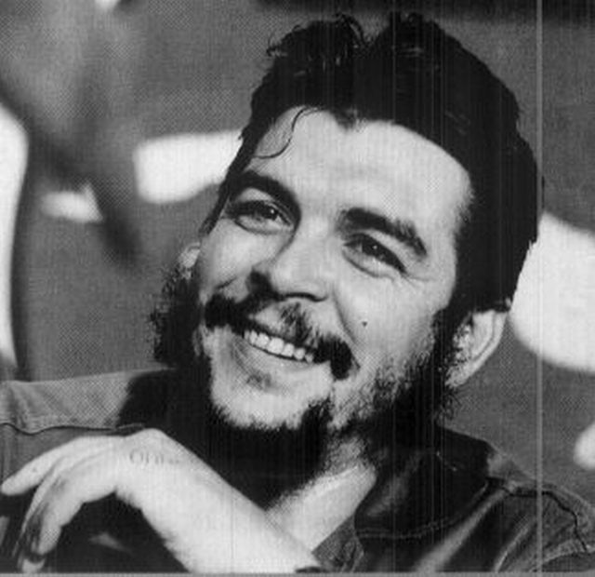
RESISTANCE
There are many ways to resist. We’ve rounded up a few examples. All of them have one thing in common: they fought for what they believed was right.

Slide 2
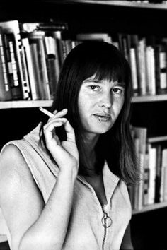
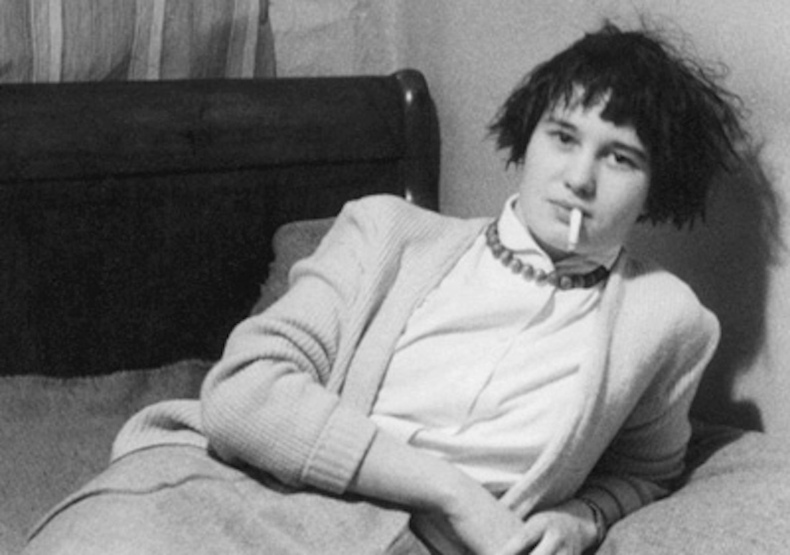
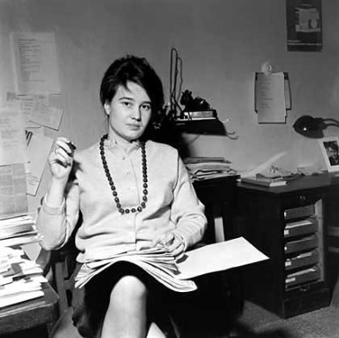
ULRIKE MEINHOF (1934-1976)

Slide 3
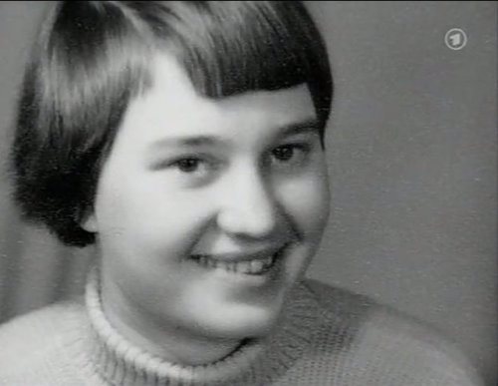
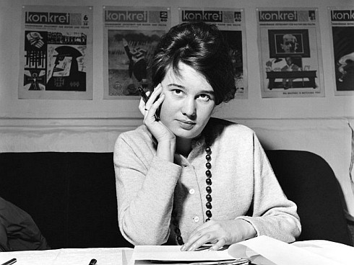
EARLY YEARS AND CAREER AS A JOURNALIST
Was born 1934 in Oldenburg, Germany
Worked for the Konkret
Adopted the Communist ideology

Slide 4
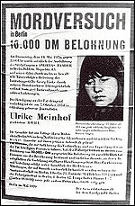
RADICALIZATION 1970 ->
The rescuing of Baader 1970
search warrants of Meinhof all over Berlin
fled underground
Took part in several bank robberies and bombings with RAF during the next two years
Meinhof’s arrest 1972
eight-year prison sentence 1974

Slide 5
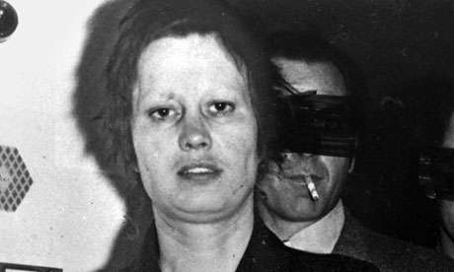
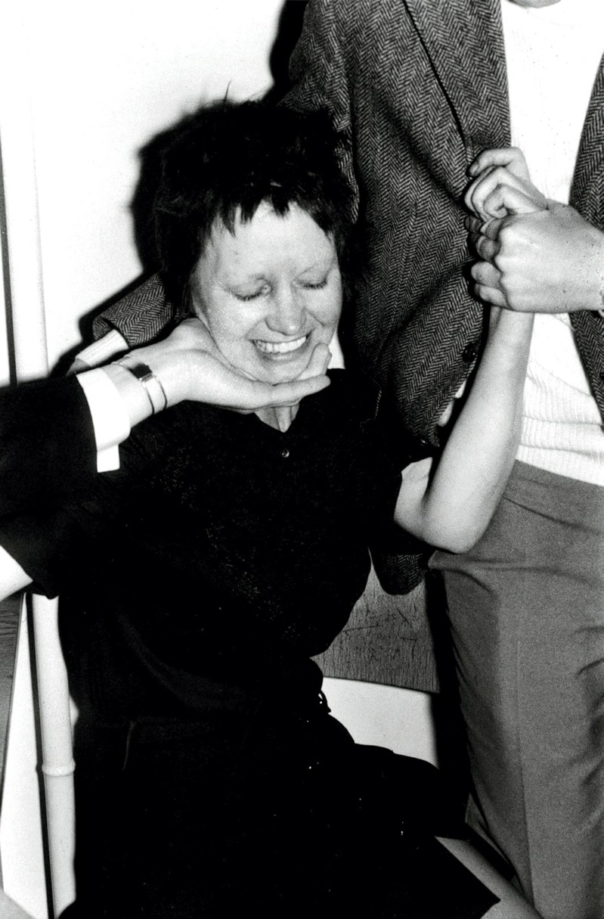
IMPRISONMENT & DEATH
Retreatment of the Meinhof case 1975
before the trial Meinhof was found dead in her cell
Baader, Ensslin and Raspe sentenced to life-long imprisonment
Meinhof’s death: a murder or a suicide?

Slide 6
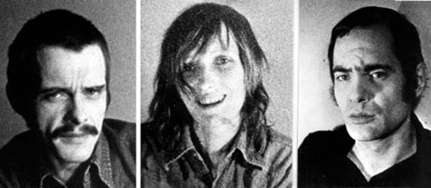
THE RED ARMY FACTION (RAF)
»We’re not feeling edgy; the system is feeling nervous.»
RAF (Red Army Fraction), ”Baader-Meinhof Group”:
The goal of the movement was to raise a Communist uprising in Germany

Slide 7
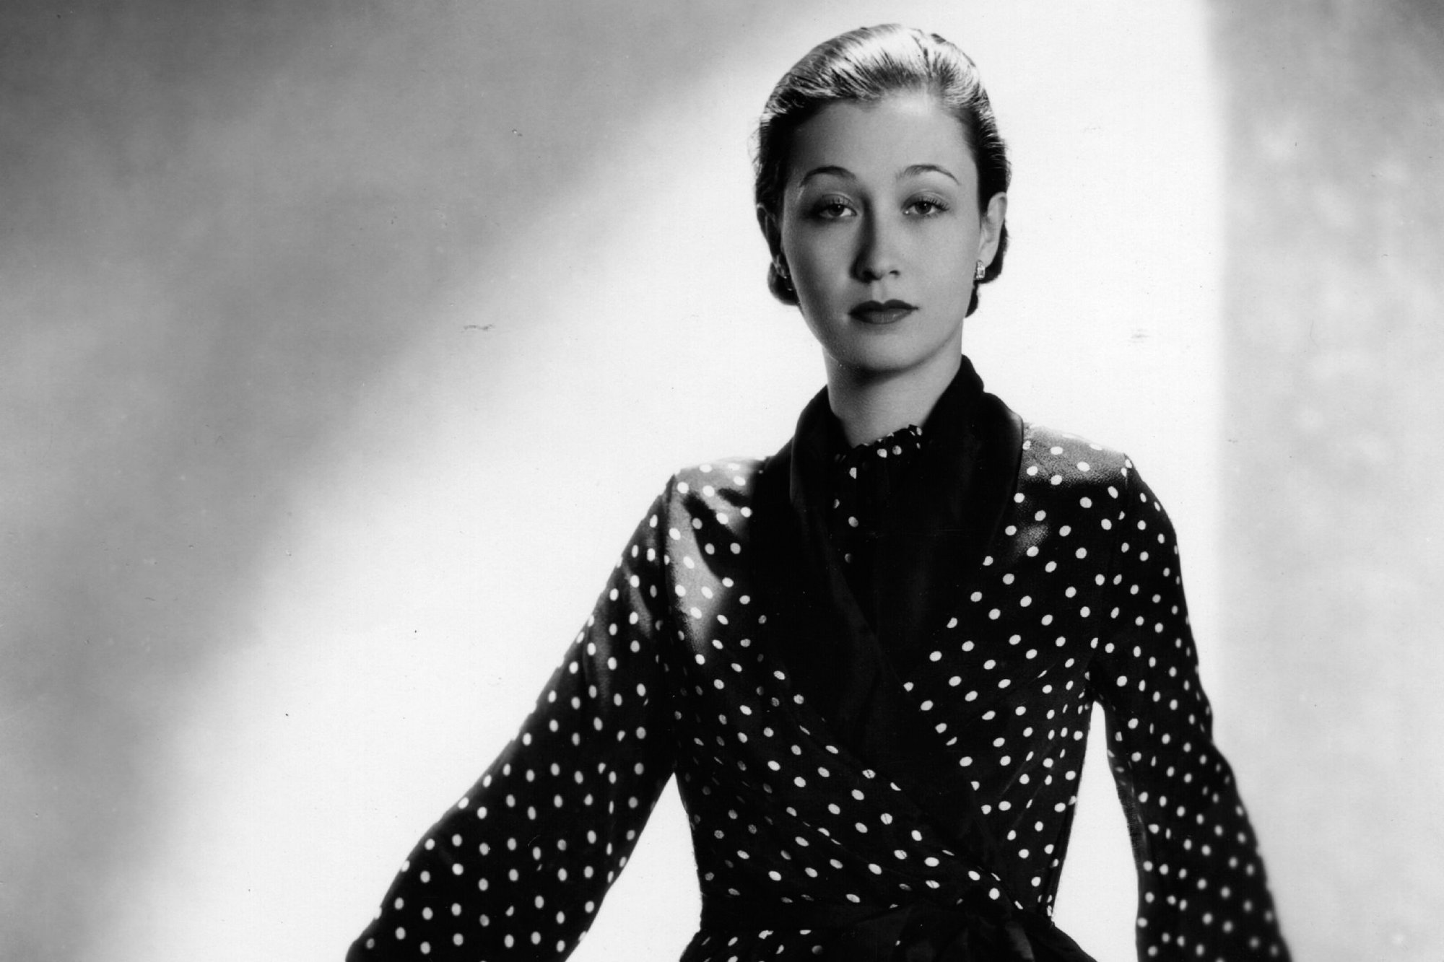
TOTO KOOPMAN (1908-1991)

Slide 8
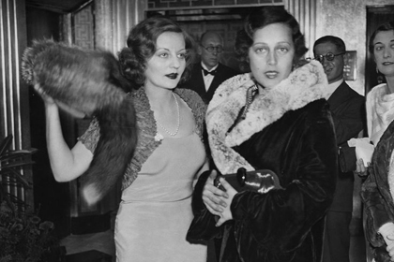
YOUTH AND CAREER AS A MODEL (1908-1933)
Was born 1908 in Java, Indonesia
Moved to Paris and gained fame as a model
A lively love life (an affair with lord Beaverbrook in 1933)

Slide 9
THE YEARS AS A SPY
Spied for Beaverbrook in Hitler’s Germany and Mussolini’s Italy 1933
Fell in love with the leader of the Italian resistance 1939
helped the movement financially and infiltrated several Black Shirt meetings
was caught and escaped twice
was caught for the third time and deported in the concentration camp of Ravensbrück by the Nazis 1944

Slide 10
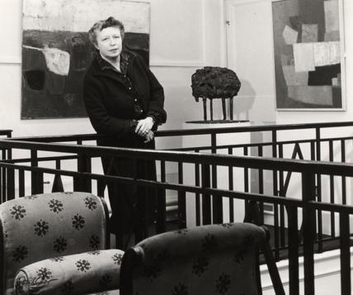
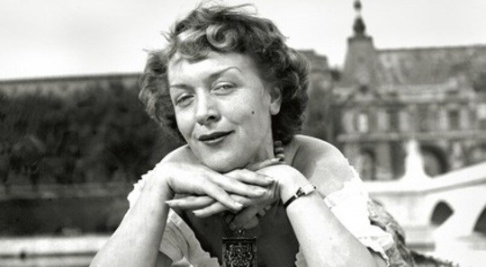
1945-1991
After liberation opened the Hanover Gallery in London with Erica Brausen 1947

Slide 11
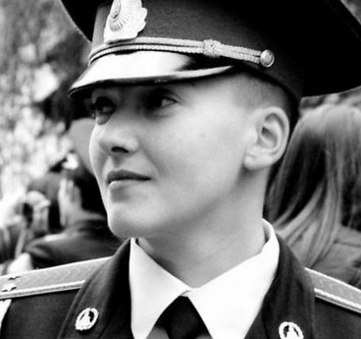
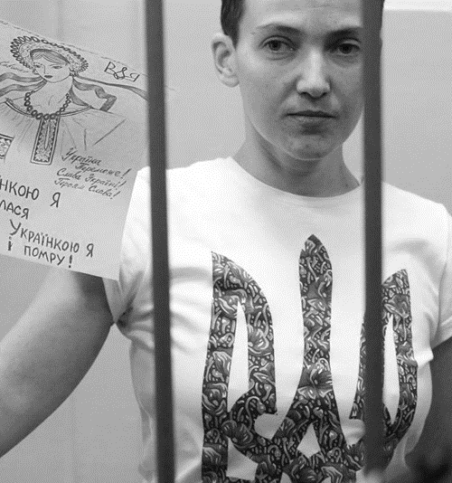
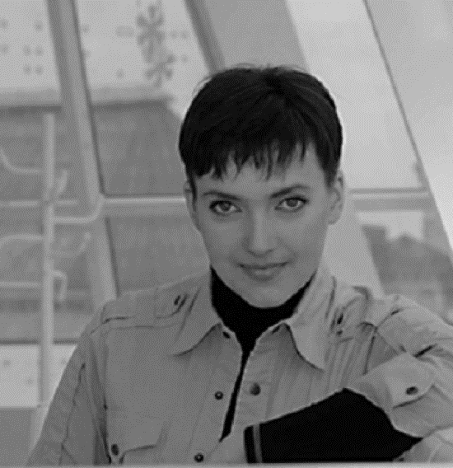
NADIA SAVTSHENKO (1981-)

Slide 12
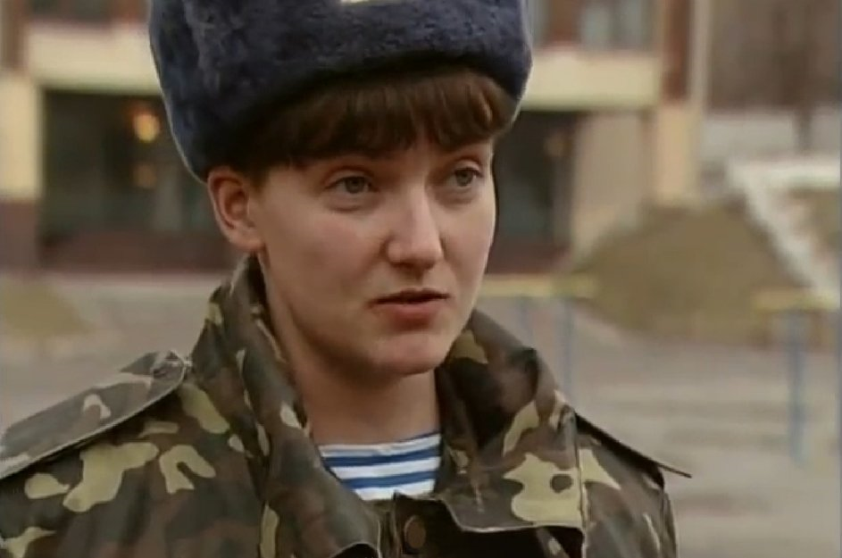
YOUTH AND YEARS IN THE ARMY
Was born in Kiev 1981
Joined the army in the age of 16
worked as a peacekeeper in Irak 2003-2008
was one of Ukraine's first women to train as an air-force pilot

Slide 13
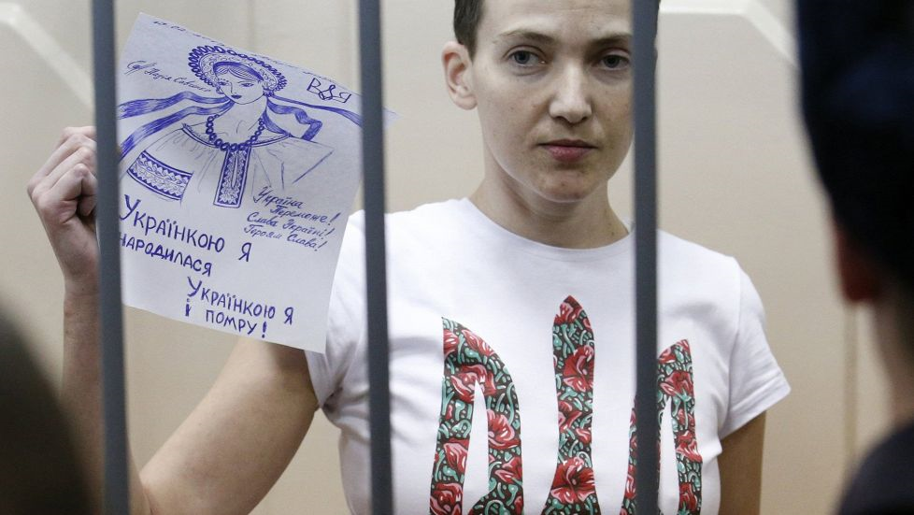
IMPRISONMENT
Volunteered to fight in the Ukraine civil war 2014
was captured and imprisoned by a pro-Russian militant group
currently imprisoned in Russia accused of the murder of two journalists
has protested her imprisonment with hunger strikes
A symbol in Ukraine

Slide 14
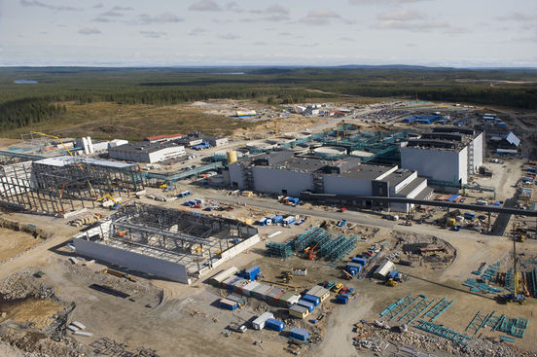
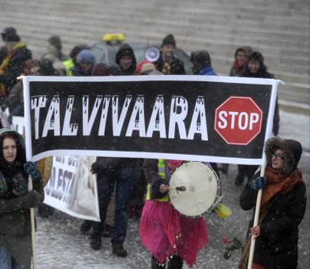
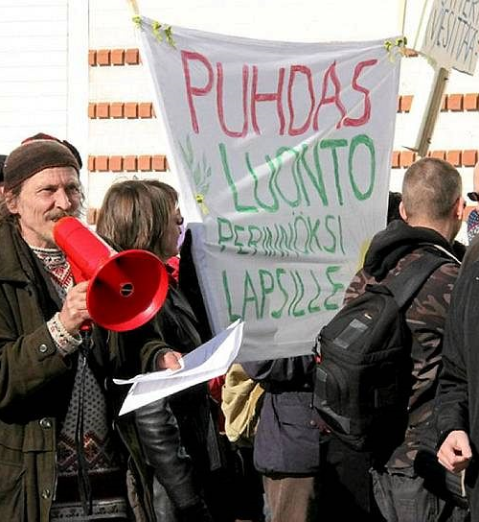
TALVIVAARA

Slide 15
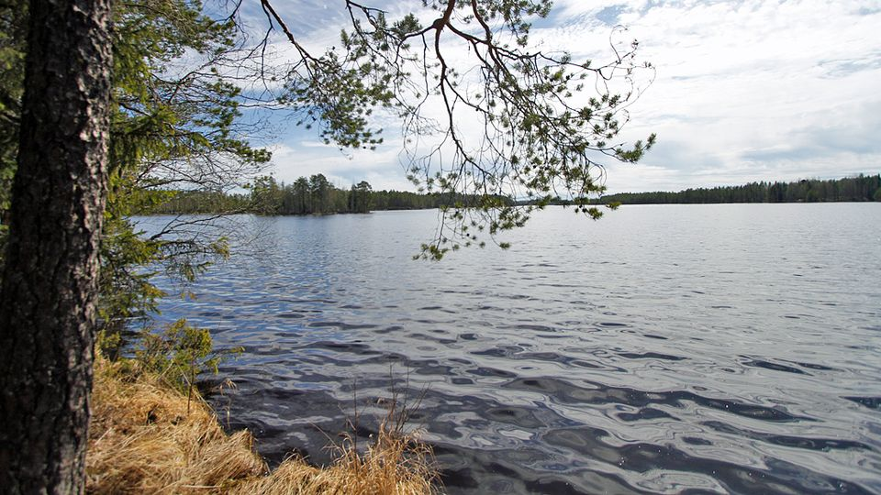
THE ENVIRONMENTAL DAMAGE
Talvivaara’s sulfate emissions
significant damages in the lakes of the area
eutrophication
- Large leaks in the pools of Talvivaara 2012

Slide 16
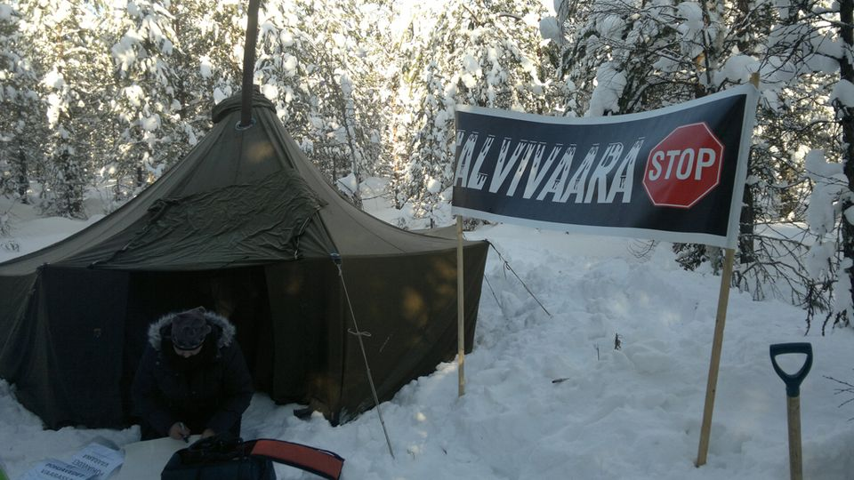
DEMANDS TO CLOSE THE MINE
- Massive environmental damage and violations of the environmental permits
demands to close the mine
Stop Talvivaara -movement
- The goal of the movement is to shut down the Talvivaara mining
- Has organized several protests

