Slide 1
"Those who cannot learn from history are doomed to repeat it."
George Santayana

Slide 2
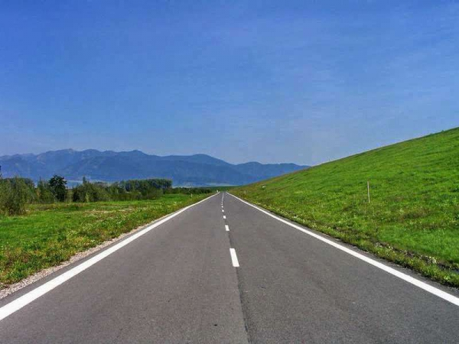
Future
Present
Past

Slide 3
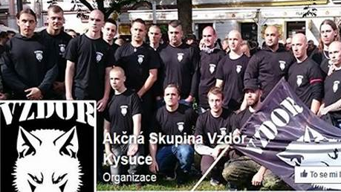
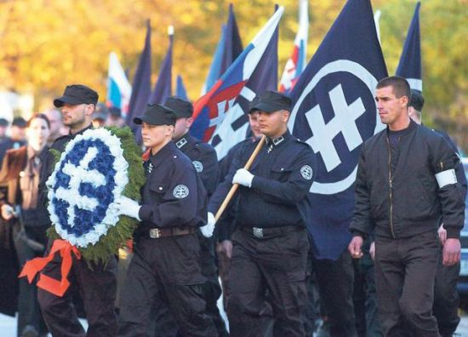
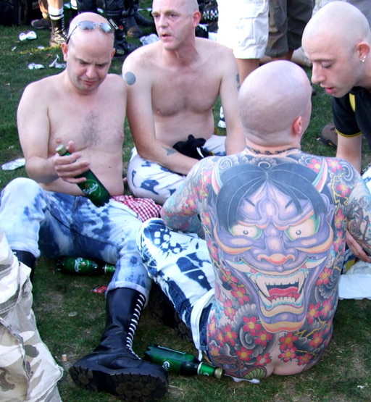
Problems of present
Right-wing extremism in Slovakia:
Nationalism, antisemitism, xenophobia and criticism of minorities and ethnic groups,
uniforms, regular meetings at meeting points,
hierarchy within the group.
verbal and physical assaults
establishing webpages and releasing CDs with xenophobic content.

Slide 4
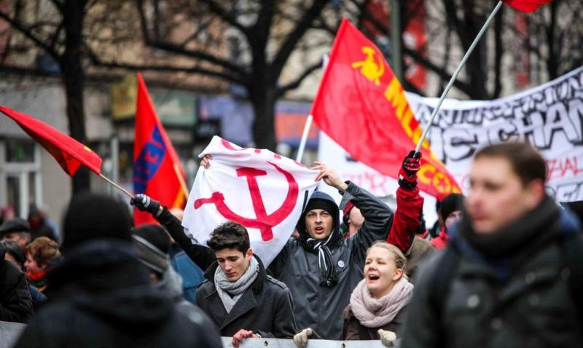
Left-wing extremists
sympathising with communist ideology.
Anarchists refuse all authorities, laws and state power.
Anti-globalists and radical ecological movements,
organise strikes, blockades, protests especially during summits.

Slide 5
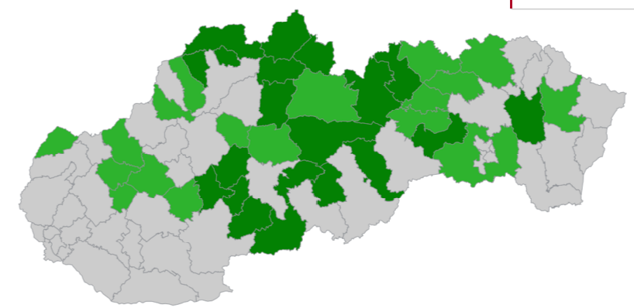
Radicalisation of political climate
The success of Ľudova strana –Naše Slovensko (ĽS –NS ) in elections 2016, the party established by former members of Slovenská pospolitosť.
ĽS - NS won by first voters
(18 - 21 –year-olds} - 22.7 %
Other parties: 17.7 % SaS, 12.6 % OĽANO – NOVA, 11.4 SME RODINA
7.6 Smer – SD, 7.0 Sieť, 5.5 SNS
Voters of ĽS - NS
Secondary educated with leaving examinations 54.4 %
tertiary educated 20.5 %
Secondary educated without school leaving examination 18.3 %
Primary educated 6.8 %
Source: Exit poll Focusu pre TV Markiza
What to do?

Slide 6
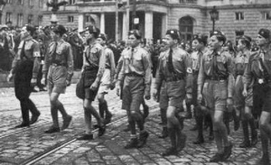
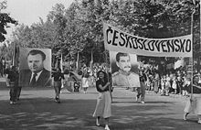
Coincidence?
1st Slovak State 1939 -45, the Hlinka youth
Communist Czechoslovakia, the communist youth
Present Slovakia

Slide 7
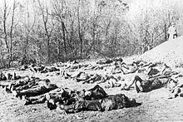
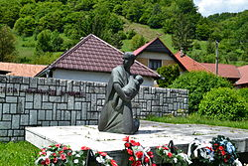
Is the past forgotten?
Ostrý Grúň – inhabitants helped partizans. In January 1945, the village burned to ashes, 64 people were shot dead, women and children included.
Elections 2016: right-wing extremist party got 16, 9% of votes

Slide 8
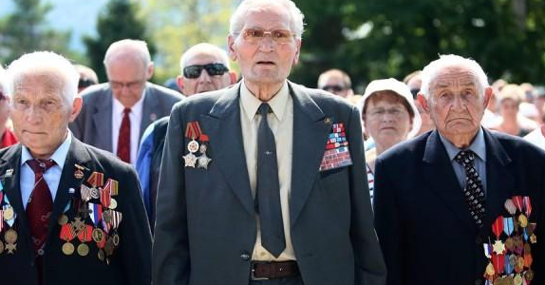
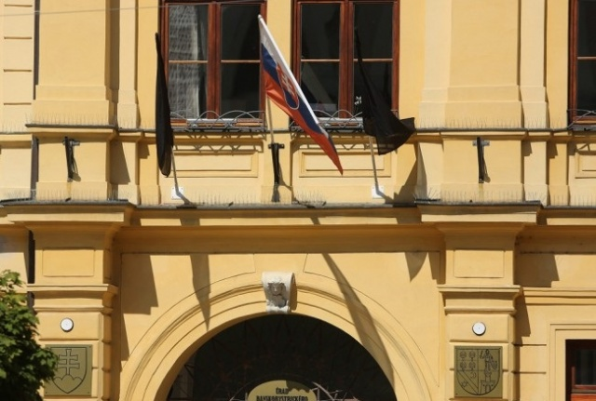
Doubting the past
Celebrations of The Slovak National Uprising
Doubting the memorial of the Uprising – a black flag on the Regional Office building on the anniversary of the Uprising

Slide 9
Why?
1. The need of belonging –extremist groups replace family boundaries
2. Need of being a member of a group
3. Revolt against school, family
4. Boredom
5. Adrenalin- the need to do something forbidden and dangerous
6.The need of discipline and strong leader
7. The need for respect
8. Social unease-unemployment, problems connected with immigrants
9. Revolt against establishment, and politicians not caring about citizens
(Source: PRÍČINY RASTU RADIKALIZÁCIE A AGRESIVITY URČITÝCH SKUPÍN OBYVATEĽSTVA – výskumná správa )

Slide 10
How to solve the problem?
Solutions for future

Slide 11
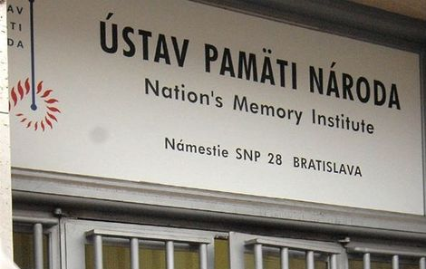
Uncover the dark part of history
the National Memory Institute
1939 – 1945
Slovak Jews 1939 - 1945
Hlinkova garda
fallen soldiers in anti-Russian movement 1941 - 1943
Documents 1939 -1945
1945 - 1989
members of State Police
Zväzková agenda Štátnej bezpečnosti
members of communist party
lists of people taken to Russian Gulag
orders of the Ministry of Interior 1948
1989 Candle manifestation
August 1968
Documents 1948 - 1989

Slide 12
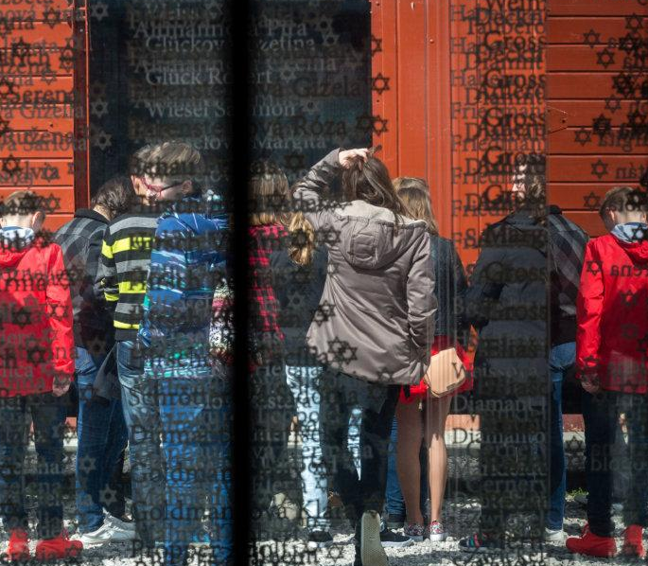
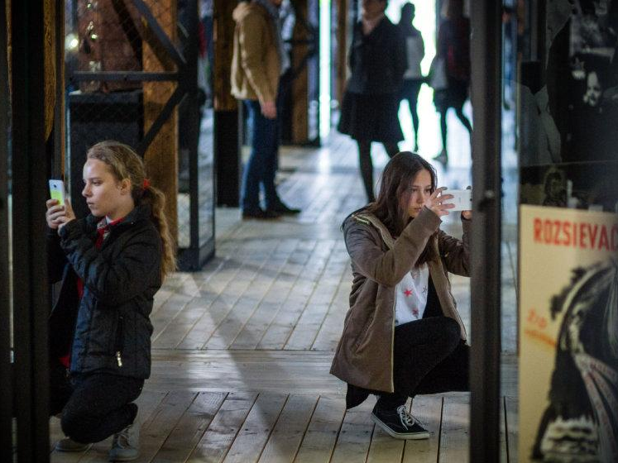
Educate the young
Field days

Slide 13
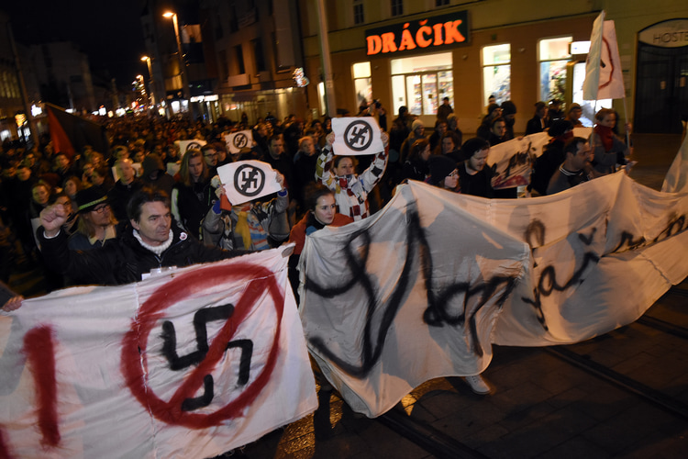
Anti-Facist protest in Bratislava

Slide 14
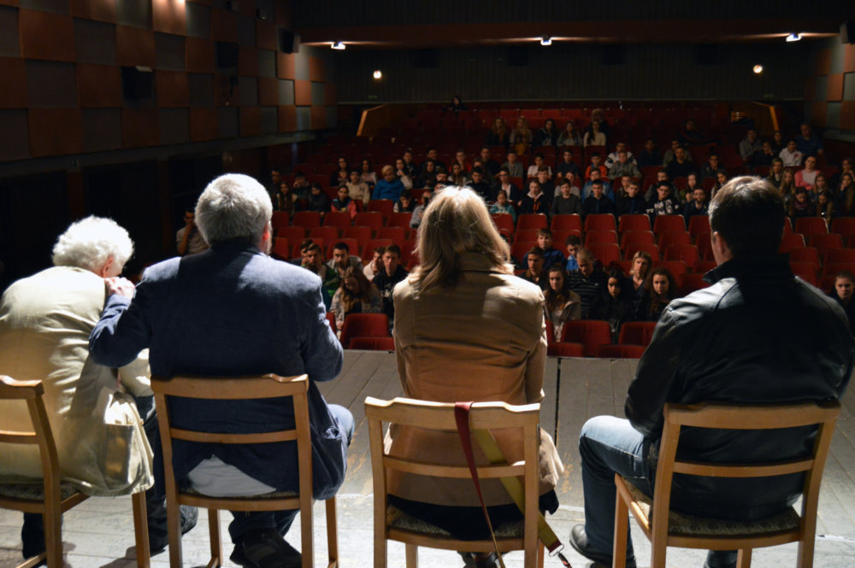
Anti-fascist panel discussions
A series of lectures, concerts and discussions organised by the photographer Andrej Bán and his team.
They gather together with citizens and especially students.

Slide 15
Bibliography:
Documents from the website of Ministry of Interior of the Slovak Republik:
Retrieved 20.11.2016 from http:/www.minv.sk/?extremizmus
1. MLÝNEK, Jaromír: 2012 Príčiny rastu radikalizácie a agresivity určitých skupín obyvateľstva. Výskumná správa. [Reasons of extremism and aggression by certain groups of the population. A research report ]
2. Extrémizmus a jeho podhubie [Extremism and its roots]
Statistical Office of the Slovak Republic
Retrieved 20.11.2016 from http://volby.statistics.sk/ep/ep2009/sr/tab108c7.html?lang=sk
The Nation’s Memory Institute
Retrieved 20.11.2016 from http://www.upn.gov.sk/en
Newspaper articles:
VASIĽKO, Tomáš: Kto volil Kotlebu a prečo? Nie, nie je to len pre utečencov. In: Denník N
Retrieved 20.11.2016 from https://dennikn.sk/395557/volil-kotlebu-preco-nie-nie-su-utecencitito-ludia-volili-kotlebu-tychto-dovodov/
VRAŽDA, Daniel: V Kľaku pri spomienke na masakru bežala aj prezidentská kampaň. In: Denník Sme, 19. 1. 2014
Retrieved 20.11.2016 from http://domov.sme.sk/c/7072390/v-klaku-pri-spomienke-na-masakru-bezala-aj-prezidentska-kampan.html

Slide 16
Pictures
SLIDE 1 http://www.age-of-the-sage.org/history/quotations/lessons_of_history.html
SLIDE 2 http://www.transport.sk/spravy/cestna-infrastruktura/4743-trstene-pri-hornade-a-severomadarsku-obec-keked-spoji-nova-cesta.html
SLIDE 3 http://www.pluska.sk/spravy/z-domova/velky-prehlad-neonacistickych-skupin-slovensku-vodca-kotleba-aj-rasisticki-rytieri.html
http://www.parlamentnelisty.sk/spravy/socialhub/Polovojenska-Akcna-skupina-Vzdor-chce-na-Slovensku-suplovat-pracu-policie-aj-armady-251059
https://pospolitost.wordpress.com/2010/05/24/otvoreny-list-generalnemu-prokuratorovi-judr-dobroslavovi-trnkovi/
SLIDE 4 http://flm.sk/
SLIDE 5 https://dennikn.sk/395557/volil-kotlebu-preco-nie-nie-su-utecencitito-ludia-volili-kotlebu-tychto-dovodov/
SLIDE 6
http://www.bystricoviny.sk/spravy/na-oslavach-snp-bude-rusno-pridu-protestovat-lavicovi-extremisti/
https://sk.wikipedia.org/wiki/%C4%8Cesko-Slovensko_v_rokoch_1948_a%C5%BE_1989
http://cerven.blog.sme.sk/c/36283/Hlinkova-Garda-S130.html
http://www.parlamentnelisty.sk/spravy/socialhub/Polovojenska-Akcna-skupina-Vzdor-chce-na-Slovensku-suplovat-pracu-policie-aj-armady-251059
SLIDE 7
http://domov.sme.sk/c/7072390/v-klaku-pri-spomienke-na-masakru-bezala-aj-prezidentska-kampan.html
https://sk.wikipedia.org/wiki/Masaker_v_K%C4%BEakovskej_doline
SLIDE 8 http://www.ta3.com/clanok/1068231/slovaci-si-pripominaju-snp-na-kotlebovom-urade-viseli-cierne-vlajky.html
http://www.teraz.sk/fotodennik/oslavy-72-vyrocia-snp-v-banskej-bystr/180221-fotografia.html?stranka=403
SLIDE 10 http://zenskyweb.sk/tagy/extremizmus
SLIDE 11 http://www.upn.gov.sk/
http://spravy.pravda.sk/domace/clanok/407763-ludskopravny-vybor-navrhuje-kontrolu-nku-v-ustave-pamati-naroda/
SLIDE 12 https://dennikn.sk/449297/so-ziakmi-koncentracnom-tabore-zivot-vaznov-prekvapil/
SLIDE 13 http://ww.plusden.sk/spravy/z-domova/velky-prehlad-neonacistickych-skupin-slovensku-vodca-kotleba-aj-rasisticki-rytieri.html
SLIDE 14 https://dennikn.sk/456164/fedor-gal-kotleba-transparentne-nebezpecenstvo-aj-vacsie/

