Slide 1
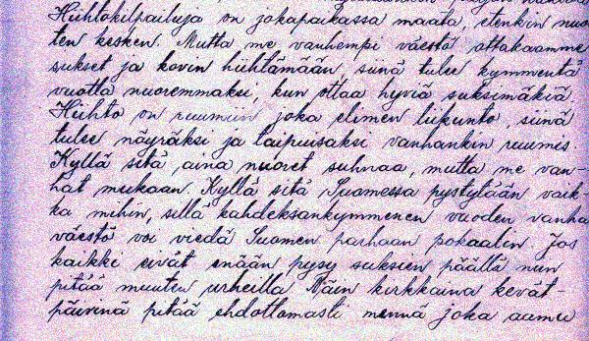
Onni Happonen’s case

Slide 2
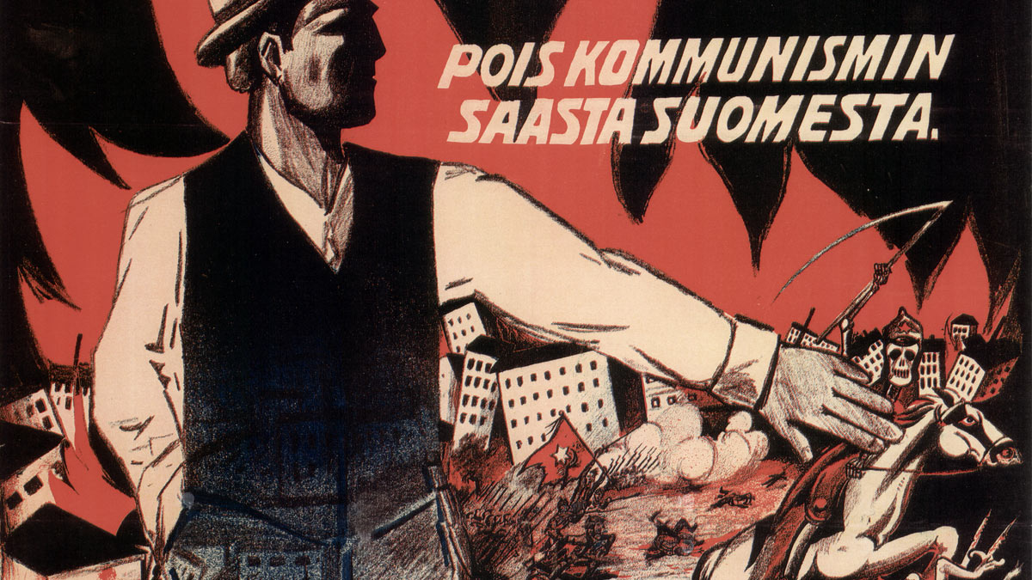
Lapua movement
Lapua movement influenced during the years 1929-1932. It was a finnish far-right anti communist popular movement. Originally it was meant to support the government but quickly became a protest movement. It was the strongest popular movement of the political history of finland.

Slide 3
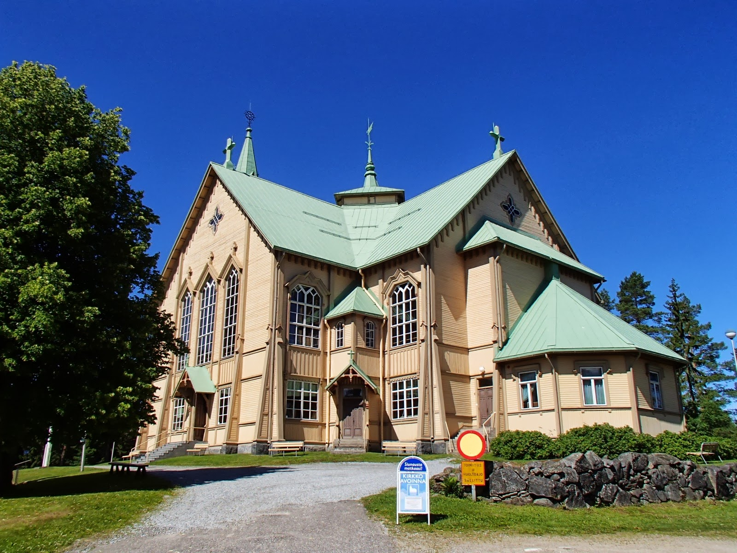
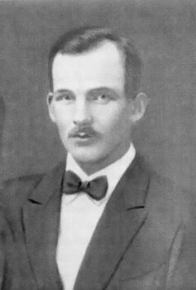
Onni Happonen
Onni Happonen was a Finnish Social Democratic municipal politician. He is remembered of being physically abused and then murdered by Lapua movement activists in 1930. Happonen was the head of the municipal government of Heinävesi. In the 1920s he also acted as the chairman of the Workers’ Association of the municipality of Pölläkkä.

Slide 4
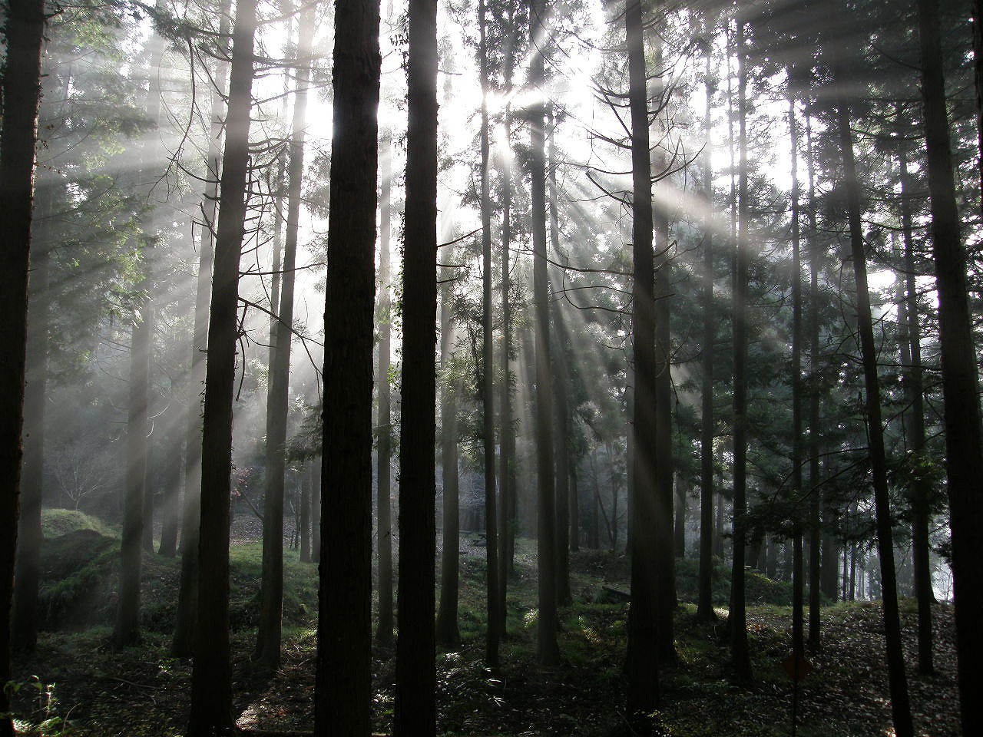
What did Onni Happonen oppose?
He protested against the establishment which was trying to limit the freedom of opinion and freedom of speech.
Onni Happonen didn’t comply with the demands of Lapua Movement activists who wanted to dismiss from the municipal government those who had divergent opinions about politics.
In so doing he was trying to defend the order of law and democracy.

Slide 5
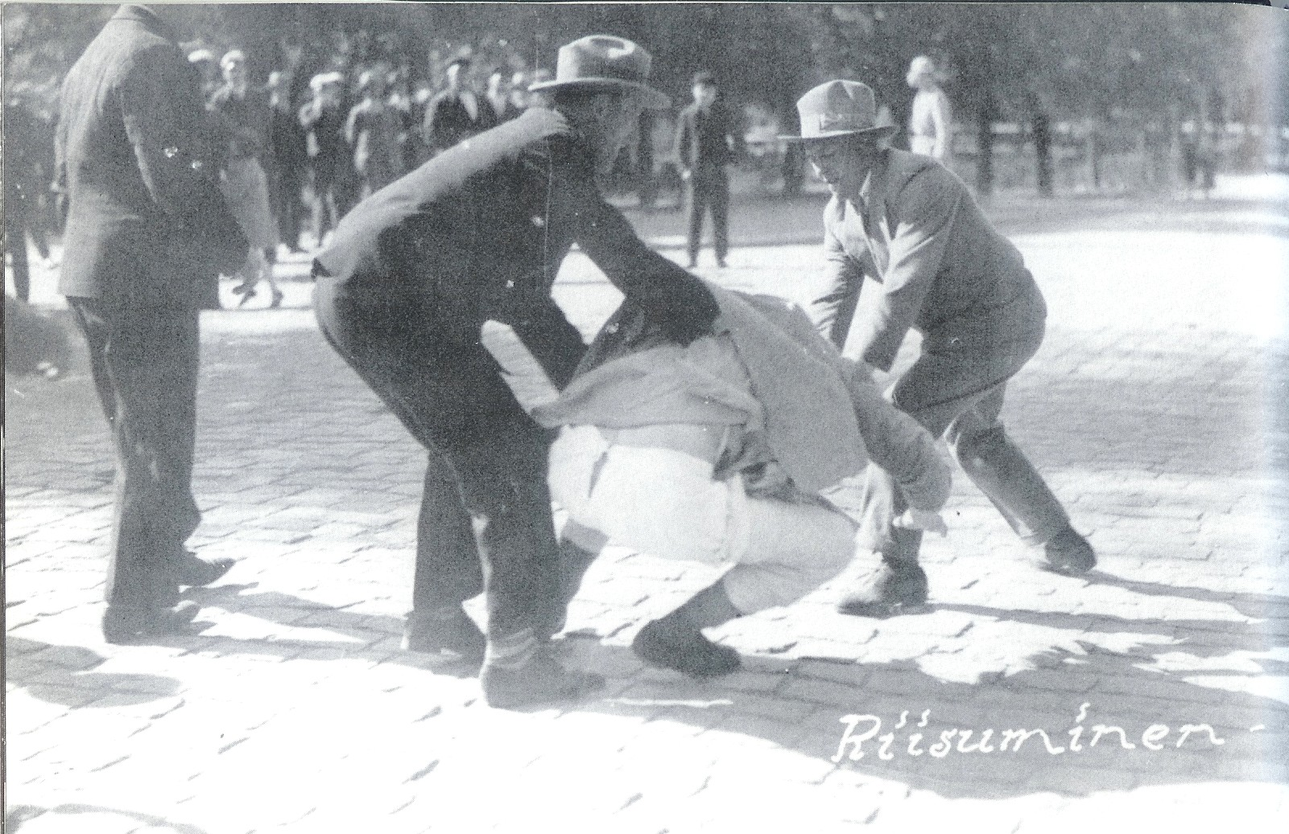
Onni Happonen’s capture
In 1930 when Lapua Movement was at its strongest, Onni Happonen, the Social Democratic chairman of Heinävesi municipal government, was captured and violently forced into a car which headed fast towards Joensuu.
However, the journey didn’t end in Joensuu.
Onni Happonen’s abduction was witnessed by lots of people.

Slide 6
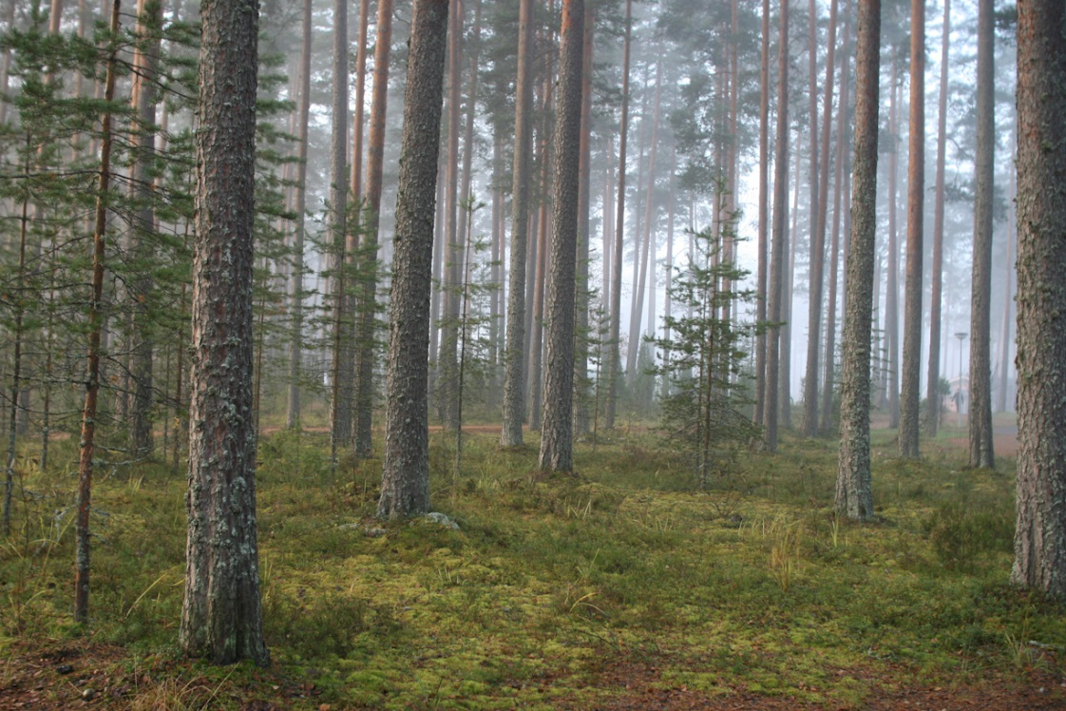
The body is found
Onni Happonen’s mutilated body wasn’t found until July 1932, two years after the murder. It was buried into the woods near Varkaus-Joensuu road. Happonen had been fiercely abused, and finally shot to death.

Slide 7
After the murder
Many people had seen Onni Happonen’s capture and two local men were even convicted for manslaughter. However, Onni Happonen’s case is still without the final answers.
It is assumed that the convicted men were just local farm-hands who took the blame for money. The real culprits, those who had planned the political murder, were not discovered because of the lack of evidence.
Were the main culprits Lapua Movement activists from a nearby town Kuopio or local men from Heinävesi? Far-right activists, local big farmers and high officials –one of whom the Heinävesi municipal’s own police chief?

Slide 8
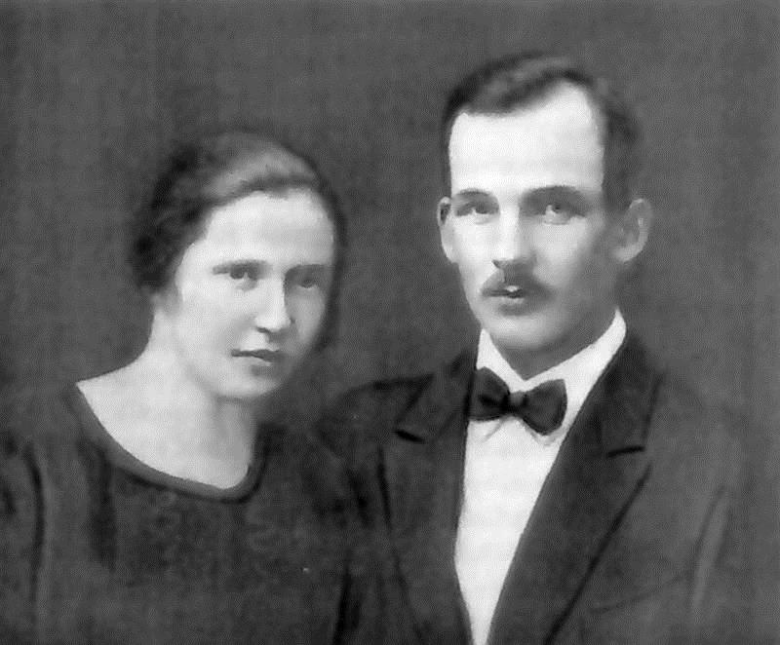
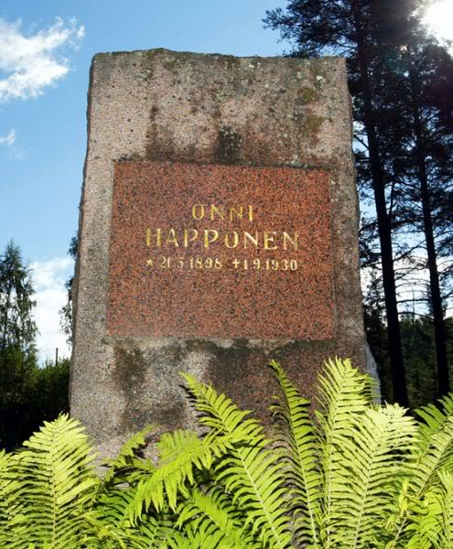
Commemoration in 2007
In 2007 a commemoration was organized for Onni Happonen in Heinävesi.
The day after the occasion the wreaths which had been brought to Onni Happonen’s tomb had been torn and lifted on poles.
Only the stony commemorial was at its place since it had been assumed that it was no use of putting up a small tomb stone for political enemies to disgrace.
Where Happonen was found
Happonen’s grave

Slide 9
Human Rights are international rules which are defined by international agreements and declarations
Human Rights
Right to live
Right for property
Right for food
Right for work
Right for knowledge
Right for family
Right for religion
Right for sufficient income
Right for secure environment
Right for teaching
Right for asylum
Prohibition of arbitrary treatment
Right for personal security
Right to participate in decision making
Freedom of opinion
Prohibition of discrimination
Right for equal treatment
Right for a place to live
Right for healthcare
Prohibition of slavery
Right for freedom
Right for privacy
Right for the name and identity
Right to move freely
Right for rest and freetime
Freedom of speech
Right for nationality
Special nurture and care for children
Prohibition of torture
Responsibilites towards society

Slide 10
Human Rights today
Even today, all human rights don’t come true. Still, different people and groups are being trampled every day.
Not everyone has food or healthcare every day.
In some countries, if your opinion, religion, work, skin color or nationality is wrong, you may not have freedom of speech, right for enviroment, right to move freely, right for freedom or right for privacy, for example.
Also, in some countries, people are still being tortured, captured, discriminated and enslaved.

Slide 11
Freedom of speech and opinion are the basis of democracy.
If a nation tries to exclude even one opinion or ideology, that nation isn’t democratic anymore.

Slide 12
What do you think?
What Human Rights are violated?
What things violate your rights?
Is there something in the present society that violates your sense of justice?

Slide 13
“The world is a dangerous place to live; not because of the people who are evil, but because of the people who don't do anything about it.”
-Albert Einstein-

