Slide 1
The Shop on Main Street
Original Title: Obchod na korze
Genre: Drama
Length: 128 minút
Produced by: Czechoslovakia
Language: Slovak
Year: 1965
Directed by: Ján Kádár, Elmar Klos
Based on a novel by Ladislav Grosman
Notes:
1

Slide 2
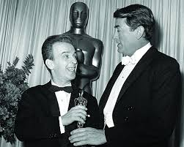
The History of the film:
It was the first Czechoslovakian film to win an Academy Award for best Foreign Language Film in 1966.
The Polish actress Ida Kamińska was nominated for an Oscar in the category Best Actress in a Leading Role.
(won by Liz Taylor for her performance in Who is afraid of Virginia Woolf)

Slide 3
Other Awards:
New York Film Critics Circle Awards and David di Donatello Awards for best foreign language film of 1966
Cannes Film Festival - Special Mention for Jozef Kroner and Ida Kamińska for their acting performances.
The directors and actors in leading roles were awarded the State Award of the Communist Regime.

Slide 4
Motivation:
Citizens of Slovakia have different attitudes towards Jewish people and towards the Slovak State as well.
Ordinary people adjusted to the system.
Most people were rather happy since this was the first time in history that Slovakia gained its own independent State.
For many Slovaks this meant a better social situation.
What is more, the territory of Slovakia was mostly untouched by the horrors of war.

Slide 5
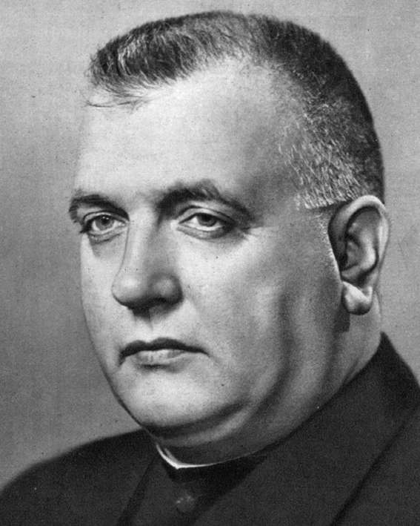
President of the Slovak State was a catholic priest, enjoying great popularity and support by the mostly catholic Slovaks.
However, gradually there started to be an opposition to the regime, both civic and communist.

Slide 6
The party in power, the only party, Hlinka Slovak People‘s Party, had its branches in every town and village.
The party had its own armed forces – Hlinka Guard - and its own youth organisation Hlinka Youth.
Party members and members of the Hlinka Guard were the first to get hold of Jewish property.
Many Slovaks aryanised because of greed or because they collaborated with the regime to secure their position.

Slide 7
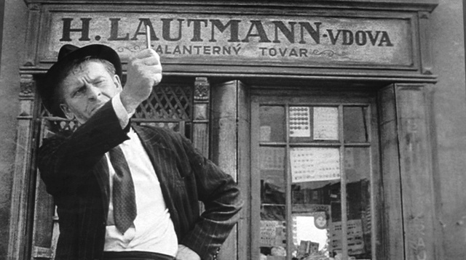
Some people were convinced that the fact that Jewish property got into Slovak hands is some kind of historical justice.
They were not aware of the fate that awaits Jews in concentration camps.
Many made themselves believe that it was the best solution for everybody.
As the Slovak uprising started only a few people were willing to collaborate with the regime. The Hlinka Guard worked with the German forces who came to suppress the uprising.

Slide 8
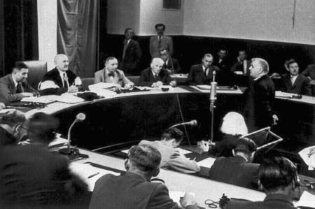
In post-war Czechoslovakia collaborators and traitors were tried by the National Court of Justice.
President Tiso was sentenced to death alongside with other prominent state representatives.
District courts tried less important collaborators.
Local people‘s courts were held in every village or town and were able to pass a sentence of up to two years imprisonment.

Slide 9
Nation's Memory Institute was established to research the two totalitarian regimes in Slovakia: The Slovak State and the Communist regime in Czechoslovakia in the period of 1948 -1989.
On the web site of the institute there are fates of Slovak Jews, lists of "Aryanizators" and members of the Hlinka Guard (Hilnkova Garda).
This way it reveals names of actual people who were persecuted or who collaborated.

Slide 10
Plot
The story takes place in a small town in Eastern Slovakia during the Slovak State.
It is based on real events.
It depicts the fate of Jews, aryanisation of Jewish property, and transports.
It also shows the different attitudes of Slovaks, how they chose to behave towards their Jewish neighbours in their hour of need.

Slide 11
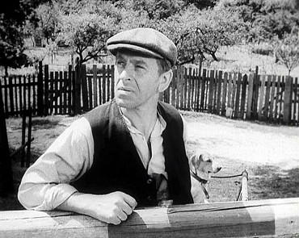
The main character
Tony Brtko is a carpenter. Unlike many others he refuses to make a career in the Hlinka Guard.
Against his will and persuaded by his wife and brother–in-law, he became Aryanizator of a small shop owned by the Jewish widow Mrs. Lautman.

Slide 12
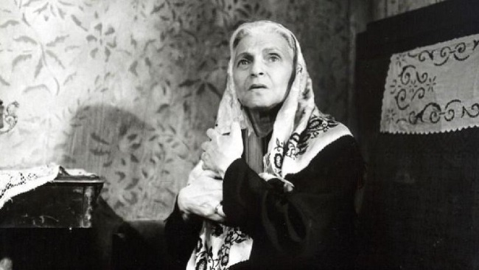
Mrs. Lautman does not understand what is happening and Tony is not able to explain.
He is given money by the Jewish community to work in her shop.
They want him to be the Aryanizator and not some cruel stranger.
Mrs. Lautman is a bit deaf and senile, but a sort of friendship starts between her and Tony.

Slide 13
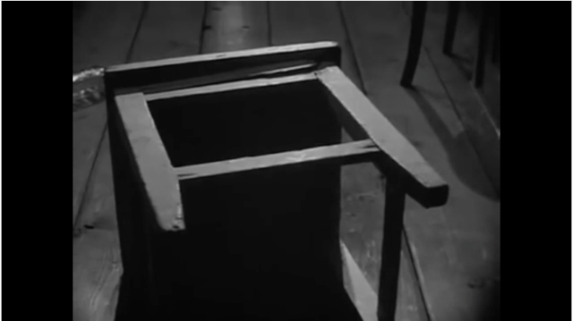
When the transportations start, Tony puts Mrs. Lautman into a little storeroom.
She falls and dies.
Tormented by remorse, Tony commits suicide.

Slide 14
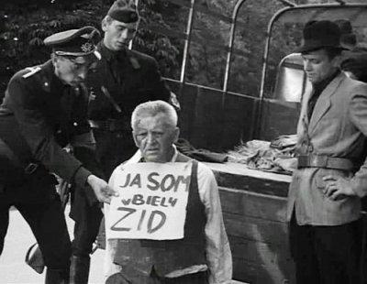
Tony finds himself in a difficult situation. He has two options: he can hend her over to be transported and send her to her death.
If he helped her, society would call him a “white Jew” and that would destroy him.
His suicide is the result of this tragic situation.

Slide 15
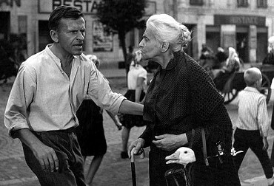
The film shows how the regime corrupts human values.
The town´s citizens are simple, ordinary people, who go to church regularly.
They got used to the regime and stand by to watch the persecutions of Jews. The Aryanisation and persecutions seem normal and ordinary to them.

Slide 16
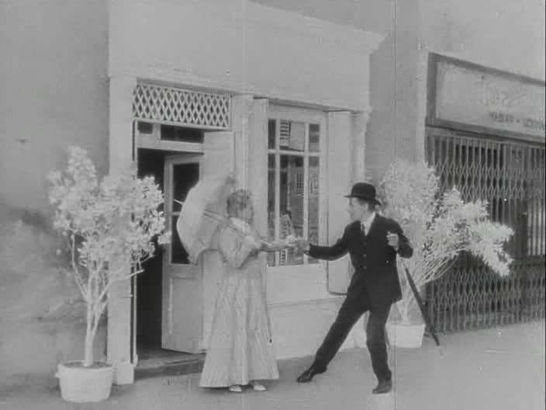
There is a surrealistic ending to the film. After Mrs. Lautman´s death the camera wonders through the shop. Tony is drunk and desperate because of what he has done. After his death, the despair changes into a dream-like vision. The souls of Tony and Mrs. Lautman exit through the open door dancing, holding hands. They are heading towards the square while the music becomes louder.

