Slide 1
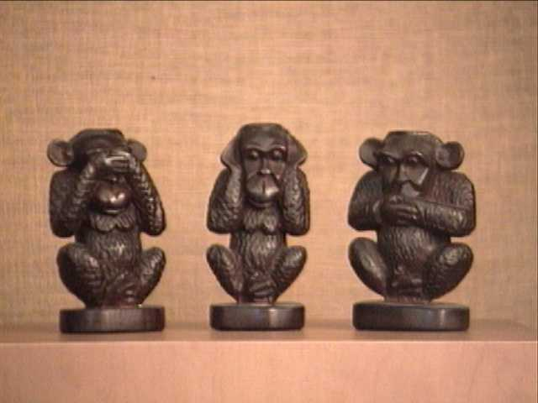
indiFference
Common people

Slide 2
„Bread and Games“
Totalitarian Regime of Czechoslovakia
1945 -1989

Slide 3
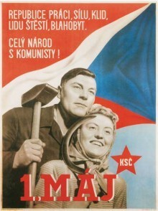
Some social benefits of the socialist regime
right to work and the obligation to work - artificially created jobs
the right to free health care
the right to free primary, secondary and higher education (taken away from "the enemy of the regime" and their descendants)
maternity leave
low prices of staple foods
subsidized holidays for workers
Construction of flats

Slide 4
... and the dark side of the regime
denial of freedom of expression
denial of freedom of movement (travel abroad)
denial of religious freedom
denial of freedom of assembly
censorship
low labor productivity
economic and technological lag behind Western democratic states

Slide 5
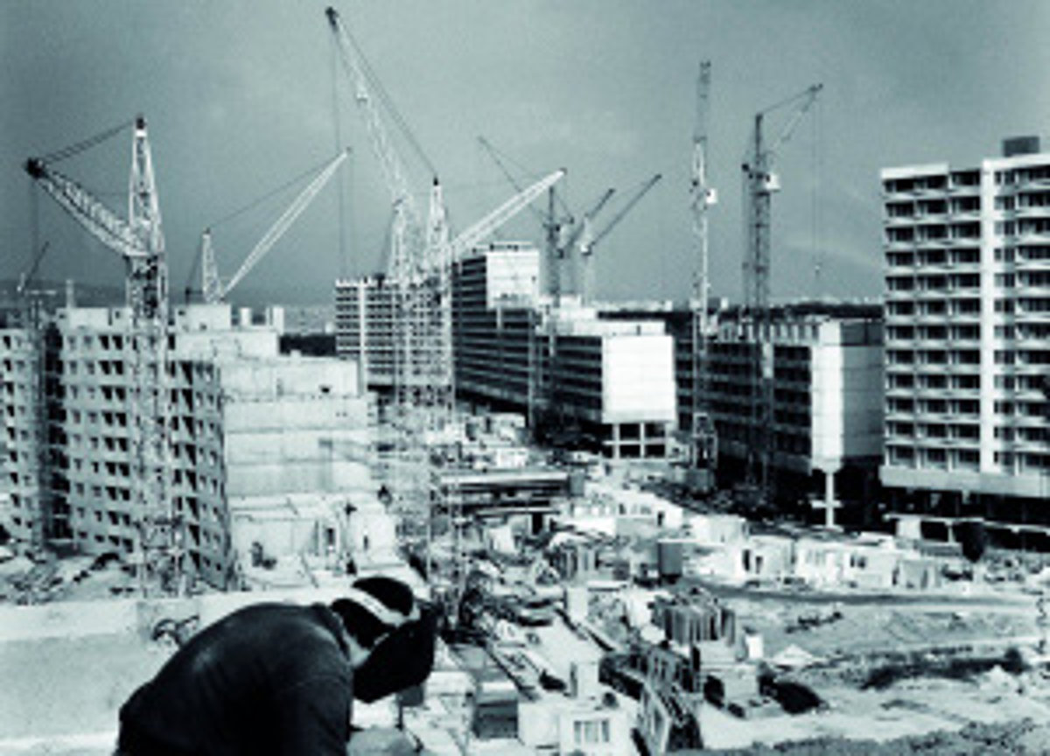
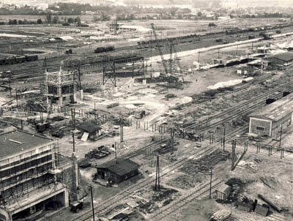
Benefits of socialism and their price
Environmental degradation
Socialist construction and industrialization

Slide 6
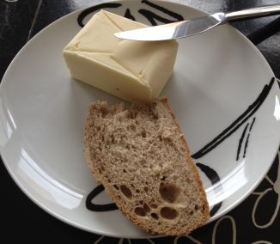
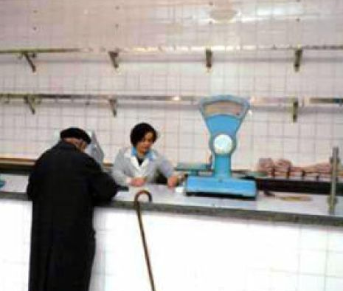
Benefits of socialism and their price
Lack of consumer goods, empty shops
Low prices of staple foods

Slide 7
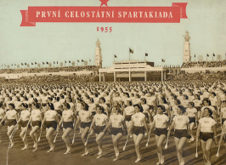
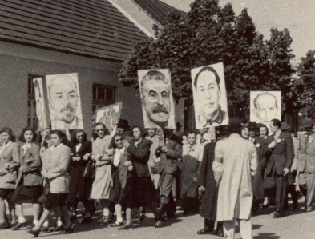
Celebration
„Spartakiáda“ – a mass sport event held every five years
1st May celebration during Socialism

Slide 8
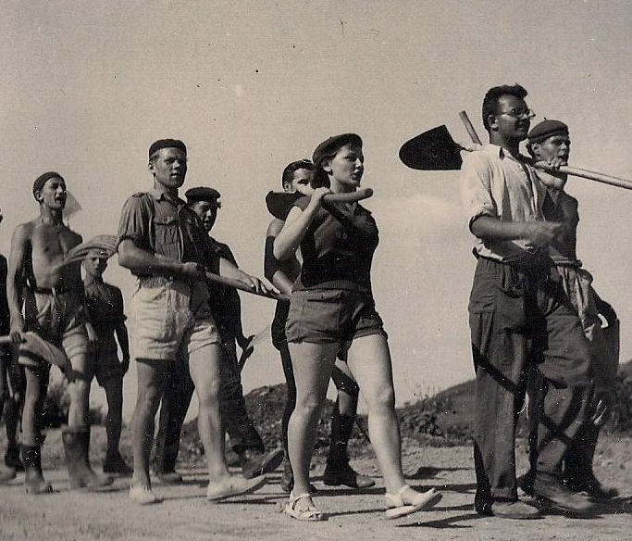
Education
Youth involved in socialist construction - the construction of the railway line called "Youth Track"
Children's organisation called „Pionieri“

Slide 9
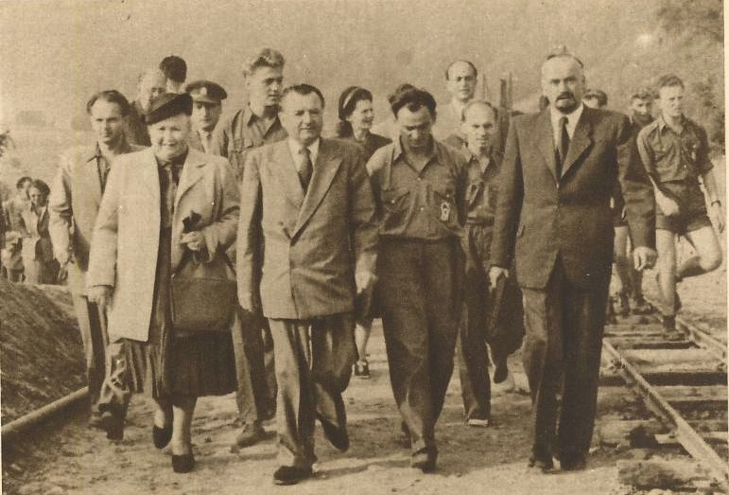
Politicians and ordinary people
President Gottwald visits the construction of railways

Slide 10
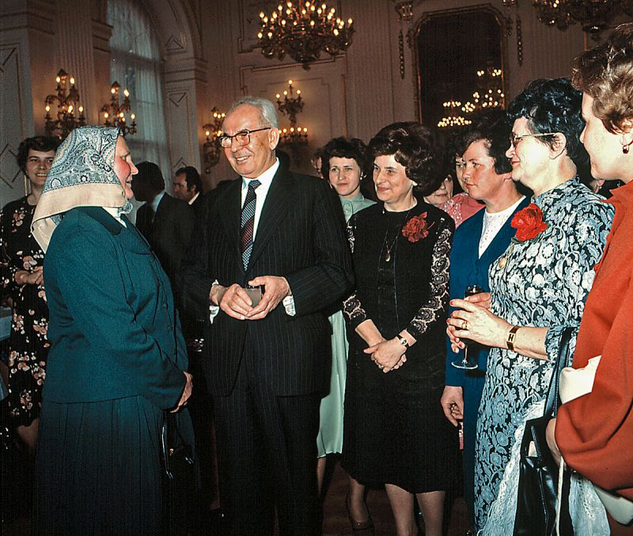
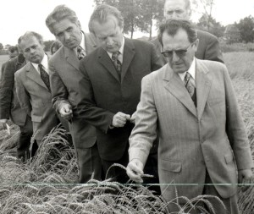
Politicians and ordinary people
Communist official Vasil Bilak among peasants
President Gustav Husak on International Women's Day

Slide 11
Sources:
Kováč, Dušan a spol.: Kronika Slovenska 2. Bratislava: Fortuna Print, s.r.o., 1999, s. 330 -418. ISBN 80-88980-08-9
Pictures
Slide 1: http://nanicmama.sme.sk/ja-zena/tri-opicky
Slide 3: http://www.reflex.cz/clanek/stary-reflex-tema-reflexu/32095/leta-nadseneho-teroru.html
Slide 5: http://domov.sme.sk/c/5894943/panelak-ktoze-by-ho-nemal-rad.html
http://www.oskole.sk/wap/index.php?id_cat=8&year=3&new=18799
Slide 6: http://www.aktuality.sk/clanok/265467/bolo-skutocne-za-socializmu-lacnejsie/
Slide 7: http://www.pnky.sk/historia/oslavy-1-maja-v-piestanoch-stalin-masaryk-aj-slniecko/
http://www.eantikvariat.com/czech/article_show.php?article_id=2451
Slide 8: http://raz.sk/regiony/bratislava-pioniersky-palac-pinkac-fotky/165516-clanok.html
http://puchovodedicstvo.sk/historia/4425/ludia-na-stavbe-priehrady-mladeze-1949-1959/
Slide 9: http://cestydobs.blogspot.sk/2012_08_01_archive.html
Slide 10: http://www.cas.sk/fotogaleria/357125/oslavovali-sme-mdz-takto-sme-si-ho-uzili-za-socializmu/11/
http://www.magnificat.sk/aktualne-zomrel-vasil-bilak/

