Slide 1
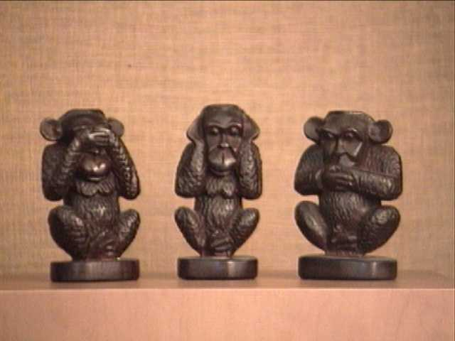
indiFference
Common people

Slide 2
„Bread and Games“
Totalitarian regime of the Slovak State
1939 -1945

Slide 3
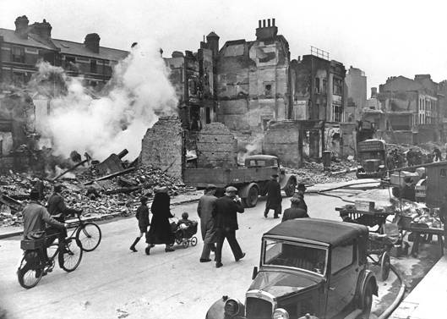
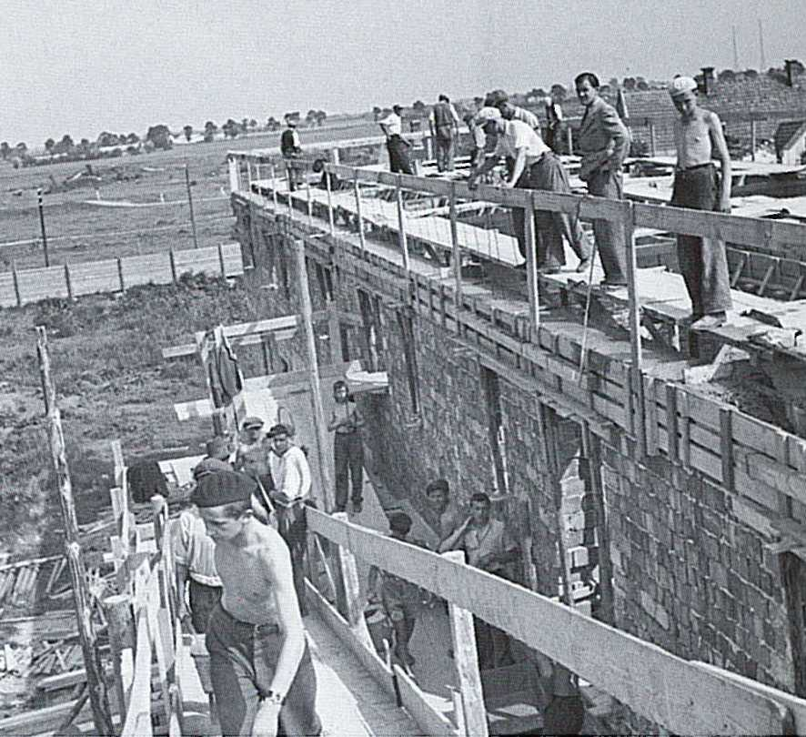
Economic upturn
development in construction, chemical, engineering, textile, and arms industry
70% exported to Germany
95 km of railways, and 287 km of roads built, electrification of 800 villages , telephone network expanded to 11,000 km
the construction of hydroelectric power plants and dams.
Bratislava 1940
The building of workers houses in Bratislava.
London 1940

Slide 4
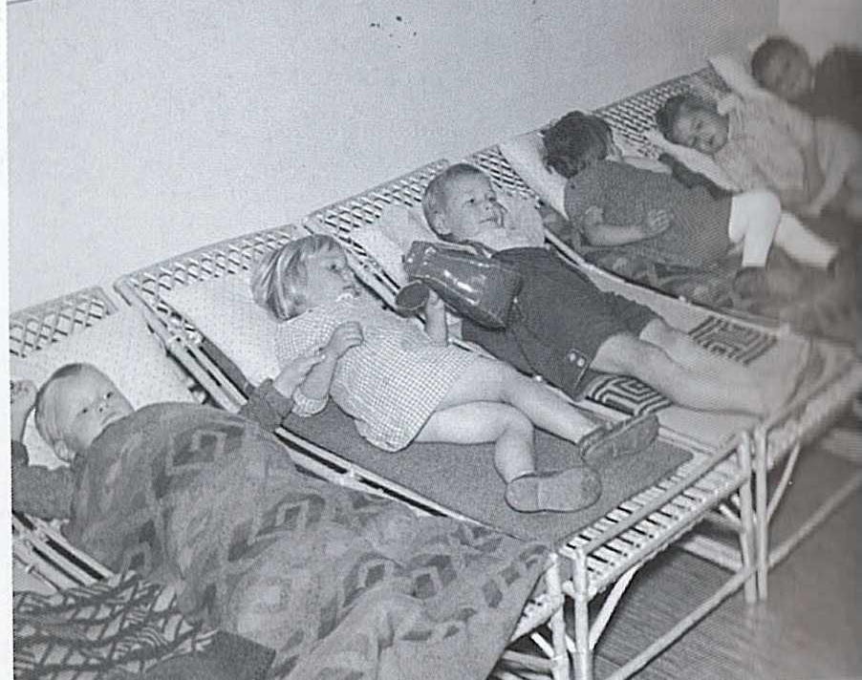
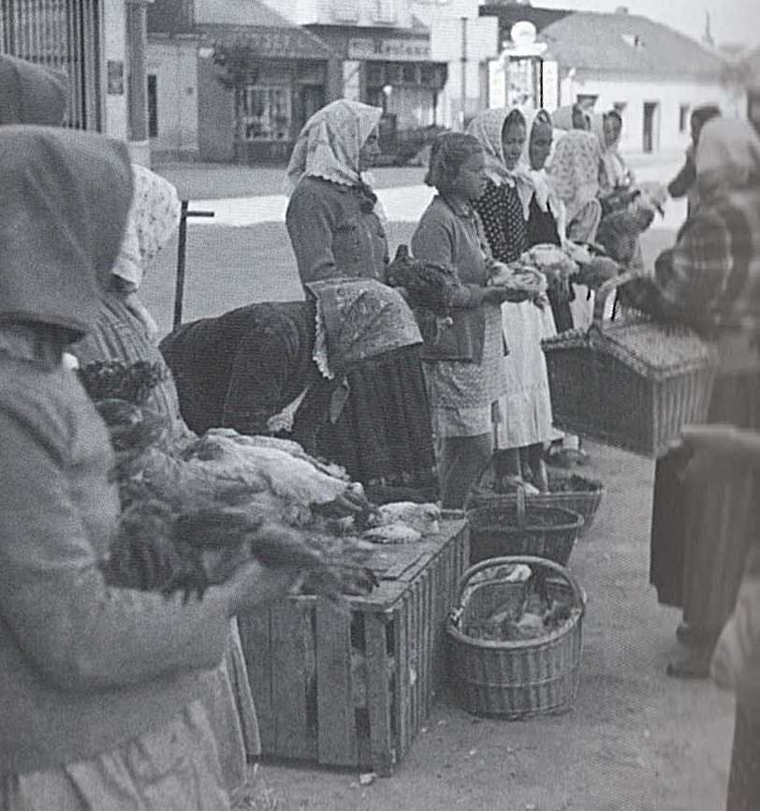
Improvements in social situation
elimination of unemployment-the Czechs leaving, the Jews being deported, young men joining the army
introduction of family allowance, and state benefits ,
recreational stay for workers and their families in state sanatoriums,
Slovak workers in Germany ( 40,000 finding new jobs in Germany every year)
Nursery
Bratislava= Pressburg
Fressburg in German slang – a place where you can get tasty food)

Slide 5
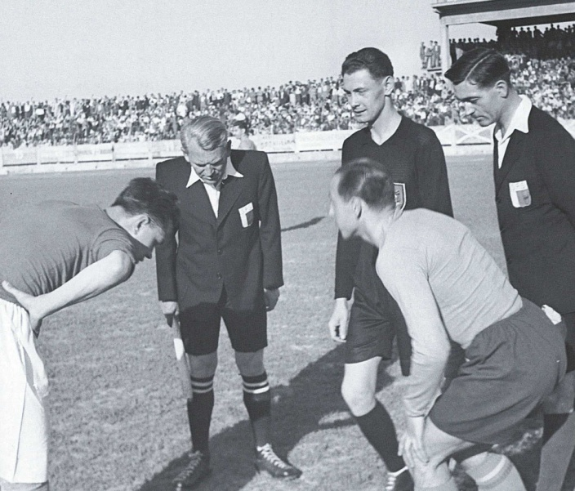
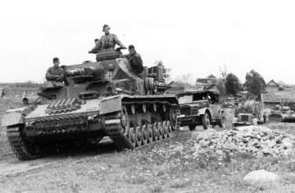
Cultural development
1941 Slovakia vs.Croatia
new universities established (the number of university students risen from 2,000 to 55 000)
Slovak Academy of Science and Arts established
boom in publishing (more than 4,000 books )
censorship
„inappropriate“ literature disposed of in libraries
professional theatres established,
sports competitions and events organised up to August 1944 - the Slovak National Uprising
Nemecko – Slovensko
s. 214
1941 Germany vs the Soviet Union

Slide 6
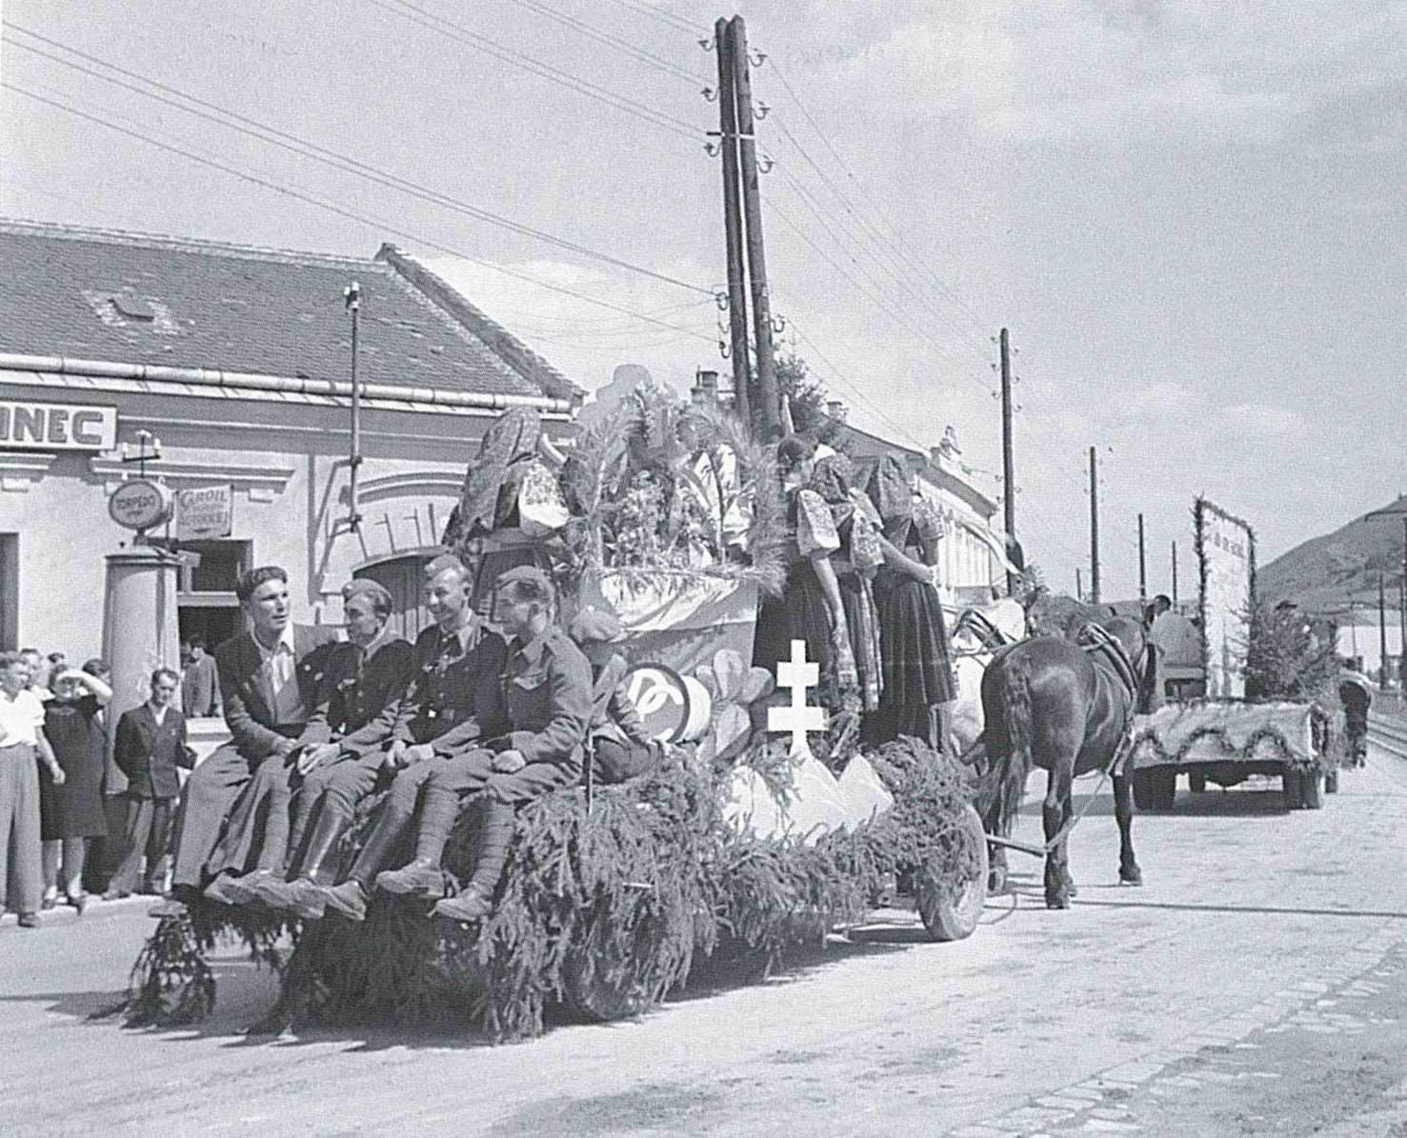
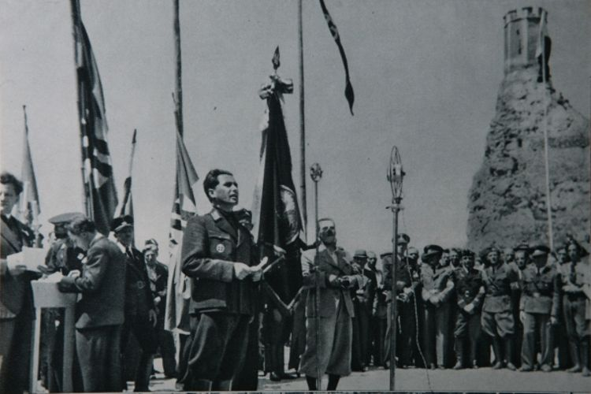
Celebrations
Labour Day/ May Day celebrated in the Slovak State in the 1940s
Minister Mach nearby the medieval castle Devin

Slide 7
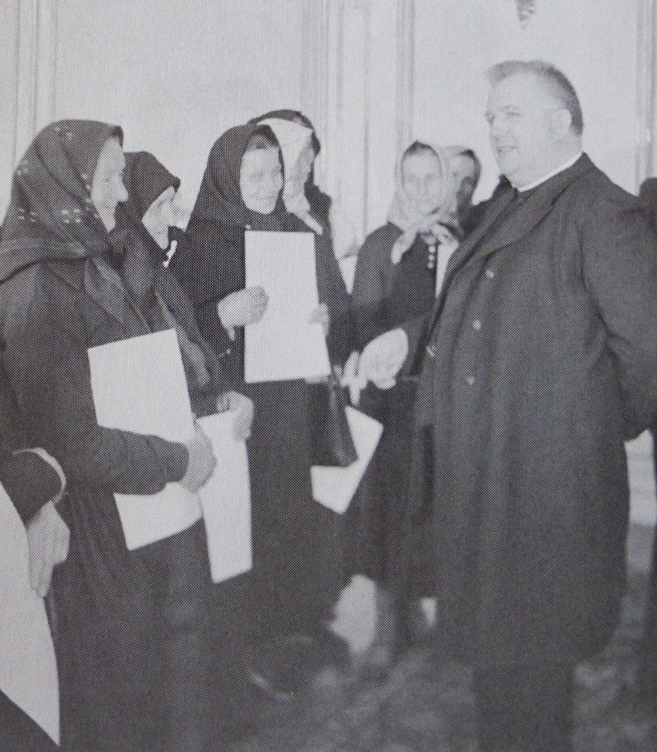
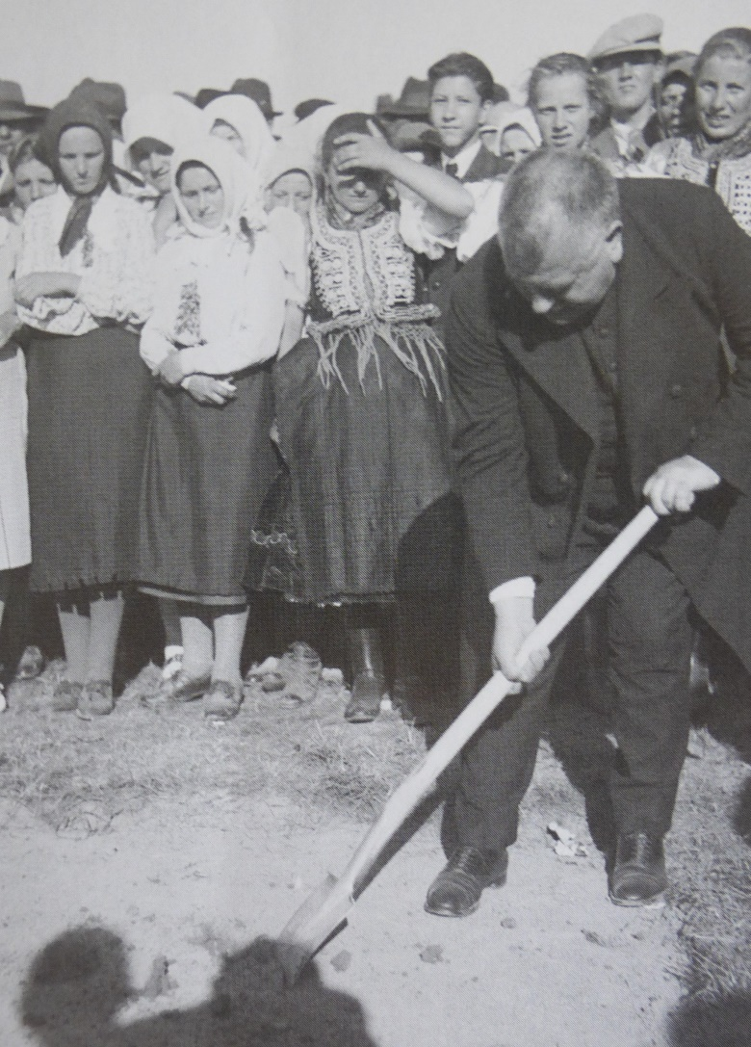
Politicians and ordinary people
President Tiso receives mothers of families with many children
President Tiso inaugurates a construction

Slide 8
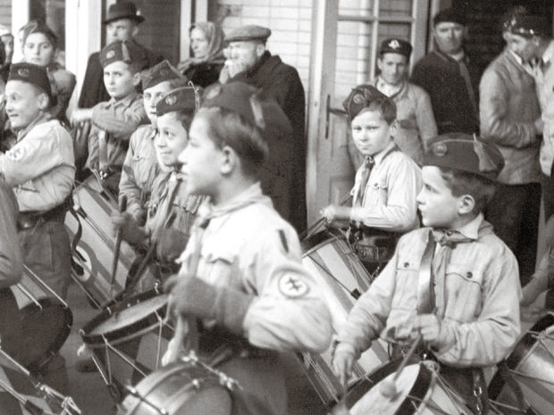
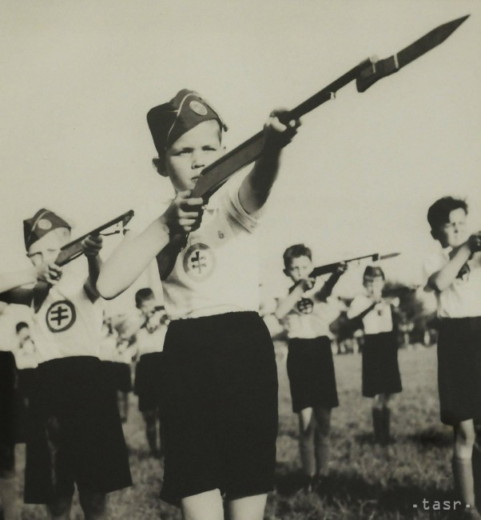
Education
Hlinka Youth 1940

Slide 9
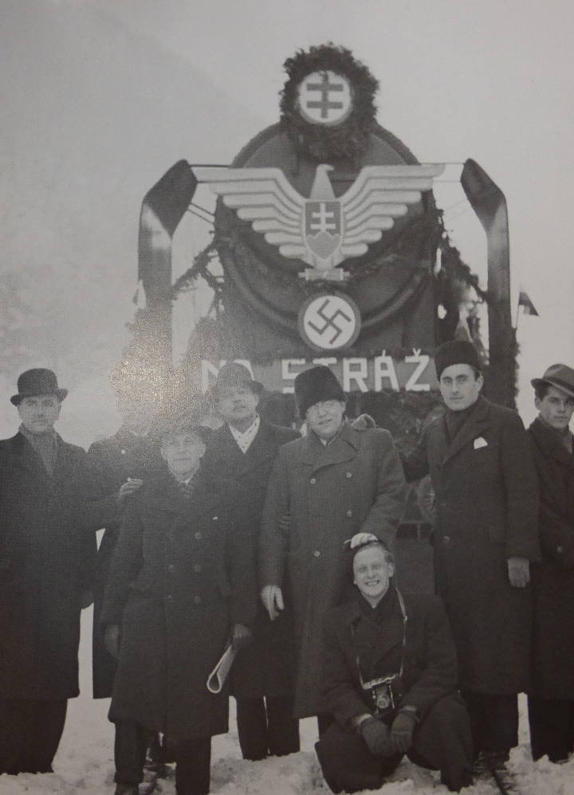
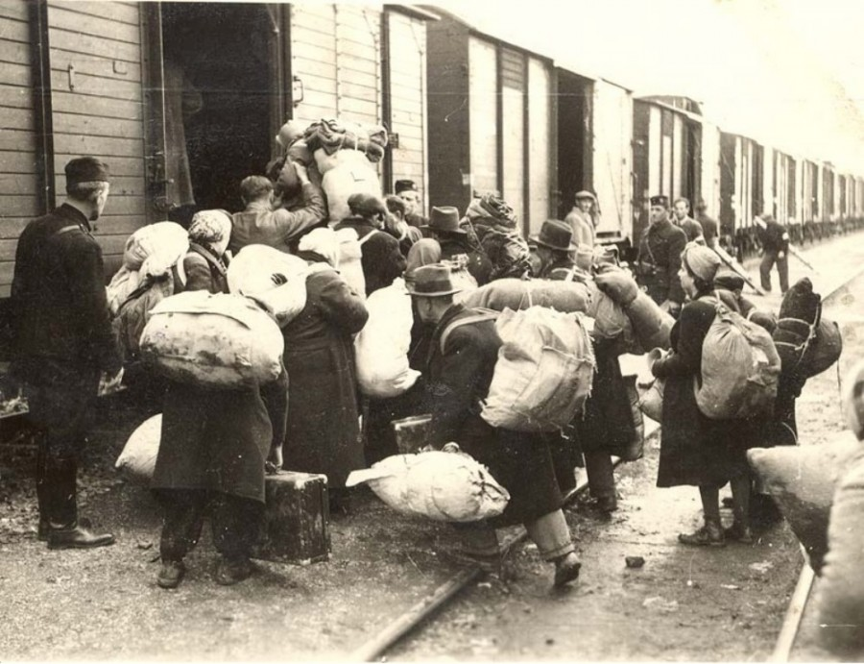
At the same time
Deportation at the railway station Žilina
Opening of a new railway line 1940

Slide 10
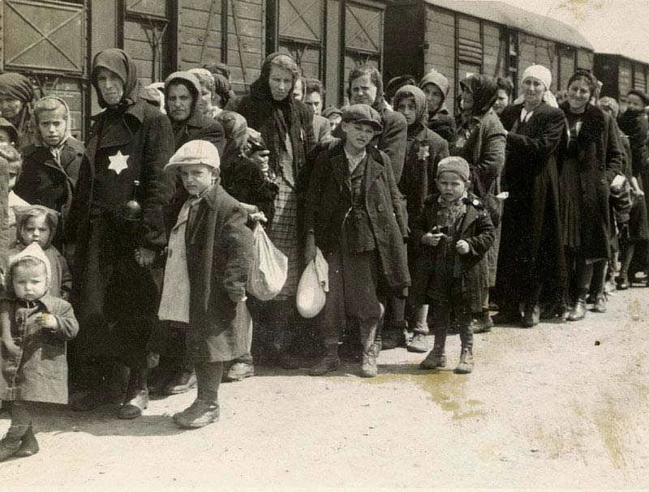
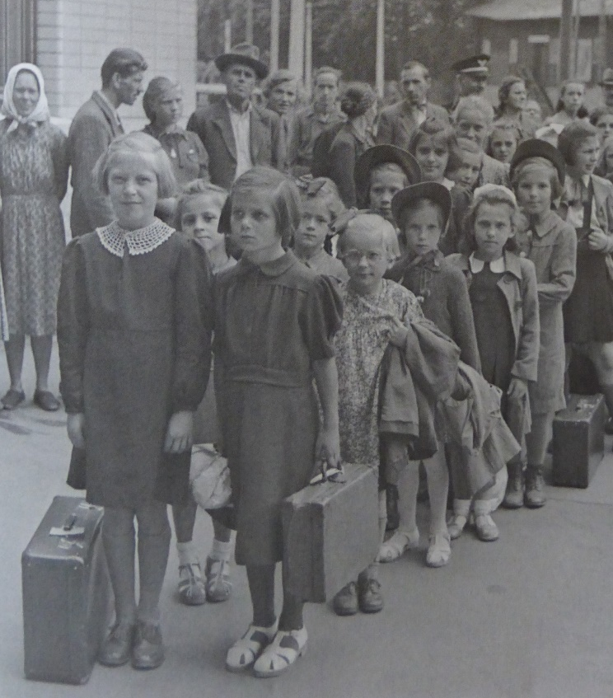
At the same time
Journey to Auschwitz
Children from poor families departing for a holiday trip.

Slide 11
Sources:
BALOGH, Alexander: Dve tváre kultúry a umenia slovenského štátu. Denník Sme 13. 4. 2014
ĎURKOVSKÁ, Mária: Kultúra ako jedna z dimenzií spoločenského života v Slovenskej republike v rokoch 1939 – 1945. In: Život v Slovenskej republike Slovenská republika 1939 – 1945 očami mladých historikov IX . Bratislava: Ústav pamäti národa, 2010, s. 245 -259. ISBN 978-80-89335-37-4
KAMENEC, Ivan: Slovenský štát v obrazoch. Praha: Ottovo nakladatelství, 2008, 248 s . ISBN 978-80-7360-700
Pictures
Slide 1: http://nanicmama.sme.sk/ja-zena/tri-opicky
Slide 3: KAMENEC, Ivan 2008. Slovenský štát v obrazoch. Praha: Ottovo nakladatelství, 2008, s. 185 . ISBN 978-80-7360-700-5
http://ww2today.com/9th-september-1940-air-raids-now-hitting-public-morale
Slide 4: : KAMENEC, I.: Slovenský štát v obrazoch.., s. 174 a 180.
Slide 5: : KAMENEC, I.: Slovenský štát v obrazoch.., s.. 211.
http://www.klubvtn.info/info_197.2.htm
Slide 6: : KAMENEC, I.: Slovenský štát v obrazoch.., s. 160. http://style.old.hnonline.sk/vikend-140/osobnosti-slovenskeho-statu-ocami-svojich-potomkov-foto-492531
Slide 7: KAMENEC, I.: Slovenský štát v obrazoch.., s. 70 a 73.
Slide 8: http://zurnal.pravda.sk/spolocnost/clanok/386667-gottwald-tisa-nezmazal-skusime-na-kotlebu-dobsinskeho/
http://www.teraz.sk/slovensko/fotografie-archiv-slovensky-stat-tiso/124829-clanok.html?mostViewedArticlesInSectionTab=1
Slide 9: KAMENEC, I.: Slovenský štát v obrazoch.., s. 187.
http://janokovacik.blog.sme.sk/c/387586/20-historickych-fotografii-prenasledovania-zidov-na-slovensku.html
Slide 10: KAMENEC, I.: Slovenský štát v obrazoch..., s. 73
http://www.delet.sk/zivot-a-judaizmus/holocaust/zidovska-otazka-a-druha-vlna-deportacii

