Slide 1
How we understand resistance?
resistance in our minds

Slide 2
The resistance takes on different forms. It can be: having a clear aim and striving to its implementation, or standing up for one’s rights. In the past there were many examples of the resistance. The most famous is the II World War period. Can we observe similar behaviour in the present? Of course, but they take a slightly different form. Formerly they could be both active and passive actions, such as setting up secret groups in order to defeat the main enemy: Adolf Hitler during the II World War.

Slide 3
Resistance in the present
Today, every one of us comes across the phenomenon of resistance. Sometimes it is related to smaller, sometimes bigger problems. We'll show some of them with a few examples from everyday life of our loved ones, peers and ourselves:

Slide 4
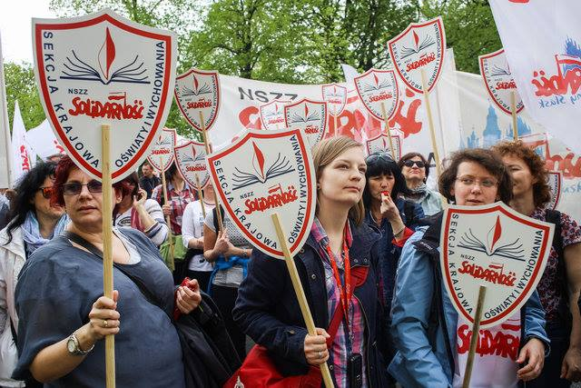
Everyone of us meets with injustice and knows really well that when it touches us, we're feeling bad, but sometimes someone resists it. People fight for their welfare, as well as others, they can do everything to reach justice for everyone, because it should be for all-no matter what kind of person you are.

Slide 5
Intolerance. All demonstrations, marches or even the simplest ignoring of unpleasant and annoying insults due to e.g. skin colour, religion or sexual orientation are good examples of resistance. This is perhaps the most common situation that we encounter and because of which a lot of people suffer.

Slide 6
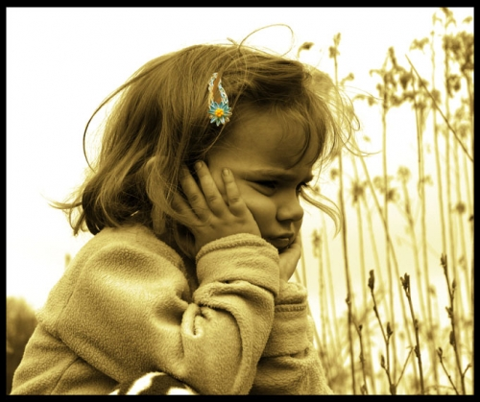
Arguments and quarrels. We're now at the age of "being rebellious". We want to do everything in defiance of parents or school. Sometimes we get nervous about unimportant things e.g. when mother tell us to wear a cap and we resist, because we will look ugly in it or it will spoil our hairstyle, or when we want to come home after nightfall. This or similar situations can lead to a larger argument, and then the resistance is presented by increasing the tone of voice, being rude and vulgar behaviour.

Slide 7
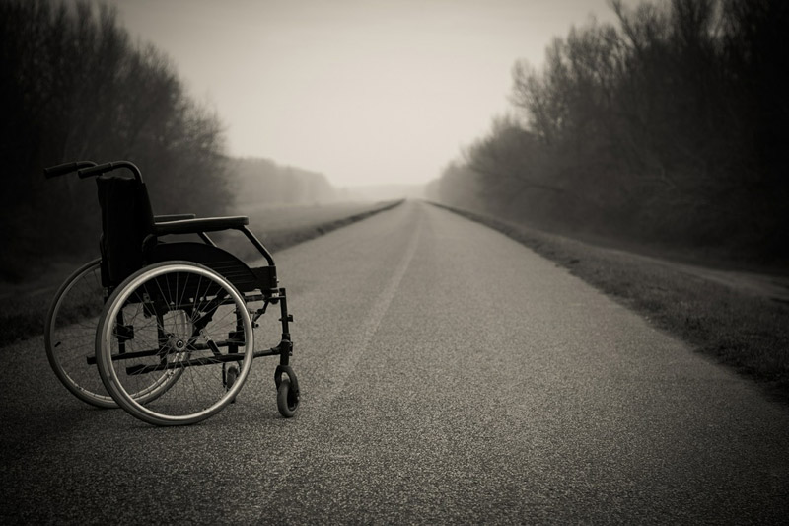
Reluctance to elderly or seriously ill. Some people feel repugnance or even disgust for the elderly, who often aren't at full strength, because of disease, or even sick peers, demonstrating it by teasing and name-calling. Fortunately, there are people who despite the tragedy, resist and they just ignore them and sometimes answer clever riposte, which makes someone think over their bad behaviour and actions.

Slide 8
When something we don't want is going to happen in our life, we resist by doing everything to prevent the situation from occurring, but unfortunately when this situation happens, we resist by ignoring consequences or effects or "pretend" that situation never existed. In really special cases we get very furious, start do be rude or just don’t do we what actually have to do.

Slide 9
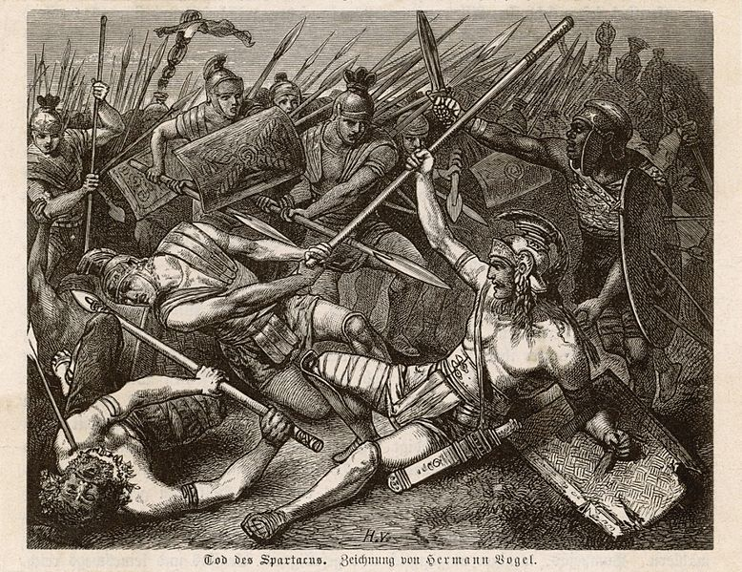
The differences beetwen the resistance in the past and in the present
Resistance in the past
In the past there were different kinds of resistance. One of the examples is the rise of slaves in ancient Rome, which Spartacus began. The cause of the rise was bad treatment of lower social groups by the empire. The Effects of resistance were significant destruction of the country and losses of the owners of the slaves.

Slide 10
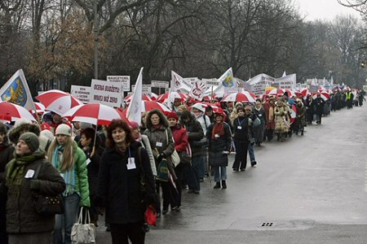
The differences beetwen the resistance in the past and in the present
Resistance in the present
One of the examples of resistance in the present are strikes of miners or teachers. I think that resistance in the past was different from a resistance in the present because they were more aggressive. Now after strikes people don’t die.

Slide 11
Is it worth to resist?
In the recent past, people risked not only their own lives, but the safty of their conscience against the prevailing norm. If these people had not opposed the then-arrangement now they would not have been so appreciated and we would not be an independent country. Today we do not have to risk our lives, but it is hard for us to tell something when we see when someone hurts other people. We are often afraid of rejection and ridicule, but we have to live according to our principes even if sometimes they are diffrent from general beliefs. Sometimes we have to resist for general good!

Slide 12
Authors; Aleksandra Papaj, Katarzyna Bąchor, Aleksandra Bryniarska, Oliwia Pikuła, Daniel Parzych, Maksymilian Zapisek, Piotr Cesarz, Tymoteusz Masarczyk, Igor Pajkert, Konrad Strzelecki
Links: http://www.whether-to-wed.com/appeals-court-strikes-gay-marriage-bans-indiana-wisconsin/
www.interia.pl – www.google.com/pl - www.porady-dla-seniora.pl/rodzina/jak-poradzic-sobie-z-choroba-bliskiej-osoby/ - http://niezalezna.pl/66507-nauczyciele-maja-dosc-obietnic-platformy-tysiace-pracownikow-oswiaty-protestuja-przed-kprm

