Slide 1
Holocaust Lesson
“LESSONS FOR PRESENT, LESSONS FOR FUTURE”
PROJECT ID: 2014-1-ES01-KA201-004981
2014/2017
Lithuania in 1939-1944
Vilniaus Šolomo Aleichemo ORT gimnazija

Slide 2
1. Introduction.The loss of Independance.
Nacis come to power in 1933 in Germany. Due to the secret protocols of the Molotov-Rebentrop pakt (nuoroda i metus ir turini), Lithuania a territory under the Russian power influence. In 1939 10.10 Lithunia is fored to acccept Russian military forces into the country.
On the enforsment of the Soviet Military forces into the country, Lithuania could no longer have an independant international policy.Įsileidus į savo teritoriją SSRS Raudonuosios Armijos karines įgulas, LR jau negalėjo savarankiškai vykdyti savo politikos ir turėjo derinti ją su SSRS.
In 1939.10.28 the Lithuanian Army entered Vilnius and the legislation of the LR came into force. But the USSR pressed the neutral LR and cumulated their Army on the border of Lithuania and Soviet Union. 1940.06.15 the Soviet Army occupied the whole Lithuania, thus violating the erlier sighned non-agression treaty.

Slide 3
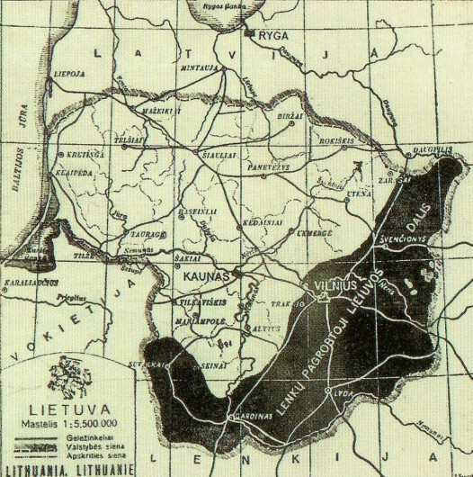
Lithuania 1920-1939

Slide 4
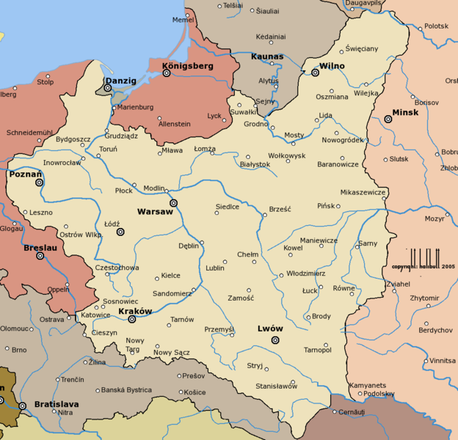
Poland 1920-1939

Slide 5
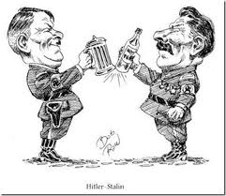
BILATERAL UNDERSTNDING

Slide 6
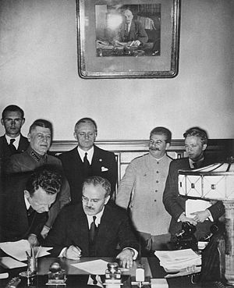
THE PACT OF THE MURDERERS

Slide 7
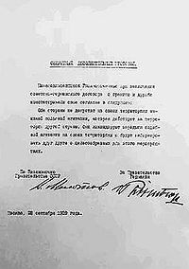
The secret Pact of the Molotov-Ribbentrop

Slide 8
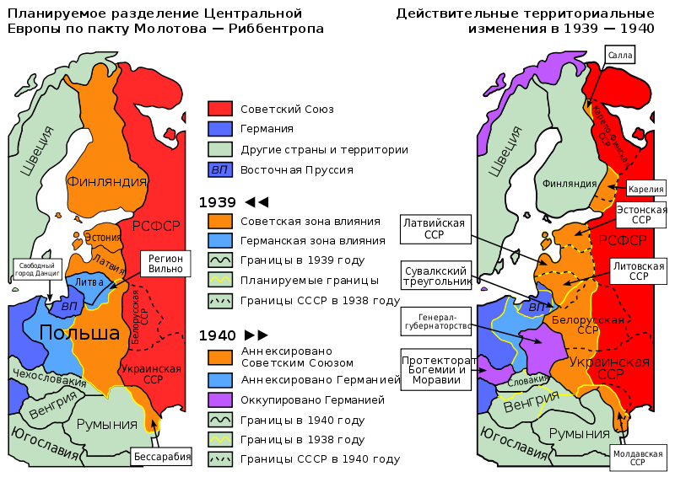
THE Molotpov-Ribbentrop PACT 1939 m.

Slide 9
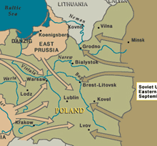
The Ripping of Poland

Slide 10
Pact Molotov-Ribbentrop
www.youtube.com/watch?v=2m2BHAeQGxg

Slide 11
The Treaty of Non-aggression between Germany and The USSR was signed in Moscow in 1939 on the 23rd of August
www.youtube.com/watch?v=L4JbfjItzio

Slide 12
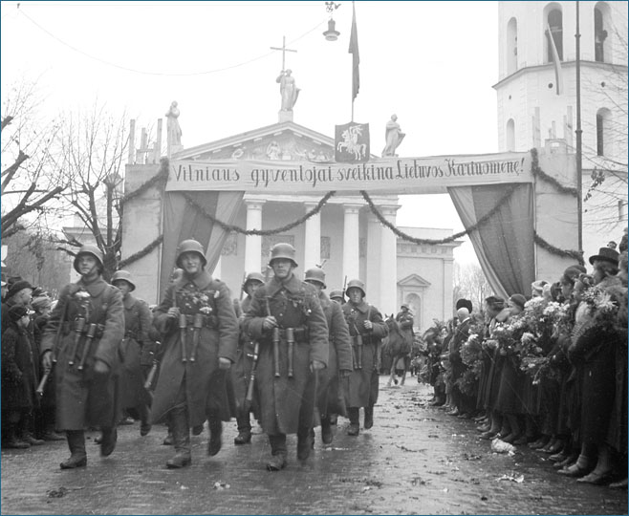
Lithuanian Army in Vilnius, 1939

Slide 13
Recuperation of the Vilnius Region
www.youtube.com/watch?v=leLwzVlVAZo

Slide 14
The Red Flud – the first occuption of Independant Lithuania by soviets.
www.youtube.com/watch?v=u-Q-DFprGBQ

Slide 15
In 1940 06 17 the so called “ National Government” was formed. It led to the rule of the communists. In the “free” elections “ for the new Seimas (Parliament) the Lithuanian labor party candidates “won” and Independent Lithuania became just one of the Soviet Republic
The sudden and humiliating sovietisation of Lithunia took place, the Constitution was abolished, private propery was nationlized, reprssions and exels to Siberian camps started
During this first soviet occupation more then 35 th Lithuanian citizens were killed, imprissoned, exelled mostly the elita of the Independant Lithuania politiciants, intellectuals.

Slide 16
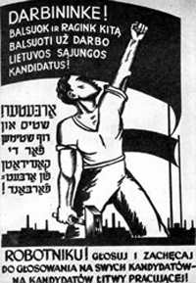
The campaign for the “workers “ government

Slide 17
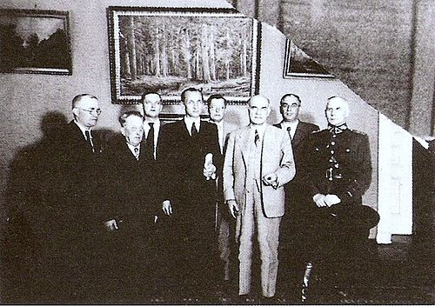
TThe so called “National Government” from the left: Matas Mickis, Vincas Krėvė-Mickevičius, Antanas Venclova, Justas Paleckis, Povilas Pakarskas, Ernestas Galvanauskas, Leonas Koganas, Vincas Vitkauskas

Slide 18
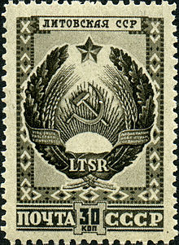
The stamp with the coat of arms of the Lithuanian SSR

Slide 19
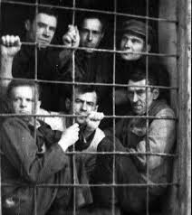
Political prisoners

Slide 20
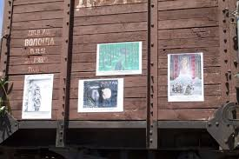
The carriage, in which Lithuanian citizens were deported to Siberia

Slide 21
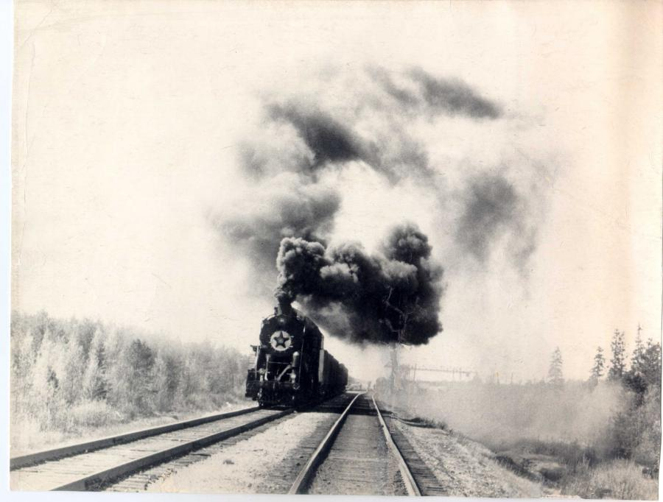
Heading to Siberia

Slide 22
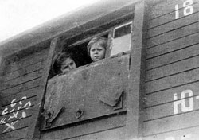
The last glance at the occupied Motherland

Slide 23
The German occupation.
In 1941 06 22 the operation Barbarosa began. It marked the beginning of the most rapiid escalation o fthe war ever seen in the world before.
After the recuperation of the Vilnius region, there were about 200,000 Jews around. Only 10,00 were evacuated to russia at the beginning of the war, the rest remaine din the occupied territory.
Lithuania was occupied practically without any opposition from the Russian army. The German legislation came into force at once.
The German occupation in Lithuania lasted for 3 years. The final solvation of the Jewish problem was in force on the teritory of Lithuania for all this period.

Slide 24
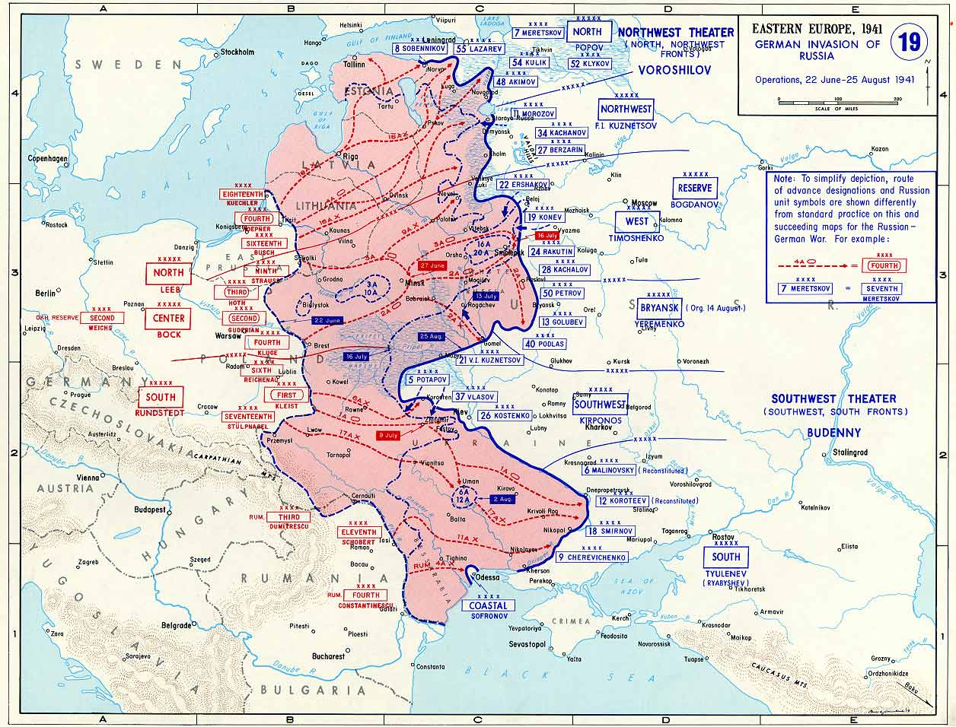
Barbarossa Plan

Slide 25
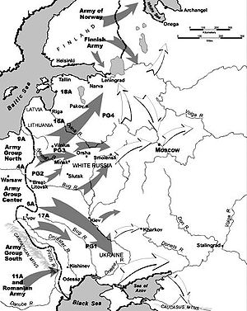
Barbarossa Plan

Slide 26
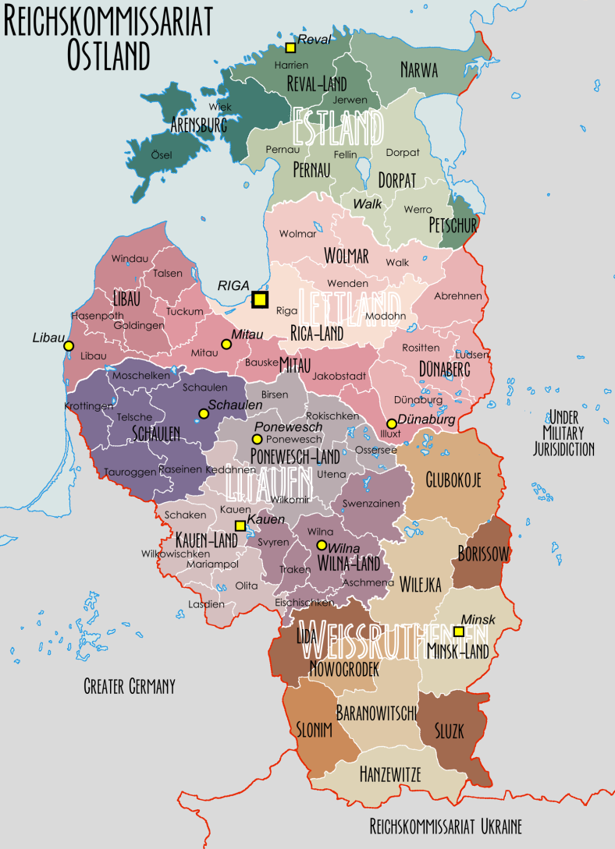
Reichskomisariat Ostland

Slide 27
3. Naci occupation in Lithuania(1941 06.22 -1944 )
Naci occupation was extremely violent and mass murders of the citizens were widely in practise. The human rights were severioly violated.
The mass murders were performed by the special einzac groups developed only for killing people.

Slide 28
THE FATE OF THE JEWS UNDER NACY REGIME
The Jews were very severely persecuted, arested and murdered with the occupation of Lithuania.
The Jews were killed by germans, police and paramilitary local forces, who answered to the calls of Lithuanian Activists (LAF). According to the analyses made by the historitians, the following groups o participants took the active part in mass murders of the Jews:1. criminals 2. local inhabitants who wanted to have revenge on Jews for their participation in the Soviet structures.3. antysemitic people
Though the fate of the Jews was clear under the Naci laws, the participation of Lithuanians in the implementation of these laws played an appreciable part. Despite the fact that there were liberal relations between Jews and Lithuanians in Independant Lithunia and the state antysemitizm was non existant, part of Lithuanians were envolved into the implementation of the Nazi policy and contributed to the destruction of the Jewish population

Slide 29
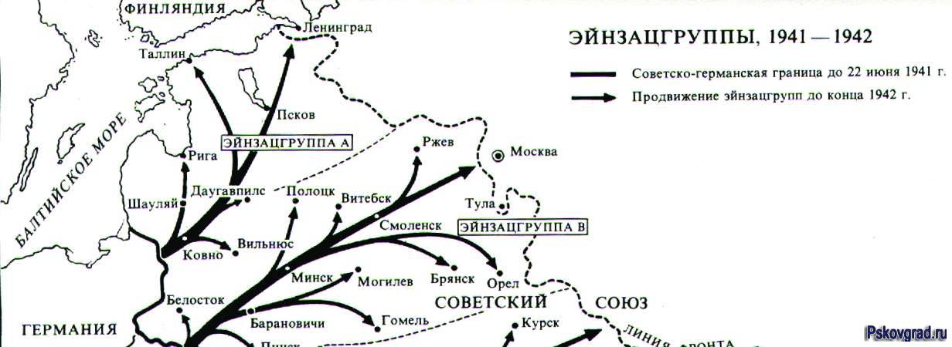

Slide 30
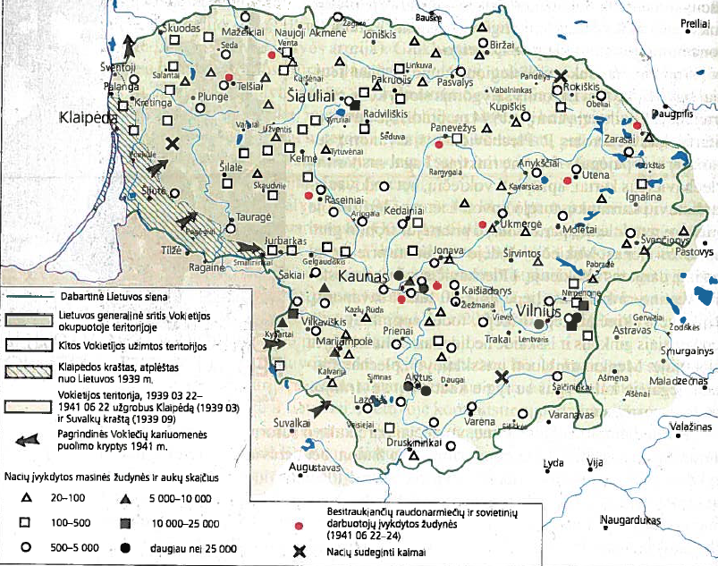
Lithuania uder the occupation

Slide 31
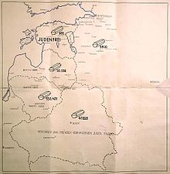
The report of the einsac group A, as of 1942, Jnuary

Slide 32
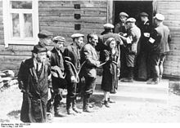
The arrests of the Jews in 1941

Slide 33
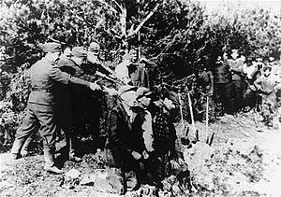
The bullet murder sight

Slide 34
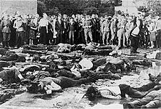
Lietūkis garage, Kaunas

Slide 35
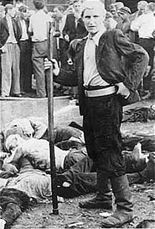
Lietūkis garage, Kaunas

Slide 36
It is considered that Lithuania was the first country in Europe were the mass murders of Jews started.
The mass murders were performed in 3 stages:
1. mass murders of Jews in Lithunia 1941 June- November
2. The executions in Gethos. 1941 July-1943 March
3. Mass murders in the other parts of Lithuania and deportation to the concentration camps. 1943 m. April-1944 m. July

Slide 37
www.youtube.com/watch?v=AhZgBcHX9rI
Lithuania uder the nazy occupation 1941-1944

Slide 38
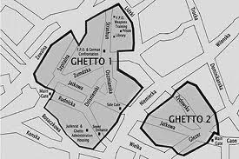
(1941 09 06 – 1943 09 23) The plan of the Vilnius Ghettoes

Slide 39
www.youtube.com/watch?v=lxQm924L19U
The secret of the Vilnius Ghetto

Slide 40
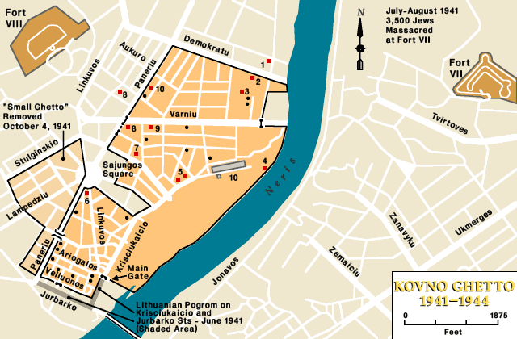
(1941 07 10 – 1944 07 12) The plan of Kaunas Ghetto

Slide 41
4.(1941-1944)
The resistence movement in Lithuania
Under the extremely rough oppression of the naci regime, the resistence organizations started their activities in 1941-44. They were opperated seperately and by national, party, governmental and other principals.
The Lithuanian national resistence organizations started their activities for the Independant Lithuania in 1941, as soon as nacis occupied Lithuania.
.
The Polish Army Krajova also operated in Lithuanian teritoryfrom 1942. Their aim was to rebuil the Polan din the prewar borders. (with vilnius and Vilnius region). This Army participated in both: the activities for the Soviets and against them.
The Soviet partizans reprezented the USSR on the occupied teritory. Russians, Lithuanias, Jews and others served there.
The Jews, who were condemed for extermination took part in the battle against nacis in various forms: a) spiritual resistence in Gettos,b0 armed resistence in Gettoes, c)armed resistence with the partizans, d) in the Soviet army.
The most active resistence of the Jews took place in Vilnius and Kaunas Gettoes

Slide 42

Lenkijos kariuomenės Armija Krajowa dalinys

Slide 43
a) Spiritual resistence in gettoes.
The resistance of the kind a as bringing food and medicine to Getto in order to survive could be qualified as resistence ander the very rough oppression of the Naciz.
Schools, theatres, lectoriums were in place in Gettoes. The orchestras performed concerts, docters were in constant battle for the health of the gettoe inhabitants.
The highets level of the spiritual resistence was just to stay human, to maintain self respect and survive.

Slide 44
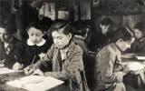
The SPIRITUAL RESISTENCE IN GETTO.
Kaunas secondary school.

Slide 45
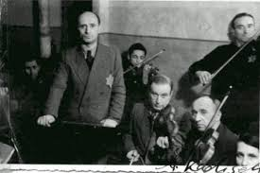
The SPIRITUAL RESISTENCE IN GETTO. Kaunas getto orchestra.

Slide 46
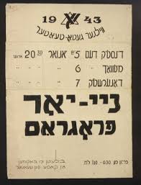
New Year poster of Vilnius Gretto Theatre.

Slide 47
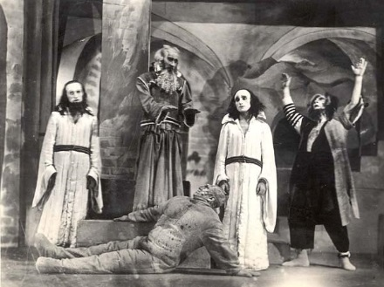
Vilnius Ghetto Theatre

Slide 48
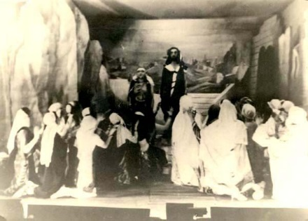
Vilnius Ghetto Theatre

Slide 49
b) The armed resistence in getto.
The methods of the resistence were mainly like this: to organize rebellions and sabotage in Gettos, or to organize fles from Gettoes to the woos and fight with the partizans
The anti-nazi organization AKO (1942-44) was created in Kaunas Getto for the armed resistence. The leader was Chaimas jelinas.The AKO members performed various actions, such as burning the naci ammunition warehouse,railway accidents, bombing and other sabotage actions.
After the Childrens Act in 1944.03.25, part of the partizans from the getto resistence movement managed to escape and continued their vattle in belorus on the lake Naroc.
The Joint Partizan Organization (FPO 1942-43) under the leadership of Icchackas Vitenbergas , Aba Kovneris, Jechielis Seinboimas was established in Vilnius Getto for the armed resistence against naciz. The survivers of such organizations as sionists, Bund, Komunist party, jouth organizations joined the organization. The aim of the organization was to manage the armed resistance against nacis. But they did not eventualy decide, where to perform the armed actions: in getto or outside Getto.
They performed sabotage, smuggled amunition and parts of the amunition from the german warehouses to Getto and assembled guns. The so called „Seinboim baricade“ battle took place in 1943.09.01. The leader himself was killed as well as many innocent people from the Getto.
The partizans evacuated from getto to the Rudidninkai and Naroc frorests from June, 1943. The last evacuation of the partizans took place during the lividation og Getto in 1943.09.23

Slide 50
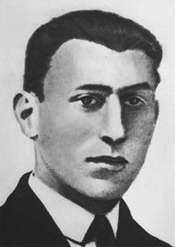
Icchakas Vitenbergas (1907 – 1943)

Slide 51

Aba Kovneris (1918-1987)

Slide 52
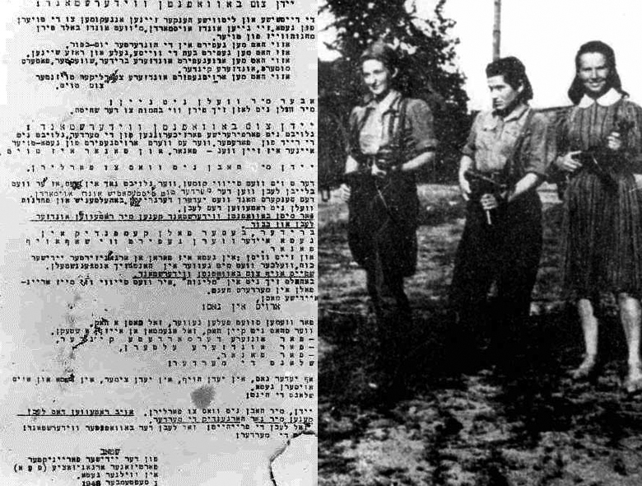
The EPO manifest „Jews, join the armed resistence“

Slide 53
C)THE ARMER RESISTNCE, FIGHTING WITH THE PARTIZANS
The Jews who fled from the Gettos, aimed to joint the antynaci movements. They could do it also enetring the partizn brigades, acting in Belorus and Lithuania.
It is considered, that among the soviet unrgground fighters there were 62% Lithuanians, 21% Russians and 17% Jews. Jews were nearly in every partian brigade. There were 4 Jews’ partizan brigades:Keršytojas, Už pergalę, Mirtis fašizmui, Kova. In 1944 the Jews’ partzan brigdes were converted into a mixed ones.
Inspite of a very vivid antysemitic happeneings, spcially in Belorus partizan brigades, the input of Jews into a partizan movement as not too small: about 31 echelons was turned over, 25 stem engines were demoloshd, 150 carriges, 5 automobilesw ere distroyed. !3 bridges were dimolished.700 tlephone poles were cut downas well as the wires, the soldiers of the nazy army killed.
The Jewish partisans together with the Soviet Army took part in the liberation of Vilnius and other cities.

Slide 54
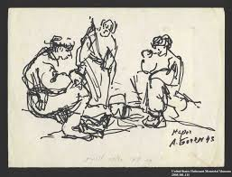
A.Boge,. Series: “Jewish partizans”

Slide 55
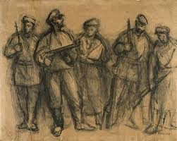
A.Boge,. Series: “Jewish partizans”

Slide 56
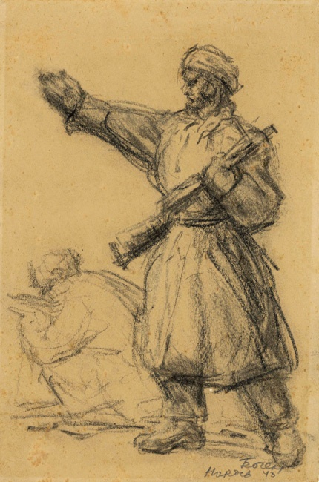
A.Boge,. Series: “Jewish partizans”

Slide 57

A.Boge,. Series: “Jewish partizans”

Slide 58
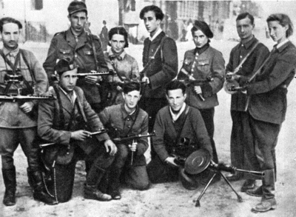
JEWISH PARTIZANS I VILNIUS 1994

Slide 59
d) Fighting in the soviet army
The Lithuanian Jews mostly served in the 16th Divizion
In 1941.12.18 The USSR Defence Comitee dcided to fom the 16th Division as a Lithuaanian one.
The divission was formed mostly from the refugees, who fled from Lithuania. The Lithuanian solders, who earlier served inthe other units of the Soviet Army, were also included.
The divission consisted of 36,3% of Lithuanians, 29% russians, 29% Jews, 4,8% other nationalities. From 10 250 oldirs of the divission, 7000 were Lithuanians or other Lithuanian citizens.
It was the most jewsih military unit of the Red Army. The division took part in the Kurst battle, took pat in the liberation of of Belorus and Lithuania from nacis. 12 soldiers were awarded the names of the Heroes of the Soviet union, 4 Jes include: Vulfas Vilenskis, Kalmanas Šuras, Grigorijus Užpolis, Borisas Cindelis (post mortem). Th divission was disembodied in 1956.

Slide 60
CONCLUSIONS
The Jewish nation suffered from a most violent terririzmand the earlier unseen mass murder.
Inspite of the horrible repressions, the Jews managed to organize resistence, display ideas, heroizm and courage. They deended the nations honour.
Jews who were condemed to death, but survived, brought the word of the partizan anthem to life”The hour, we dreamed of will come, and our steps will reverberate: we are here!”

