Slide 1
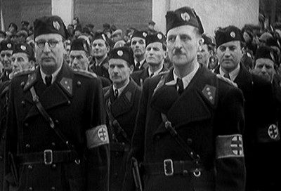
The Hlinka Guard

Slide 2
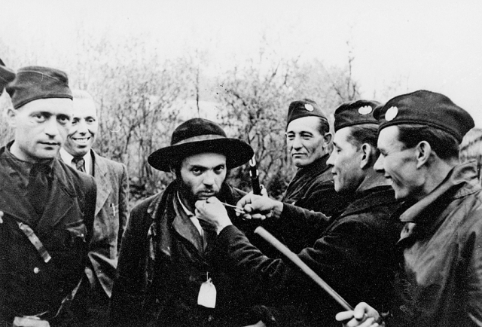
Hlinka Guard was a paramilitary unit established by the Hlinka Slovak People's Party as a supportive body for state authorities. It was formed in the summer of 1938, legalized and armed in October 1938.
After the establishment of the Slovak State (March 14th 1939), it actively participated in the persecution of Czechs, Gypsies, Jews and democratically minded Slovaks, later on deportations of Jews.

Slide 3
It was intended to carry out pre-military and paramilitary training of boys and men aged 6 to 60.
Eventually, it took over and practically implement many tasks of the police force. It operated as a political police in cooperation with state security headquarters.
It had special units - Cavalry, Aviation, Motorized unit, Signals, Rail unit, Academic unit of the HG).

Slide 4
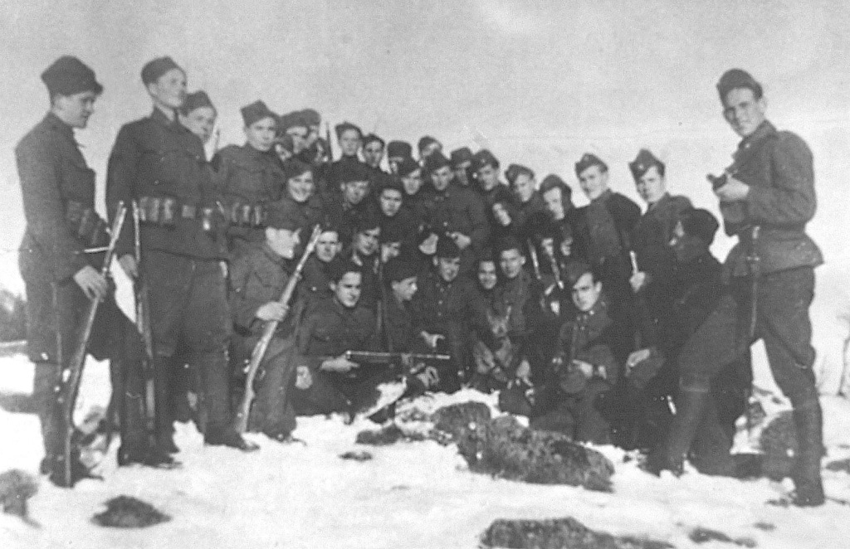
Any form of disagreement with the regime was brutally repressed. During the uprising, special Strike and Emergency Troops directly participated in punitive expeditions and actions against rebels and civilians.
Alongside these troops, Field Companies were formed and sent to the front.

Slide 5
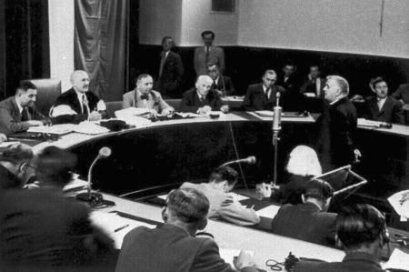
After the war, the Hlinka Guard was banned and its members tried for war crimes. Many have received death sentences for involvement in the murders of civilians and rebels.

Slide 6
Sources:
Documents:
http://www.upn.gov.sk/publikacie_web/hlinkova-garda.pdf
http://style.hnonline.sk/vikend/292094-ano-som-gardista-dobry-krestan
Pictures:
https://sk.wikipedia.org/wiki/Hlinkova_garda
http://forum.valka.cz/topic/view/63849/HLINKOVA-GARDA-II-
http://domov.sme.sk/c/8039198/najvacsie-vojnove-zlociny-poslali-ich-na-pracu-umierali-po-tisicoch.html
https://www.postoj.sk/1978/rozhovor-slovensky-stat-a-jeho-gardisti

