Slide 1
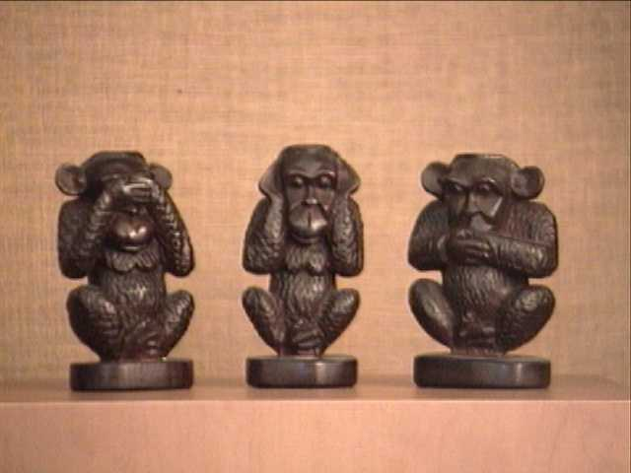
indiFference
Artists vs. totalitarianism

Slide 2
Responsibility of Intelligentsia
?
resistance
collaboration
indifference

Slide 3
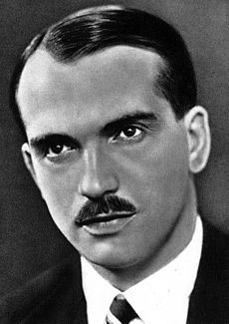
EMIL BOLESLAV LUKÁČ 1900 -1979
1938-39 MP of Czechoslovak parliament
*1939 –45 parliamentarian of Slovak Assembly
*1947- 1950 worked for the government (the department of education and culture)
a poet, interpreter,
a protagonist of literary genre - neosymbolism
a teacher of Slovak literature
the founder of the Association of Slovak Writers
published literary magazines (Tvorba 1940 – 1944)
„ ... don't ask of a poet to be someone's mouthpiece ...“

Slide 4
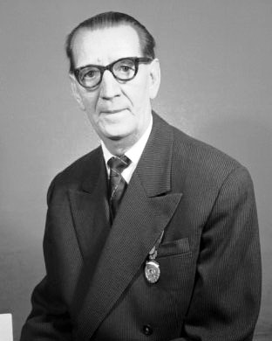
JANKO BORODÁČ
1892 -1964
* the founder of Slovak modern theatre
the very first Slovak graduated actor
later became an outstanding theatre director
introduced Slovak classic drama to the stage
established the first cast of Slovak National Theatre
He was awarded for the development of Slovak theatre during the existence of the Slovak State as well as by the communist regime of Czechoslovakia (several times)
He wasn't able to stop the exodus of Jewish actors, who were being persecuted for their Jewish ancestry.

Slide 5
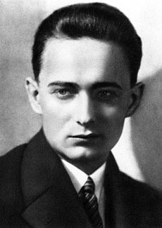
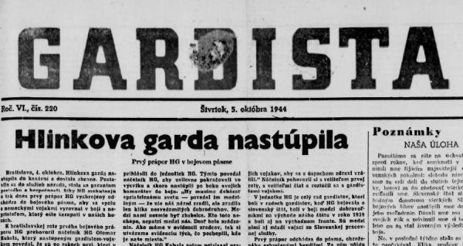
Milo Urban 1904 – 1982
a writer and journalist
*a chief editor of the pro-government magazine ‘Gardista’
* after war sentenced to public reprimand

Slide 6
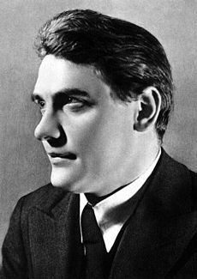
Laco Novomeský
A poet, a protagonist of Slovak avantgard
member of Communist party
helped to organise the Slovak National Uprising
in the 1950s sentenced in political trial

Slide 7
Štefan Bednár
1909 -1976
a painter and a graphic designer
took part in anti-fascist resistance
forged Identification cards for the persecuted

Slide 8
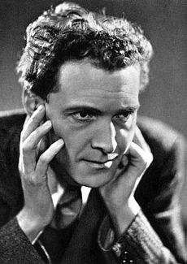
Ľudo Ondrejov
1901 -1962
an outstanding Slovak writer,
Aryanized - a used bookstore from the Steiner family who afterwards died in a concentration camp, (this was held secret by the communist regime until very recently)
*1944- 1945 a member of communist partisan group
after the WW2 worked for government

Slide 9
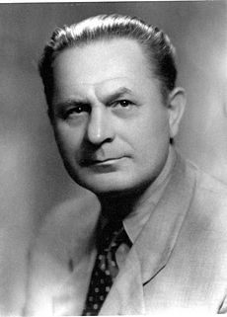
Alexander Moyzes
1906 – 1984
* He was a Slovak composer, teacher and organizer of musical life.
* Professor at the Academy of Music and Drama
* 1937 - 1948 Head of the music department of Radio Bratislava
* 1949 - 1978 Professor of composition at the Academy of Performing Arts, Rector for 6 years
* 1969 - 1970 President of the Association of Slovak Composers

Slide 10
Moyzes 1944
"I was deciding whether to join the Uprising or not and I remember that it was Fero Bokes who talked me out of it. He thought it was a bit strange. So I was already on the train, but went off in Trnava and I came back home. I thought to myself, lets wait and see how it turns out. And later it was impossible to join. "
Moyzes 1968
Strongly protested against the occupation of Czechoslovakia by the Soviet Army in 1968, he was therefore dismissed from the position of President of the Association of Slovak Composers
Printed scores of his 8th Symphony with words of protest were scrapped.

Slide 11
Sources
BALOGH, Alexander: Dve tváre kultúry a umenia slovenského štátu. Denník Sme 13. 4. 2014
ĎURKOVSKÁ, Mária: Kultúra ako jedna z dimenzií spoločenského života v Slovenskej republike v rokoch 1939 – 1945. In: Život v Slovenskej republike Slovenská republika 1939 – 1945 očami mladých historikov IX . Bratislava: Ústav pamäti národa, 2010, s. 245 -259. ISBN 978-80-89335-37-4
KAMENEC, Ivan: Slovenský štát v obrazoch. Praha: Ottovo nakladatelství, 2008, 248 s . ISBN 978-80-7360-700-5
Pictures
Slide 3: https://sk.wikipedia.org/wiki/Emil_Boleslav_Luk%C3%A1%C4%8D
Slide 4: https://sk.wikipedia.org/wiki/Janko_Borod%C3%A1%C4%8D
Slide 5: https://sk.wikipedia.org/wiki/Milo_Urban
Slide 6: https://sk.wikipedia.org/wiki/Laco_Novomesk%C3%BD
Slide 7: https://sk.wikipedia.org/wiki/%C5%A0tefan_Bedn%C3%A1r
Slide 8: https://sk.wikipedia.org/wiki/%C4%BDudo_Ondrejov
Slide 9:https://sk.wikipedia.org/wiki/Alexander_Moyzes
Slide 10: http://kultura.sme.sk/c/5115656/skladatel-co-si-vzdy-robil-a-hovoril-svoje.html#ixzz4Dr6dsPqK

