Slide 1
BIOGRAPHY OF
Julio María López Orozco

Slide 2
He was born in Elche in 1885, son of the liberal and freemason lawyer Julio María López Martínez and of the teacher Herminia Orozco Chacón.
Glorieta and Santa María Basilica

Slide 3
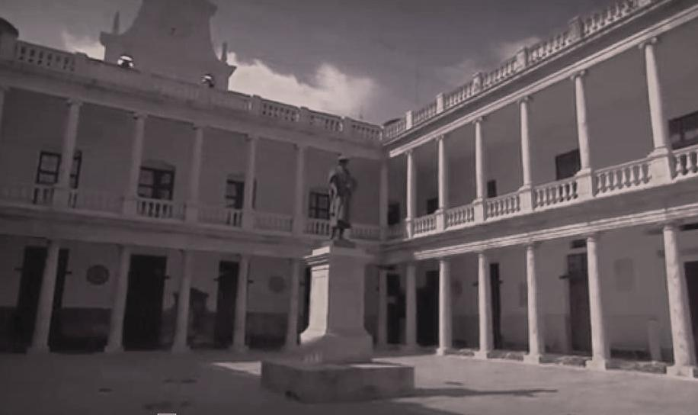
He finishes his studies of Medicine in the University of Valencia in 1908.
Atrium of the University of Valencia

Slide 4
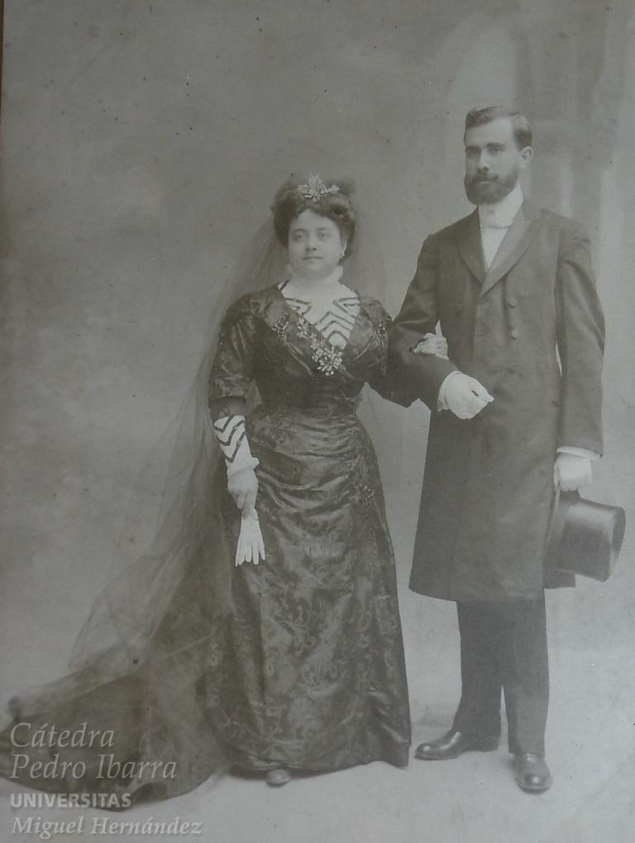
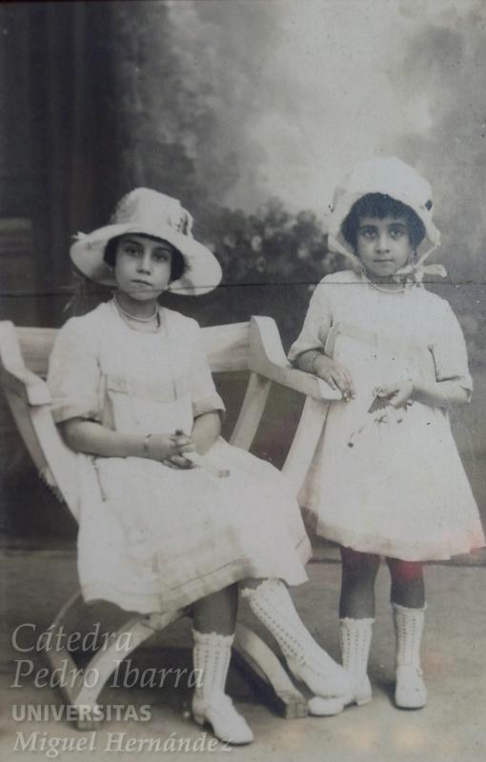
From 1909 to 1913
He marries Esperanza Álvarez and their daughters Herminia and Pilar are born.
He works as a town’s doctor at Orxeta (Alicante).

Slide 5
In 1913, he moves to his hometown and starts a medical office.
In 1914, his wife dies and he is appointed as the doctor of two districts in Elche.
“Mr Julio María López Orozco’s Medical-surgical clinic.
1, Canalejas (Corredera) Street.
Medicine and General surgery.
From 10 to 12 am.
Free for the poor on Wednesdays.
Home visits.
Retainers accepted”.

Slide 6
From 1917 he starts his political activity:
He becomes a member of the Antigermanophile League (1917).
In 1920, he joins the lodge “Constante Alona n. 8” in Alicante.

Slide 7
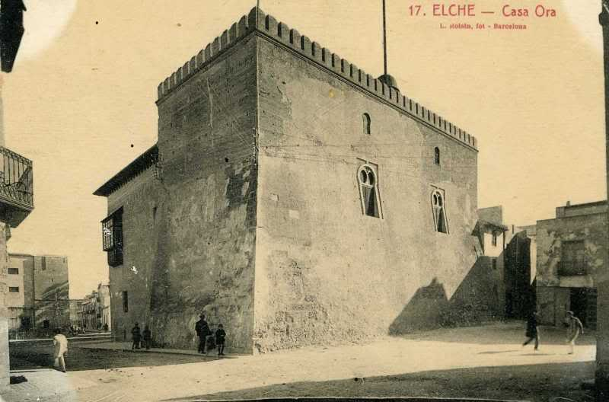
In 1924, he is named Grand Master of the lodge “Illice Constante n. 7” in Elche.

Slide 8
In 1928, he is named as the president of the Republican Alliance of Elche. He goes to Gijón as the representative of the Levant Regional Lodge.
In 1930, due to the Jaca events, he is sent to prison together with other republicans and socialists from Elche.
Notes:
La imagen es del Frente Popular y Sucesos de Jaca

Slide 9
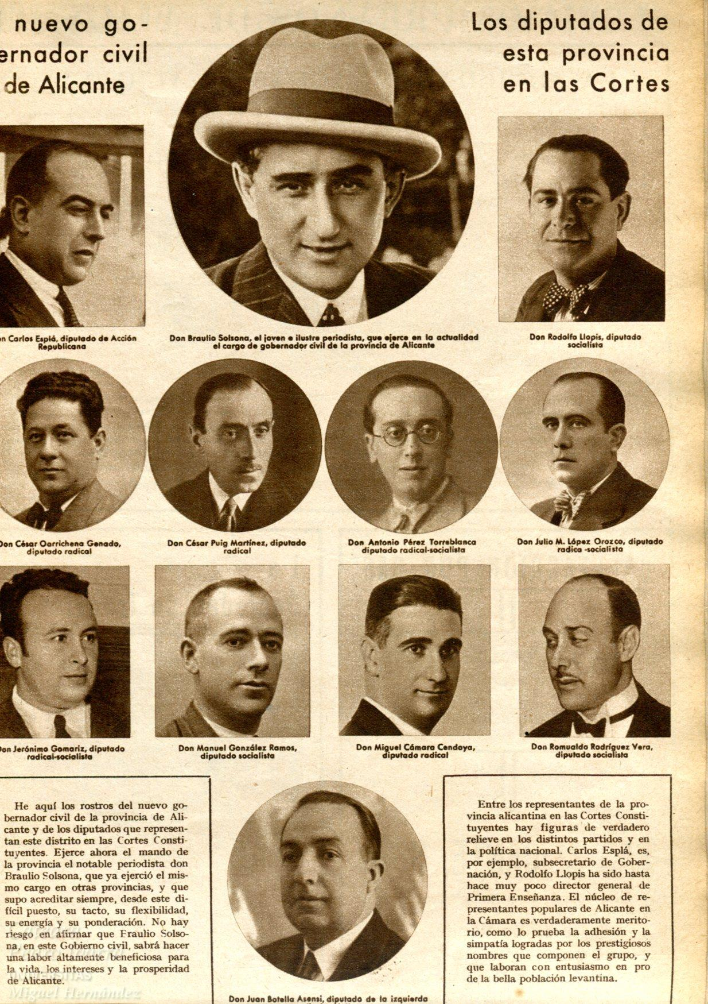
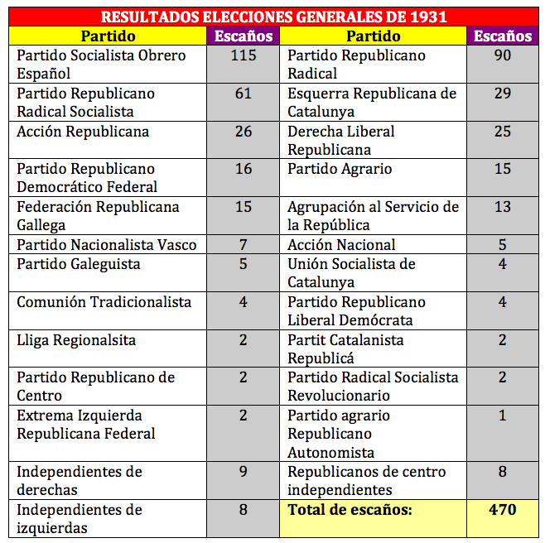
In 1931, he is elected Member of the Lower House of the Parliament.
Manuel Azaña voting in the elections of 1931.
Congreso de los Diputados. Lower House of the Parliament.

Slide 10
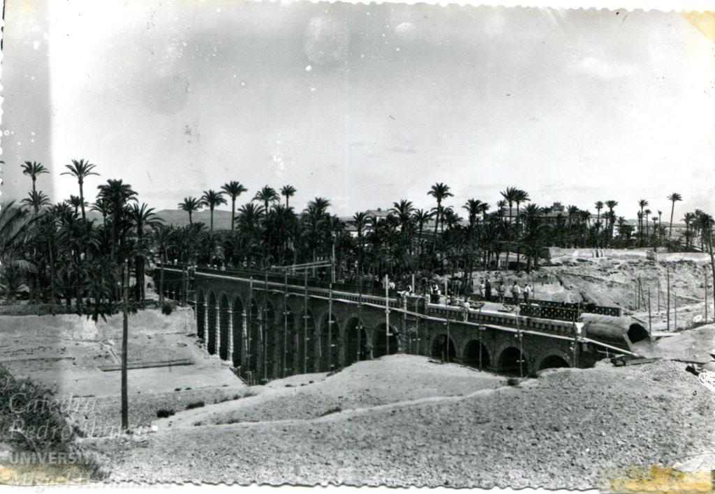
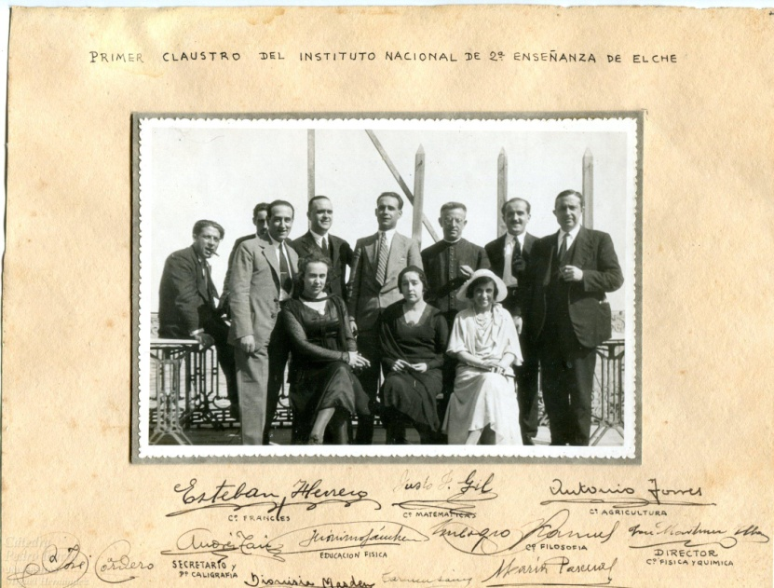
In 1932, he opens the first National Secondary School in Elche.
He is appointed chair of the Water Authority of Segura river.
Kursaal Theatre. Opening of the first National Secondary School in Elche.
Hidrological works in Elche.
Gómez House. First National Secondary School.
First faculty members of the National Secondary School of Elche.

Slide 11
In 1933, he settles as a doctor in Madrid and he is named the vice president of the national board of the Radical Socialist Republican Party.
Symbol of the Radical Socialist Republican Party.
Puerta del Sol (Madrid).

Slide 12
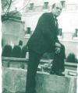
In 1936, he settles down in Elche again.
He joins the Republican Union (Unión Republicana).
He is appointed as the chair for the Local Committee of Refugees.

Slide 13
Period 1936-1939
He is the director of the blood hospitals, set up by the International Red Aid (Socorro Rojo Internacional).
Also the chair of the Committee for the Passive Defense against Aircrafts.

Slide 14
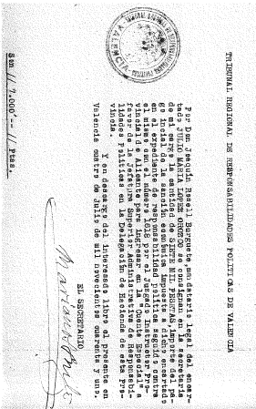
After the Civil War
He is tried by the Law of Political Responsibilities.
He is arrested, imprisoned in Alicante and his property confiscated.
He is acquitted and fined with 35.000 pesetas in limited installments.
Adults reformatory in Alicante.
Partial payment of the fine.

Slide 15
He remarries Asunción Manchón Navarro.
He is tried again by the Law of Repression of Freemasonry and Communism.
Mr Julio and his second wife Asunción.

Slide 16
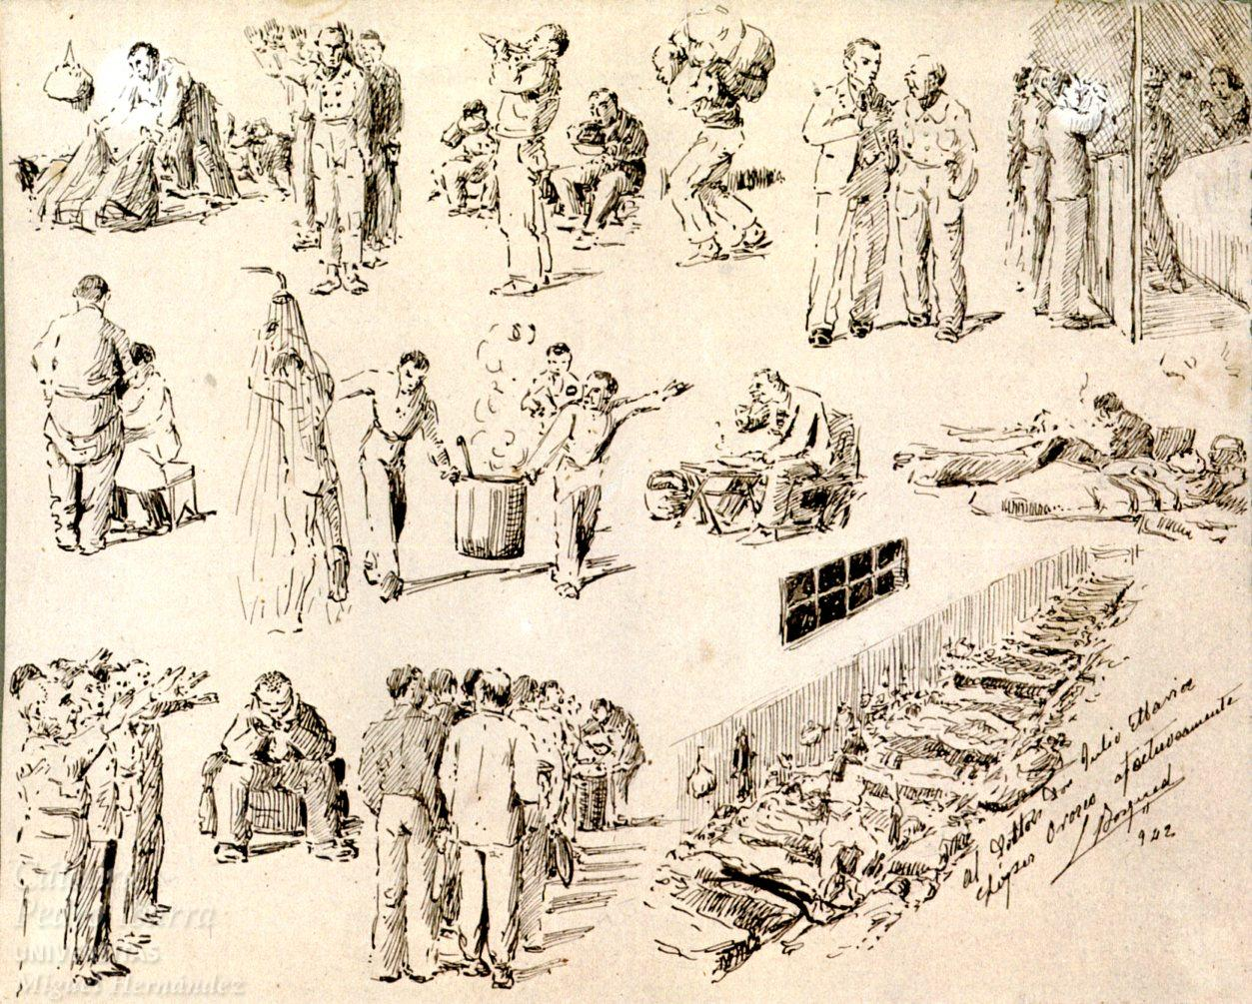
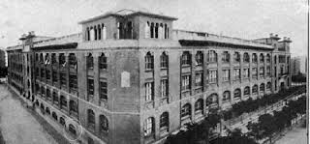
He is sentenced to 25 years in prison and sent to Porlier Prison in Madrid.
Picture given to Mr Julio by a friend inmate.
His wife manages to get a reduction of sentence to 12 years. He is transferred to Burgos Prison in 1943.
Porlier Prison.

Slide 17
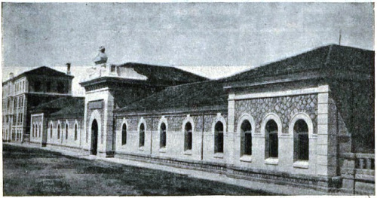
“Un patio donde gira
mi corazón, clavado;
mi corazón, desnudo;
mi corazón, clavado;
mi corazón que tiene
la forma gris de un patio.
un patio donde giran
los hombres sin descanso.”
Marcos Ana
Burgos Prison
Transcription of the last paragraph of a poem by “Marcos Ana”, an inmate in Burgos Prison. The poem is dedicated to María Teresa León:

Slide 18
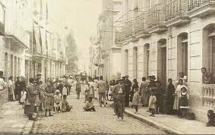
In 1945, he comes back to Elche on parole due to health reasons.
In 1946, he requests a permission to perform his medical career. However, he is purged by the Regime not to hold a public post in his job.

Slide 19
His wife requests a petition for a pardon and that same year he is eventually allowed to practice Medicine inside the municipality of Elche.
He uses a sprung cart for the home visits.

Slide 20
Francoist Regime sentences him to a kind of internal exile inside his very own hometown.
He becomes an invisible citizen for Elche’s inhabitants.

Slide 21
He dies on April 7th, 1970.
Announcement on Mr. Julio´s decease

Slide 22
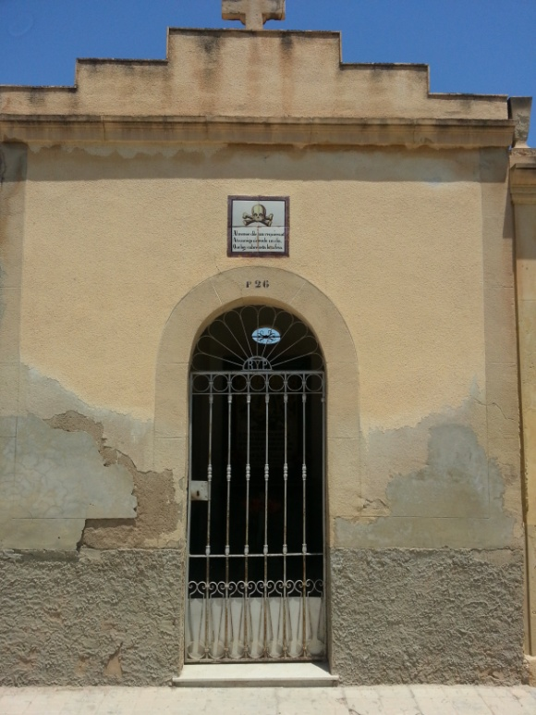
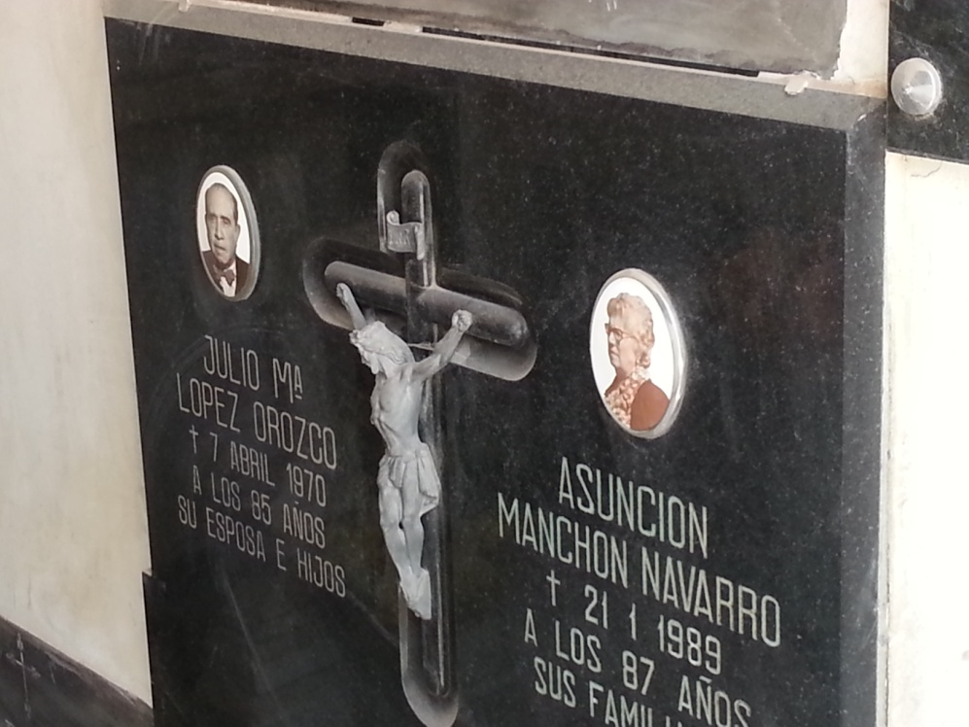
His burial becomes a mass tribute to a republican and an excellent doctor, known in Elche as Mr Julio, doctor of the poor.
Tombstone of Mr Julio María López Orozco and his wife Asunción Manchón Navarro.
Front of family mausoleum.

Slide 24
ACCOMPLISHED BY:
ANA MARÍA IBÁÑEZ LOPERA
ACKNOWLEDGEMENTS:
MIGUEL ORS MONTENEGRO
For the documentation granted, which made possible the elaboration of this didactic unit.
©

